Slide 1
POISONING IN THE AMU
Management and Therapeutic Considerations
Dr. Christopher Brown
Consultant Physician in Acute Medicine/Diabetes

Slide 2
Disclaimer*
Please note that QUACK is a regional teaching programme operating across GG&C, Lanarkshire and Ayrshire & Arran.
This presentation outlines general management, though local variances e.g. antibiotic prescription may vary slightly depending on your local trust
Remember to check your local guidelines

Slide 3
Acute Poisoning
Common
  5% ED attendances
  3% AMU attendances
2000 Deaths per year in UK
Some of the highest rates of deliberate poisoning in Europe
Often multiple drugs
Alcohol commonly an associated factor
You will see this very frequently in AMU/GP admissions

Slide 4
Objectives
General principles in the management of any poisoning you see in acute setting
Specific management options with certain substances commonly taken
  Paracetamol
  Opiates (Heroin, Methadone, Morphine derivatives)
  Salicylates (Aspirin)
  Tricyclic Antidepressants (Amitriptyline)

Slide 5
General Management -History
Applies to ANY episode of poisoning
  WHAT
  HOW MUCH (Ideally mg/Kg)
  WHEN
  WHAT ELSE (Including Alcohol)
  WHY
  Collateral History
    Use Paramedics, friends, relatives…

Slide 6
General Management – Initial Assessment
A (Airway)
B (Breathing)
C (Circulation)
D (Disability-AVPU/ Glasgow Coma Scale)
DEFG ( Don’t ever forget the Glucose)
Baseline Observations

Slide 7
General Management - Clinical Assessment
Use all your senses, search for the clues
LOOK
  Track Marks
  Pupil Size
FEEL
  Temperature, Sweating
SMELL
  Alcohol
  General Examination
  Primary/Secondary Survey
  CVS/Neurological review

Slide 8
General Management - Investigations
ECG – cardiac monitoring
Bloods – UEs, BIC, CK, MG 2+, CA 2+
Specific drug levels – Paracetamol/Salicylate
Serum/Urinary samples for toxicology
Catheter/CXR etc.
Psychiatry input?
TOXBASE
  NPS advisor
  ICU if unwell

Slide 9
Specific Management Options - 1
Decreasing absorption of the harmful agent
  Gastric Lavage
    Unpopular - need to protect the airway, may push drug through pylorus into small bowel.
    Practically difficult to do outside ED
  Absorbents
    Activated Charcoal , usually within 1 hour of ingestion
    Longer repeated doses in drugs that delay gastric emptying e.g. Aspirin

Slide 10
Specific Management Options - 2
Increasing elimination of the harmful agent
  Alkaline Diuresis (Aspirin)
  Haemodialysis (Aspirin)

Slide 11
Specific Management Options - 3
Antagonising the direct effects of the harmful agent
  Desferrioxamine (IRON)
  Naloxone (OPIATES)
  N-Acetylcysteine (PARACETAMOL)

Slide 12
Specific Poisons - Paracetamol
Commonest drug used
50% of all Self Poisoning Episodes
100- 200 deaths per year in UK
Dangerous
Commonly available OTC
Patients are initially “well”
High index of suspicion

Slide 13
Paracetamol - Normal Metabolism
Paracetamol converted to:
  N-Acetyl-p-benzoquinonamine (TOXIC)
  This is conjugated with Glutathione
  Glutathione stored in the body
  Produces a NON TOXIC metabolite

Slide 14
Paracetamol Metabolism in Overdose
Glutathione stores are used up by the excess Paracetamol
Toxic Metabolite build up
Binds irreversibly to hepatic cell membranes
Resulting in liver necrosis

Slide 15
Paracetamol Overdose -Management
Initial ABC ( usually well systemically)
Get a good history
  TIME TAKEN, AMOUNT
  Any other medication
  History of liver disease/risk factors
N-Acetylcysteine mainstay of treatment
Shown to be advantageous if given in the first 10 hours

Slide 16
N - Acetylcysteine
Specific antidote used for Paracetamol
Provides the Sulphydryl groups needed to increase the availability of Glutathione
So that Body can turn the toxic metabolite into the non toxic form and prevent liver cell necrosis
Problem: Not shown to be effective after 15 hours…

Slide 17
Paracetamol Management
Able to measure levels of Paracetamol in the blood.
Helps to guide whether amount taken is enough to be hepatotoxic
IF IN DOUBT start treatment before the Paracetamol levels get back to save time

Slide 18
Paracetamol Management - Pitfalls
Patients with Liver Disease/ Alcohol misuser
  Chronically depleted stores of Glutathione will allow toxic build up of metabolites sooner than healthy people
Staggered Overdoses
  Levels unreliable
After 15 hours- what do you do??

Slide 19
Paracetamol Management
Err on side of caution
Late presentation >15hrs – treat and monitor for impending liver failure
Early referral to specialist unit
High mortality compared with cirrhosis/ decompensated liver disease
Psychiatry input essential

Slide 20
Opiate Poisoning - Features
Common (particularly in GRI)
Heroin, Methadone, Analgesics in Elderly
Action on the Mu-opiate receptor giving the effects in overdose.
  Pinpoint and sluggishly reactive pupils
  Respiratory depression
  Coma
  High mortality of untreated due to respiratory arrest

Slide 21
Opiate Overdose -Management
INITIAL MANAGEMENT
A
B
C
D
E

Slide 22
Opiate Overdose -Management 2
NALOXONE
  Opioid antagonist
  High affinity for the Mu-opiate receptors
  Little other effects systemically - safe
  Rapid onset (<1 min)
  Effects last 2-4 hrs, may need repeated doses
  Give I-M or I-V
  Low threshold to give in “unresponsive patient”

Slide 23
Salicylate (Aspirin) Poisoning
Toxicity occurs due to disturbance in Acid-Base balance
  Respiratory Alkalosis
  Metabolic Acidosis

Slide 24
Aspirin Poisoning - Mechanism 1
Direct stimulation of the respiratory centre makes you over breathe.
  Hyperventilation and espiratory alkalosis
Kidney attempts to compensate for the alkalosis by excreting alkali to give you a metabolic acidosis
Aspirin inhibits the normal metabolic pathways

Slide 25
Aspirin Poisoning - Mechanism 2
Aspirin inhibits the normal metabolic pathways, so you get failure of the normal metabolism of CHO, fats and protein.
  Build up of organic acids
    Ketones
    Lactate
    Pyruvate
  Causes a worsening and intractable metabolic insult
Metabolic acidosis = bad news for usual metabolic processes
  Cardiac decompensation
  Hepatic/renal failure
  Coma

Slide 26
Aspirin Poisoning -
Clinical Features
Common
  Vomiting, Dehydration, Tinnitus, Vertigo
  Sweating, Bounding pulses, Hyperventilation
Uncommon
  Confusion, Disorientation, Coma, Convulsions
  Haematemesis, Hyperpyrexia, clotting abnormalities, renal failure
  Related to serum concentration/metabolic acidosis

Slide 27
Aspirin Overdose -Management
Initial Supportive therapy.
  If small amounts and asymptomatic may need no treatment
Management tailored according to the amount taken
Able to take Salicylate levels to help guide treatment options

Slide 28
Aspirin Management - General
A
B
C
D
(EFG)

Slide 29
Aspirin Management - Specific
When extremely high levels of Aspirin have been ingested and the patients are symptomatic steps may be taken to:
  DECREASE Absorption
  INCREASE Drug elimination

Slide 30
Aspirin - Decreasing Absorption
Activated Charcoal
  Given in those who have taken more than 250mg/Kg body weight less than 1 hour ago
Gastric Lavage
  May be considered in those who have taken more than 500mg/kg body less than 1 hour ago. Steps must be taken to protect the airway (involve ICU)

Slide 31
Aspirin - Increasing Drug Elimination
Haemodialysis is a definitive management
  Used in severe life threatening overdose
  Aims to correct the acid base disturbances while removing the active salicylate
  Useful in associated AKI

Slide 32
Tricyclic Antidepressants
Seen relatively frequently due to prescribing in GP
Can be fatal
Can be very symptomatic, effects made worse by alcohol
Main effects are on the cardiovascular and CNS
Effects are
  Anticholinergic
  Quinidine- like

Slide 33
TCA Overdose - Clinical features
Anticholinergic effects predominate
  Dry Mouth, Dry Eyes, Dilated Pupils, Urinary Retention, Blurred Vision, Dizziness, Palpitations, Pyrexia without sweating
  CNS effects - Confusion, Delirium, Coma, Convulsions, Myoclonus and Respiratory Depression

Slide 34
TCA Overdose Clinical Features
Cardiac Toxicity (quinidine effects)
  Heart Block, Asystole, Bradycardia, Tachycardia, Ventricular Dysrythmias
  ECG Changes - broadening of QRS complex, Widened QT Interval, Torsades de Pointes…

Slide 35
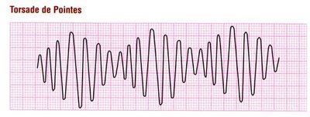

Slide 36
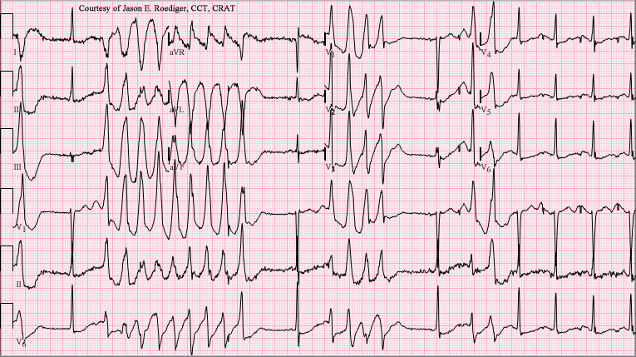

Slide 37
TCA Overdose - Management 1
Mainstay of initial management is supportive.
Try not to give other drugs due to interactions/cardiac instability
A - May need intubating
B - Often depressed
C - Give IV fluids if low BP
D - Control convulsions with Diazepam

Slide 38
TCA Overdose -Management 2
Activated Charcoal if more than 4 mg/Kg within 1 hour.
  N.B WATCH OUT FOR THE AIRWAY
Correct hypoxia with oxygen
Correct acidosis with Sodium Bicarbonate
Correct any arrhythmias with Sodium Bicarbonate
  Ensure electrolytes replete (i.e K+ > 4.0, Mg 2+ > 0.7)

Slide 39
SUMMARY
Get as much history as you can
  Clarify timeline and agents taken
Mainstay of any poisoning is supportive
Don’t Forget the ABCDE
Specific antidotes
For specific circumstances consider decreasing the absorption or increasing the elimination of the drug
Look up Toxbase!

Slide 40
Get in touch!
Website
www.quackmeded.co.uk
Email
ggc.quackmeded@nhs.scot
Social Media
Twitter: @QUACK_ Med
Facebook: QUACK education

