Slide 1
Vasopressors in shock
Callum Robertson
Anaesthetic Trainee
Ayrshire & Arran

Slide 2
Disclaimer
Please note that QUACK is a regional teaching programme operating across GG&C, Lanarkshire and Ayrshire & Arran.
This presentation outlines general management, though local variances e.g. antibiotic prescription may vary slightly depending on your local trust
Remember to check your local guidelines

Slide 3
Learning Outcomes
State the difference between vasopressors, inotropes and chronotropes
Recognise when to start a metaraminol infusion
Identify which patients would benefit from a noradrenaline infusion and state how to set up
Distinguish when second vasoactive agents could be required in the context of sepsis

Slide 4
Glossary
Vasopressor – agent that causes vasoconstriction
Inotrope – agent that increases or decreases myocardial contractility
Chronotrope – increases or decreases heart rate
Vasodilator – Causes arterial, venous or arteriovenous vasodilation
Inodilator – agent that vasodilates and increases myocardial contractility
Dromotrope – Increases or decreases AV nodal conduction
Lusitrope – Promotes diastolic relaxation of the heart

Slide 5
Why Vasopressors/Inotropes?
When fluid is no longer effective or contraindicated vasopressors and inotropes offer a mechanism to maintain perfusion pressure
Maintaining mean arterial pressure (MAP) protects organs from secondary damage e.g. due to a hypovolaemic or septic insult
Choice of vasopressor or inotrope depends on the clinical effect desired on alpha and beta receptors…
Remember, in order to calculate the MAP
= diastolic + (systolic-diastolic)/3 + diastolic pressure

Slide 6
Alpha and beta adrenergic receptors
Alpha 1 receptor
Mydriasis
Vasoconstriction (vasopressor)
Glycogenolysis
Alpha 2 receptor
Negative feedback noradrenaline release and synthesis
Reduces insulin secretion

Slide 7
Alpha and beta adrenergic receptors
Beta 1 receptor
Increases HR (chronotropy)
Increases force of contraction (inotropy)
Increases Renin release
Beta 2 receptor
Vasodilation
Smooth muscle relaxation
Dopamine receptors
Splanchnic vasodilation

Slide 8
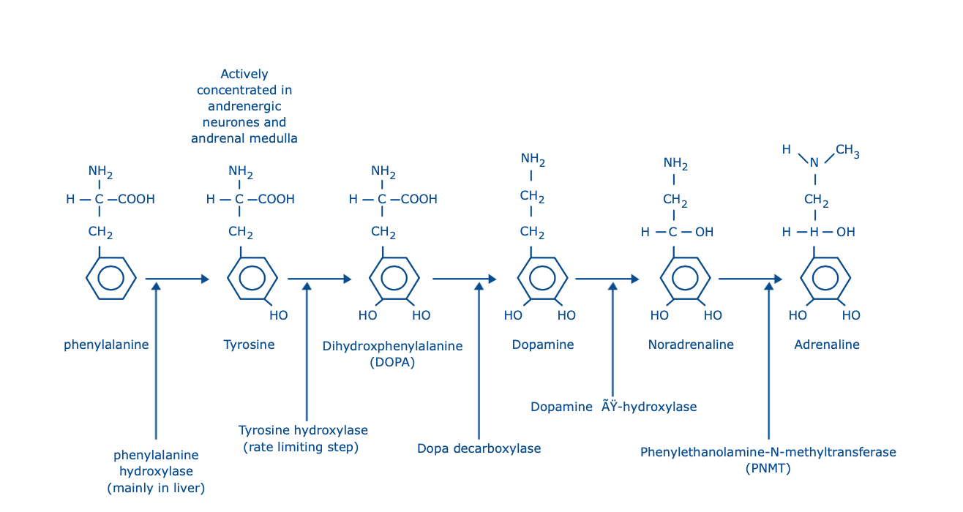
Catecholamines

Slide 9
Aetiology
Produced by chromaffin cells in the adrenal medulla, catecholamines are naturally occurring hormones capable of vasoactive effects.
These often feature dose dependent actions and allow for a wide array of sympathetic adaptation to insults
In addition there are synthetic catecholamines such as dobutamine and dopexamine

Slide 10
Aetiology
In addition to catecholamines there are noncatecholamines commonly used such as:
  Ephedrine
  Phenylephrine
  Metaraminol
  Methoxamine

Slide 11
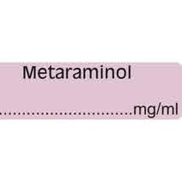
Metaraminol
First line vasopressor in many situations as it can be bolused and given safely peripherally
Metaraminol acts both directly (predominantly on alpha 1 receptors) and indirectly (increasing noradrenaline levels and activity)
As it acts indirectly to some extent there is a degree of tachyphylaxis once native noradrenaline stores are depleted (less effect with successive doses or sustained use)

Slide 12
Metaraminol
Due to its mechanism of action and tachyphylaxis it is often used as a temporising vasopressor
  E.g. hypotension secondary to regional anaesthesia or until central access is obtained
A 10mg ampoule is made up to 20ml in 0.9% NaCl, 0.5mg boluses are usually safe to treat hypotension
Alternatively, an infusion can be made up with 20mg metaraminol up to 40ml in 0.9% NaCl. Typically started at 5ml/h and titrated to response

Slide 13
Metaraminol caution
Due to the indirect actions of metaraminol, caution is advised with patients on TCAs and MAOIs.
The release of noradrenaline from sympathetic nerve endings can be unpredictable with these agents as they interfere with the metabolism of noradrenaline
Consider smaller bolus doses/infusion rates for clinical effect

Slide 14
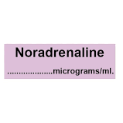
Noradrenaline
Recommended as the first choice vasopressor by the Surviving Sepsis guidelines
In addition, it is a safe starting vasopressor in most conditions encountered in HDU/ICU – ‘if in doubt, try noradrenaline’
Noradrenaline is predominantly an alpha agonist causing:
  Vasoconstriction
  Increased systolic and diastolic pressure (and as a result, afterload)
  Reflex baroreceptor mediated bradycardia – rarely seen

Slide 15
Noradrenaline cardiogenic shock
Vasoconstriction increases afterload
In cardiogenic shock, our normal goal is to reduce afterload to reduce effort on the heart and as a result reduce cardiac ischaemia
However, the vasoconstriction can improve diastolic filling pressure which may improve stroke volume and provide cardiac and secondary organ protection
Not an easy answer – additional monitoring e.g. Pulmonary artery catheter, pulse contour analysis or oesophageal doppler might be required to optimise cardiac output

Slide 16
Noradrenaline
Unlike metaraminol, noradrenaline is highly potent and should not be bolused
It can cause tissue necrosis if extravasation occurs and profound peripheral vasoconstriction. For that reason it is recommended to be given centrally, with an arterial line to maximise the safety profile of infusions
However, some studies suggest it can be given safely peripherally in dilute concentrations as a temporising measure, much like metaraminol (seek expert advice if your department doesn’t routinely accommodate this)

Slide 17
Noradrenaline
Infusion and Pharmokinetics
4mg ampoule diluted in 50ml 5% glucose (0.08mg/ml)
Can be 2x (8mg/50ml) or 4x strength (16mg/50ml)
Peripheral infusion – 1mg in 50ml - according to some trials this is appropriate as a bridge or short duration e.g. overdose
Half life measured in minutes with rapid metabolism – i.e. does not accumulate. Wide effective dose range 0.05 – 1 ug/kg/min

Slide 18
Noradrenaline
Starting an infusion
Typically start at 5ml/h (0.4mg/h) as a rough guide
  Aim for a MAP > 65mmHg in septic patients however target should be individualised - might need a higher MAP to drive renal perfusion pressure
Noradrenaline can then be up or down titrated typically by 1ml at a time (consider smaller jumps for 2x or 4x concentrated solutions)
Typical priming volume is ~ 0.5 ml in a central line
  Thus it may take ~5 minutes before effects are seen

Slide 19
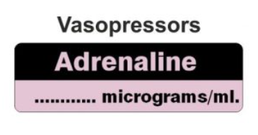
Adrenaline
Present at either 1 in 1000 (1ml) or 1 in 10000 (10ml) dilutions
Dose dependent actions
  Low infusion rate – predominantly beta (chronotropic and ionotropic)
  High infusion rate rate – predominantly alpha (vasoconstrictive)
First line in ALS cardiac arrest guidelines
  Often used as first line in ICU patients immediately following cardiac arrest as an infusion for its alpha and beta effects and for anaphylaxis due to its beta effects (bronchodilation)

Slide 20
Adrenaline
Other important effects include:
  Bronchodilatation (useful in anaphylaxis)
  Raised metabolic rate
  Hyperglycaemia
  Hypokalaemia
  Exacerbation of lactic acidosis in severe sepsis
Unlike noradrenaline, you don’t get the reflex drop in heart rate – it goes up too

Slide 21
Adrenaline Dosing
Rapidly metabolised
1mg bolus during a cardiac arrest
Typical dose range in ICU 0.01-0.5 ug/kg/min
  Usually made up as 4mg in 50ml glucose – can be 2x or 4x strength (some centres use 5mg in 50ml)

Slide 22
Summary – Metaraminol/Noradrenaline/Adrenaline
Metaraminol | Noradrenaline | Adrenaline
Direct and Indirect | Direct | Direct
Alpha activity | Alpha activity | Alpha and Beta
Can be bolused | Should not be bolused | IV boluses in certain conditions e.g. cardiac arrest
Peripheral or central | Peripheral – trials have shown ¼ concentration can be given Central preferred | Can be given peripherally but preference would be central access for sustained use
Use – bridging therapy or short term use (tachyphylaxis) | 1st line vasopressor in most situations, 1st line in Surviving Sepsis | 1st line in ALS and anaphylaxis

Slide 23
Other commonly used agents
Dobutamine
Vasopressin
Isoprenaline

Slide 24
Dobutamine
Synthetic catecholamine structurally similar to isoprenaline
Sympathomimetic agent – direct acting
Beta 1 activity predominantly (but also weak beat 2 and alpha 1)
Inotrope to increase contractility, stroke volume and CO
Used effectively in cardiogenic shock (and in some severe sepsis e.g. heart stunning)

Slide 25
Dobutamine
The effects of dobutamine are:
  Increased myocardial contractility
  Increased ejection fraction or stroke volume
  Increased heart rate
  Increased atrioventricular conduction
  Tendency to tachydysrhythmias at higher infusion rates
  Vasodilatation of arterioles to skeletal muscle (beta-2 adrenergic effect)
The effect on MAP depends on the situation (MAP=CO x SVR)
In septic shock with a low cardiac output, e.g. inadequate fluid resuscitation, MAP usually increases (dobutamine increases CO)
In septic shock with a normal or high cardiac output (the more usual situation) MAP may be relatively unaltered or even decrease (dobutamine does not affect CO but drops SVR)

Slide 26
Dobutamine
Like adrenaline and noradrenaline, the preference is to give via central access with an arterial line or potentially additional cardiac output monitoring
In particular due to its beta vasodilatory effects it can profoundly drop afterload, this can be counterintuitive if it drops MAP in a septic patient for example and thus it is often used in combination with primary alpha agents such as noradrenaline.
However, hypotensive patients on the Coronary Care Unit often receive peripheral dobutamine without invasive haemodynamic monitoring. This is acceptable because:
  Dobutamine causes much less vasoconstriction than other agents
  The clinical diagnosis is usually obvious – patients are cold, clammy and peripherally shut down.
  It is highly likely that the CVP is high and the cardiac output is low
  Patients in cardiogenic shock are in poor general condition, are not usually sedated or ventilated and therefore may not tolerate CVC insertion procedures well
In common with other catecholamines, dobutamine has a short half-life measured in minutes due to rapid metabolism and must be given by continuous infusion. The dose range is approximately 2-20 µ g/kg/min.

Slide 27
Dobutamine use in sepsis
The patient should have invasive haemodynamic monitoring in place. Fluid resuscitation started and noradrenaline commenced to achieve a MAP >65 mm Hg.
  A sample of blood from the CVC should be taken to measure haemoglobin saturation (S_{CV}O₂).
If S_{CV}O₂ <70 % (normally approximately 75 %) the oxygen extraction ratio is abnormally high and implies that oxygen delivery to the tissues is inadequate:
  This may occur even if the cardiac output is within the normal physiological range as oxygen requirements are elevated in severe sepsis

Slide 28
Dobutamine use in sepsis
Check the haemoglobin concentration. Administer packed red blood cells if [Hb] <70 g/L to achieve a target of 70-90 g/L.
  A higher threshold for administration may be considered in specific circumstances, e.g. myocardial ischaemia and severe lactic acidosis.
Commence dobutamine infusion, aiming for S_{CV}O₂ >70 %.
Set infusion pump to run initially at approximately 5 ml/h (5mg/ml)
Monitor patient closely for signs of improvement:
  S_{CV}O₂ ≥70 %
  Improved urine output
  Decreased plasma lactate concentration or base deficit

Slide 29
Vasopressin
Vasopressin (anti-diuretic hormone, ADH) is a naturally occurring nonapeptide hormone synthesised by the hypothalamus
As well as its effects on the collecting ducts of the kidneys to increase water permeability, vasopressin is also a potent vasopressor
Acts via vasopressin V1 receptors.

Slide 30
Vasopressin
Studies show that vasopressin levels are depleted in critical illness such as septic shock
From this observation there has been much interest in using vasopressin to treat septic shock
A large randomised study failed to demonstrate benefits in comparison to noradrenaline and as a result it is not recommended as a first line vasopressor
It has been shown to be an effective adjunct to noradrenaline, supplied in 20IU ampoules it is commonly started at 1 ml/h and adjusted to effect

Slide 31
Isoprenaline
Non selective beta adrenergic agonist (almost no activity on alpha receptors)
As a result it is primarily ionotropic and chronotropic
Typically, although the ionotropic effects increase systolic pressure, the drop in SVR by smooth muscle relaxation causes a drop in MAP

Slide 32
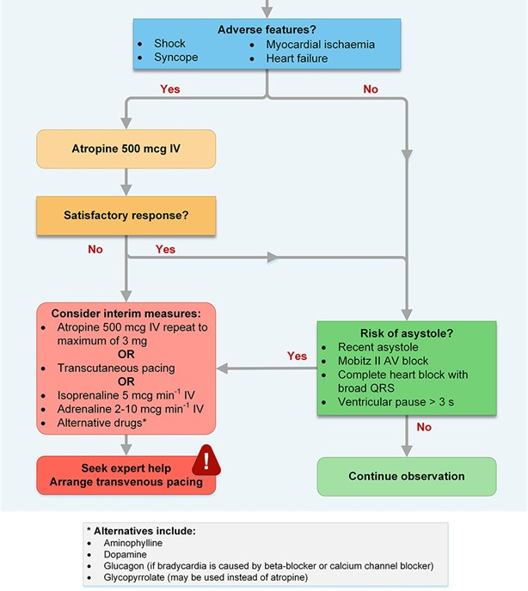
Used in ALS bradycardia algorhythm

Slide 33
Isoprenaline
Some experts argue that transcutaneous pacing is seldom effective
As a result atropine would be the first line agent followed by an isoprenaline infusion
Typically started at 5mcg/min but can be doubled
Can be given peripherally and acts as a bridge to transvenous pacing

Slide 34
Summary
Metaraminol/Noradrenaline/Adrenaline are commonly used in the HDU/ICU environment
Vasopressors should be used if fluid is no longer effective/contraindicated to maintain MAP
The Surviving Sepsis Campaign Guidelines 2008 suggests we should target a MAP >65mmHg in most patients

Slide 35
Summary
Vasopressors are not a substitute for adequate fluid resuscitation
Invariably they increase afterload so may be counterproductive in patients with heart failure
Where available they should be given centrally and guided by invasive arterial line monitoring
Noradrenaline is the recommended first line vasopressor used to treat septic shock (MAP <65 mm Hg or serum [lactate] >4 mmol/l) unresponsive to simple fluid resuscitation.
If a satisfactory response is not achieved after fluid resuscitation and a noradrenaline infusion, consider:
  Adrenaline infusion (NB metabolic derangement)
  Vasopressin infusion
  Dobutamine infusion if S_{CV}O₂ <70 %
  Corticosteroids – patient could potentially have acute relative adrenal insufficiency

Slide 36

Further Reading
Surviving Sepsis Guidelines
E-LFH – module 03_11_02 Vasoactive agents in sepsis
ALS – bradyarrhythmia
J. Russel et al, Vasopressin versus norepinephrine infusion in patients with septic shock, N Engl J Med. 2008 358(9):877-87
2018 ACC/AHA/HRS Guideline on the Evaluation and Management of Patients With Bradycardia and Cardiac Conduction Delay

Slide 37
Thank you
Please fill out the online survey to obtain a certificate

Slide 38

Get in touch!
Website
www.quackmeded.co.uk
Email
ggc.quackmeded@nhs.scot
Social Media
Twitter: @QUACK_ Med
Facebook: QUACK education

