Slide 1
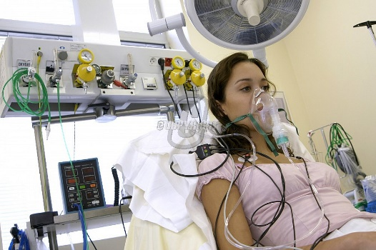
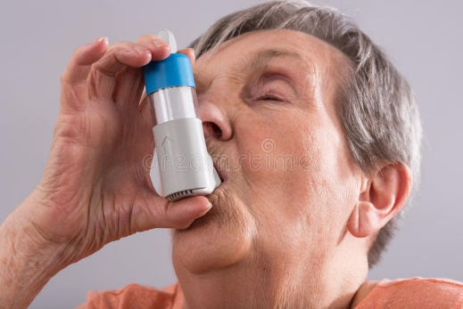
Management of Acute Asthma
Gemma McGrory
ST7 AIM

Slide 2
Disclaimer*
Please note that QUACK is a regional teaching programme operating across GG&C, Lanarkshire and Ayrshire & Arran.
This presentation outlines general management, though local variances e.g. antibiotic prescription may vary slightly depending on your local trust
Remember to check your local guidelines

Slide 3
Aims
What is asthma?
Case presentations
How to manage according to severity in acute receiving / as inpatient

Slide 4
What is asthma?
Asthma is an inflammatory condition associated with bronchial hyper-responsiveness
Paroxysmal and reversible airway obstruction

Slide 5
Acute asthma
Acute bronchospasm and excessive production of secretions
Triggers inflammatory cascade within bronchial tree leading to symptoms
If chronically undertreated leads to airway remodelling and fixed airways obstruction

Slide 6
Acute Asthma
1167 asthma deaths in UK in 2011
  90% of these were preventable
5-10% asthmatics ‘severe’
  High dose inhaled or regular oral steroids

Slide 7
Asthma Deaths
Risk factors
  Previous near fatal asthma
  Previous admission for asthma
  3 or more classes of asthma medication
  Heavy / increasing use beta-agonist
  Frequent emergency contacts for asthma care
  NSAID sensitivity
  Inadequately treated disease
  Smoking
  Pregnancy
  Failure to recognise severity of asthma

Slide 8
Presentation
SOB
Recent poor control
+- Infective symptoms
Accessory muscles use
Wheeze
Tachycardia
Silent chest

Slide 9
Acute Asthma
Gradual-onset - in about 80%, severe attacks develop over more than 48 hours
Sudden-onset - often in association with significant allergen exposure. Patients tend to be older and to present during the night

Slide 10
Case 1
Mary Jones presents to the Ambulatory Care unit with 10 days of worsening SOB
She has been waking up during the night coughing and feeling SOB
She is wheezy and has a productive cough
Given blue inhaler by GP which helps a bit

Slide 11
Case 1
What information do you need to tell how well / unwell she is?

Slide 12
Case 1
What information do you need to tell how well / unwell she is?
  Known asthma?
  Sats
  Respiratory Rate
  PEFR
  How does she look?
  Can she speak in sentences?

Slide 13
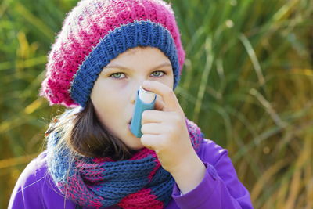
Case 1
Atopic but not previously asthmatic
RR 18
Sats 98% on air
Wheeze throughout chest
Speaking in full sentences
PEFR 440 (500 predicted)
CRP 40

Slide 14
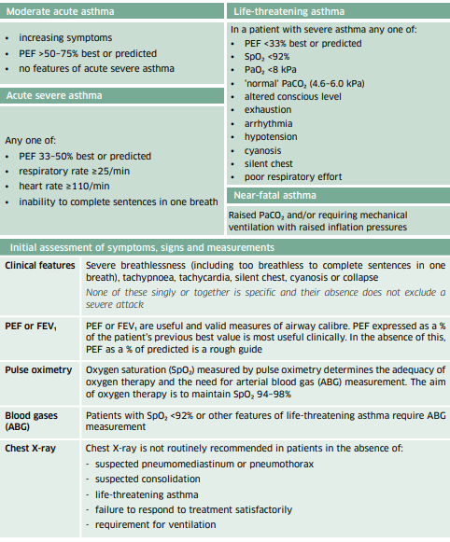

Slide 15
Case 1
Mild exacerbation secondary to infection
Safe for discharge home with oral steroids and antibiotics and GP follow-up within 48 hours
Usually prednisolone 40mg 5 days +- gastro-protection
Triggers?
Worsening statement

Slide 16
Case 2
You are asked to see Jessie Smith in the receiving unit
She has been admitted with 5 days worsening SOBOE and now at rest, chest tightness, wheeze and dry cough
Blue inhaler not working
On Relvar Epllipta and montelukast

Slide 17
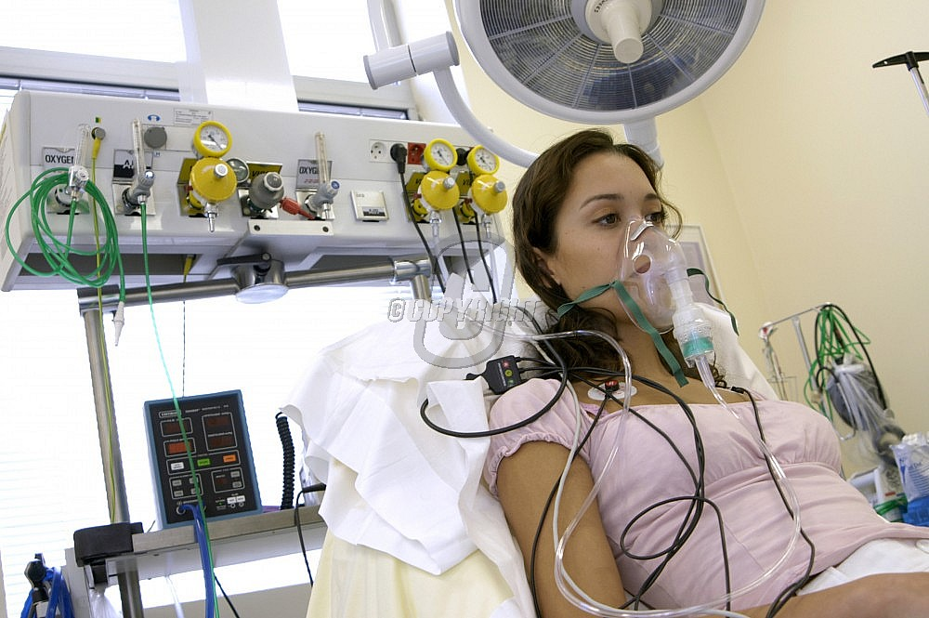
Case 2
RR 30
Sats 97% on trauma mask
HR 115
Wheezy
Unable to speak in full sentences
Tripodding

Slide 18
Case 2
Clearly we need more information…
What information do we need?

Slide 19
Case 2
Clearly we need more information…
What information do we need?
  ABG
  CXR

Slide 20
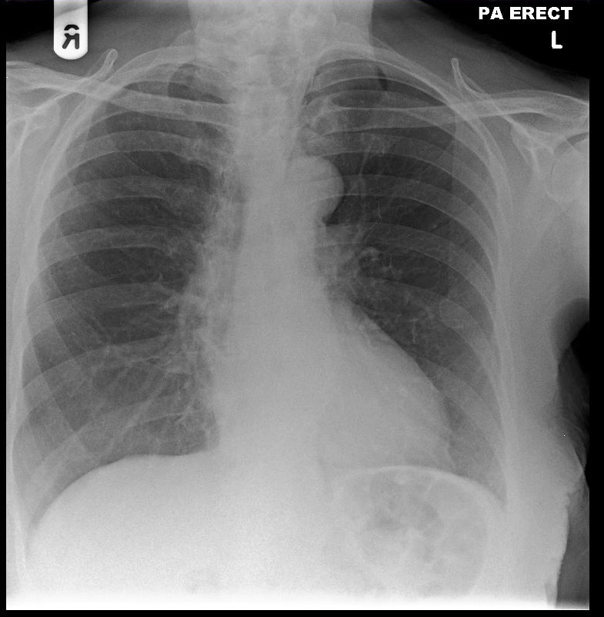
Case 2
ABG on 15l
  H+ 32
  PCO2 3.4
  PO2 28.3
  SO2 99%

Slide 21
Case 2
Acute severe asthma
5mg salbutamol neb + 0.5mg ipratropium nebuliser
Prednisolone / Hydrocortisone IV
+- gastroprotection
Wean O2
Reassess

Slide 22
Case 2
You go back to reassess after 3 nebs
Still tripodding, still unable to speak in full sentences
Bloods are back

Slide 23
Blood Results
Parameter | Value
Sodium | 143
Potassium | 3.8
Bicarbonate | 18
Urea | 3.2
Creatinine | 57
eGFR | >59
Haemoglobin | 12.3
White Cell Count | 11.2
Platelets | 325
Glucose | 6.4
PT | 10.1

Slide 24
Case 2
You go back to reassess after 3 nebs
Still tripodding, still unable to speak in full sentences
Looks as though she is tiring
What now?

Slide 25
Case 2
You go back to reassess after 3 nebs
Still tripodding, still unable to speak in full sentences, still wheezy
Looks as though she is tiring
What now?
  Repeat ABG
  Further nebs while you wait

Slide 26
Case 2
ABG on 6l O2 neb
  H+ 47
  PCO2 5.1
  Po2 10.1
  SO2 91%
What’s wrong with this ABG?

Slide 27
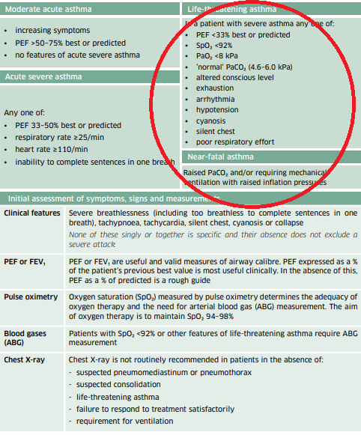
Case 2
Normal PCO2 yet raised RR
So2 <92%
= Life threatening asthma

Slide 28
Case 2
Immediate ICU review
IV Magnesium 2g IV over 20 mins
Can use IV salbutamol but critical care use only

Slide 29
Chronic Management
Mostly done by GPs or asthma / practice nurses
Doesn’t mean all patients optimally controlled!
Admission opportunity to review medications and symptom control

Slide 30
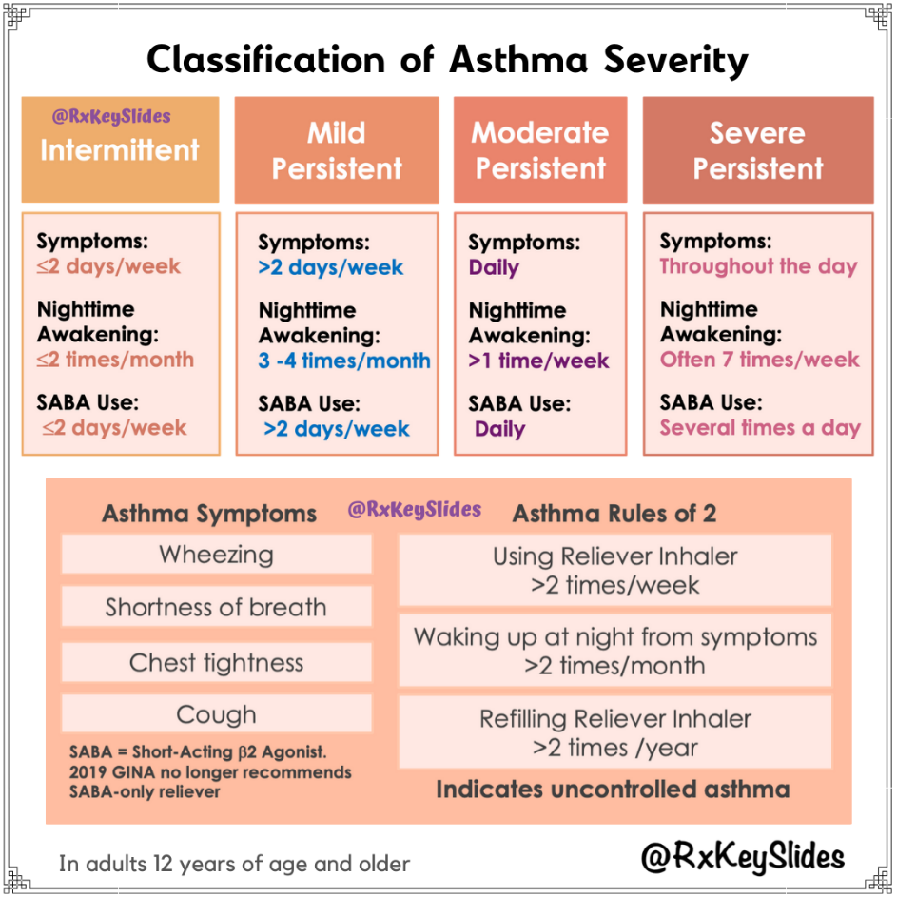

Slide 31
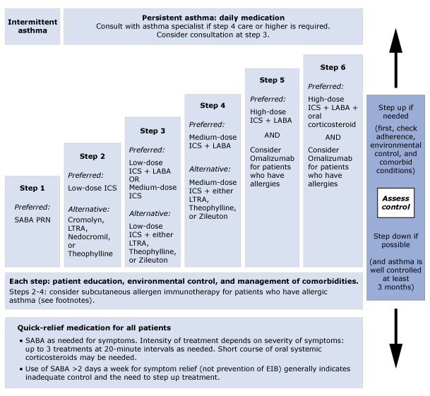

Slide 32
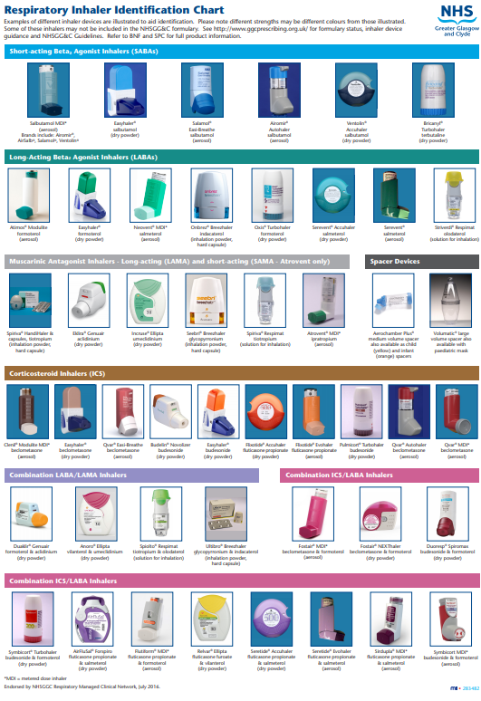

Slide 33
Thank you
Please fill out the feedback form for your certificate of learning

Slide 34
Get in touch!
Website
www.quackmeded.co.uk
Email
gg-uhb.quackmeded@nhs.net
Social Media
Twitter: @QUACK_ Med
Facebook: QUACK education

