Slide 1
SKIN LESIONS
DR. PUO NEN LIM (CHRIS)
DR. AMRITA RANDHAWA

Slide 2
Disclaimer*
Please note that QUACK is a regional teaching programme operating across GG&C, Lanarkshire and Ayrshire & Arran.
This presentation outlines general management, though local variances e.g. antibiotic prescription may vary slightly depending on your local trust
Remember to check your local guidelines

Slide 3
TO COVER
Benign lesions
  Melanocytic naevus
  Seborrhoeic keratosis
  Dermatofibroma
  Myxoid cyst
  Pyogenic granuloma
  Lentigo
Infections
  Viral warts
  Molluscum contagiosum
Pre-cancerous
  Actinic keratosis
  Bowen’s disease
  Keratoacanthoma
Skin Malignancy
  Basal cell carcinoma
  Squamous cell carcinoma
  Malignant melanoma

Slide 4
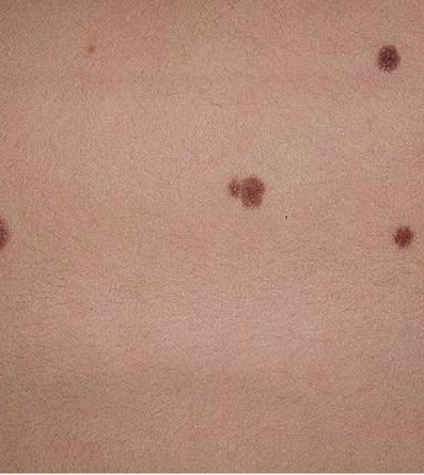
BENIGN MELANOCYTIC NAEVUS
AKA moles
Proliferation of melanocytes usually present from birth
Classified according to histology (Junctional, Compound, Intradermal)
Regularly shaped with colours distributed in a symmetrical pattern
Can be flat or slightly raised

Slide 5
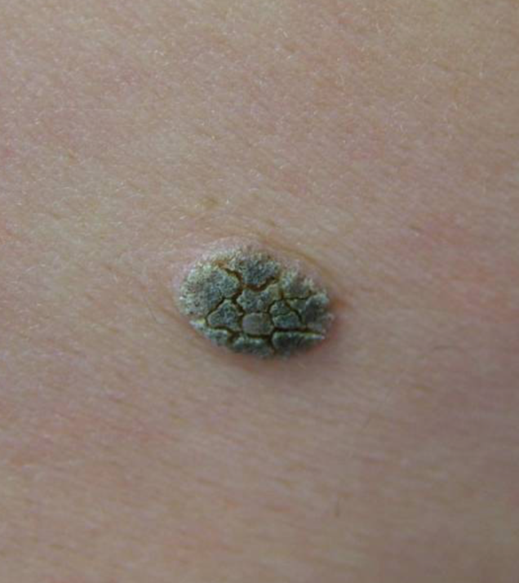
SEBORRHOEIC KERATOSIS
Benign overgrowth of keratinocytes in epidermis
Most common in elderly population
Usually asymptomatic
Irregular surface with ‘stuck-on’ appearance
No treatment required but can be removed by cryotherapy or curettage and cautery if needed

Slide 6
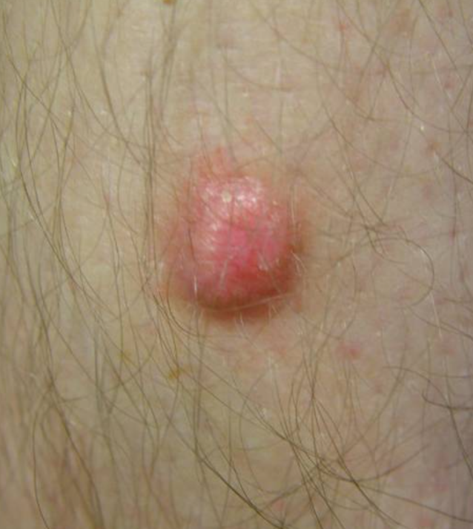
DERMATOFIBROMA
Benign fibrous nodule
Commonly on the lower limbs, especially thighs and lower legs
Usually around 5mm in size and elevated
Colour tends to be red to brown
Firm consistency
No treatment required

Slide 7
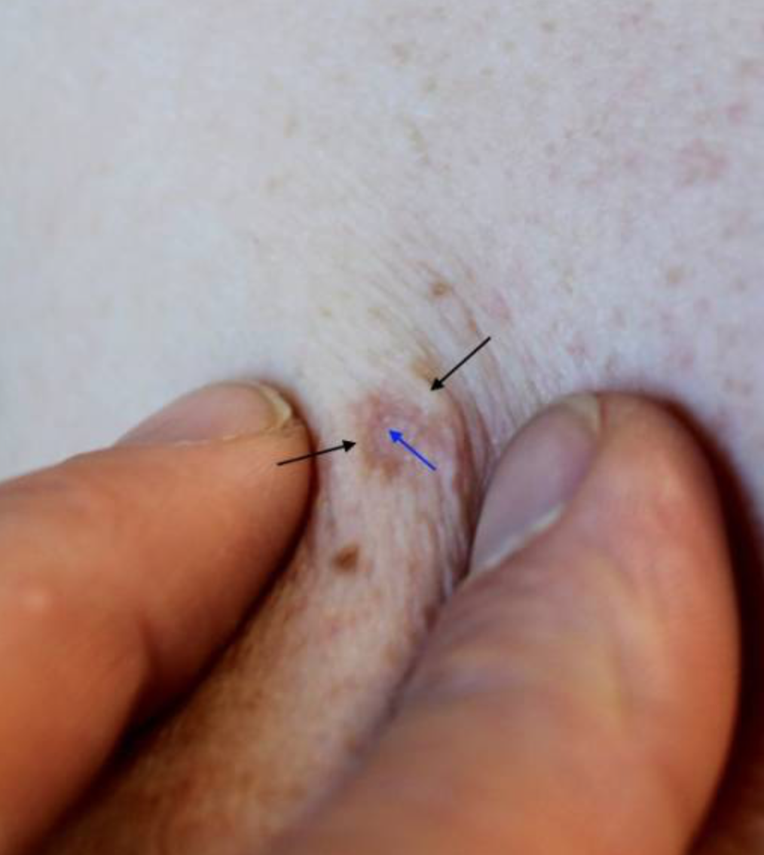
DERMATOFIBROMA
Pinching the skin results in central dimpling

Slide 8
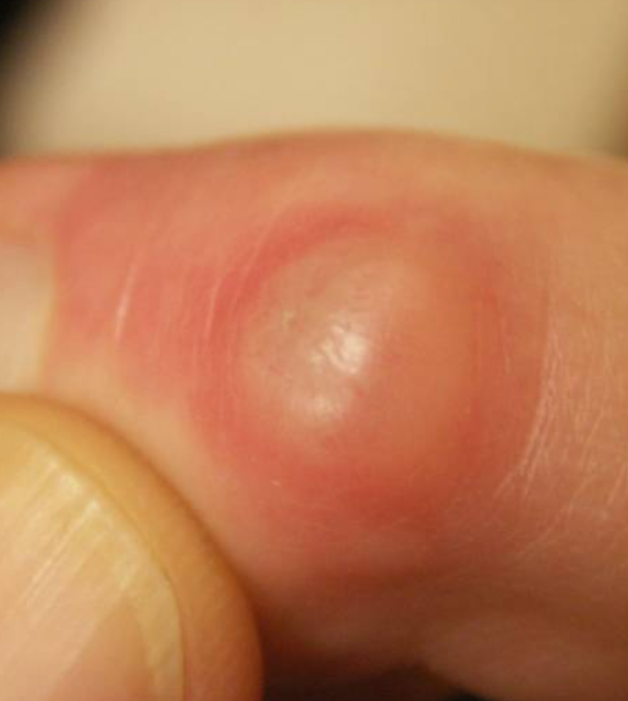
MYXOID CYST
Benign ganglion cyst found at the distal interphalangeal joints or proximal nail fold
Arises from synovial lining of joints and tendons
Smooth shiny surface with clear jelly-like fluid
No treatment required unless symptomatic
Surgical options include aspiration or excision

Slide 9
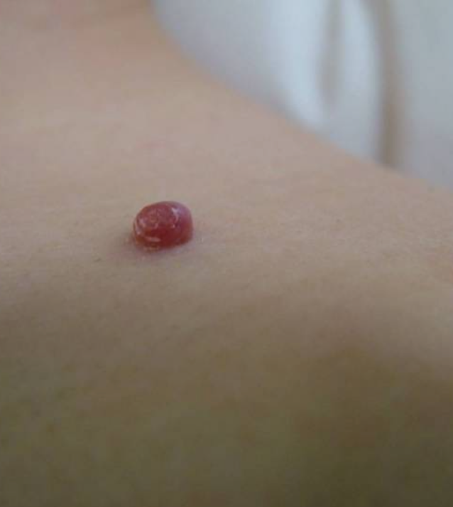
PYOGENIC GRANULOMA
Benign rapidly growing capillary blood vessels
Usually due to trauma
Appears as a small erythematous papule but quickly enlarges into nodule
Bleeds easily
Mainly self-limiting
Diagnostic biopsy sometimes needed to rule out amelanotic melanoma

Slide 10
LENTIGO
Pigmented lesion with clearly defined border
Does not fade in winter months
Usually due to UV exposure
Types
  Lentigo simplex
  Solar lentigo
  Ink spot lentigo

Slide 11
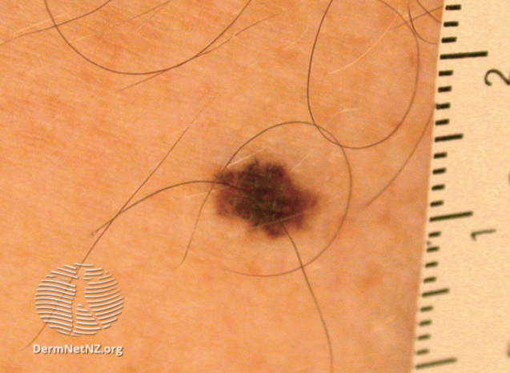
LENTIGO SIMPLEX
Precursor to junctional naevus
Usually happens in childhood and increases in number in young adults
Well-demarcated macules 3-5mm diameter with uniform colour
Majority remain static or disappear in adult life

Slide 12
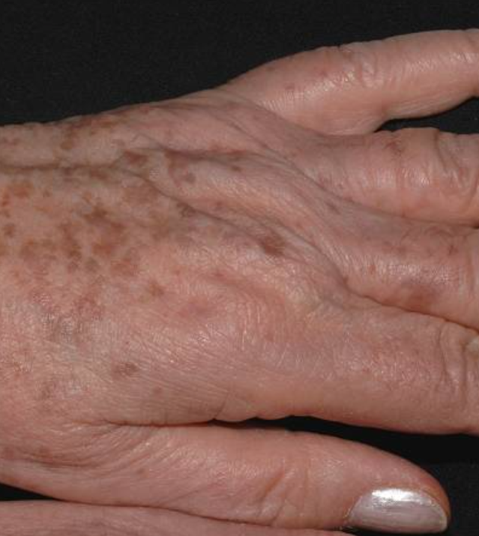
SOLAR LENTIGO
AKA age spots
Sun-induced lesions
Most commonly on face, forearms and dorsal aspects of hands
Uniformly brown macules

Slide 13
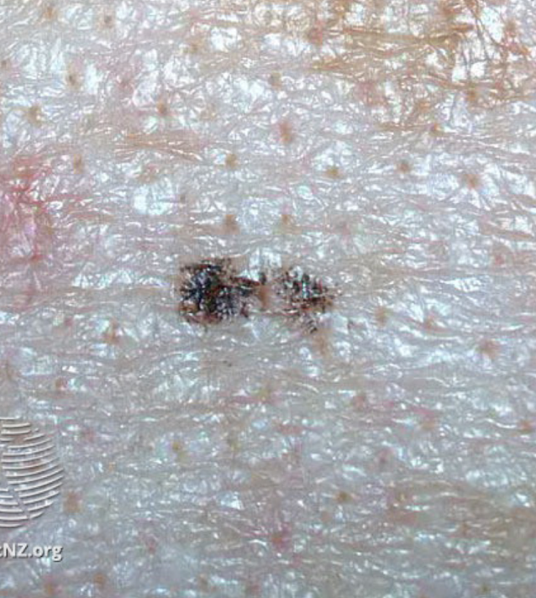
INK SPOT LENTIGO
Usually on the trunk
Happens after sunburn in fair skinned individuals
Small, black macule

Slide 14
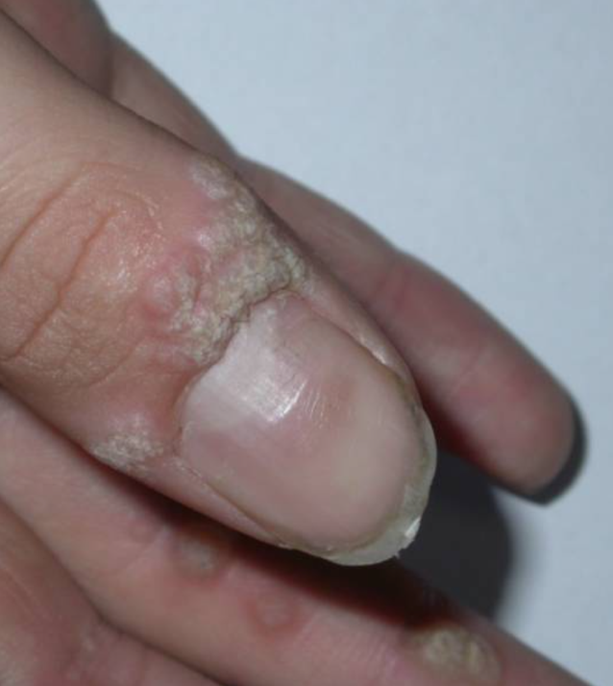
VIRAL WARTS
Due to HPV infection
Usually presents as firm papules with rough surface
Common areas include dorsum aspects of hands, fingers, soles of feet, anogenital region
No treatment as they usually self-resolve within 2 years
Treatment options
  Paring of warts
  Cryotherapy
  OTC salicylic acid
  Duct tape

Slide 15
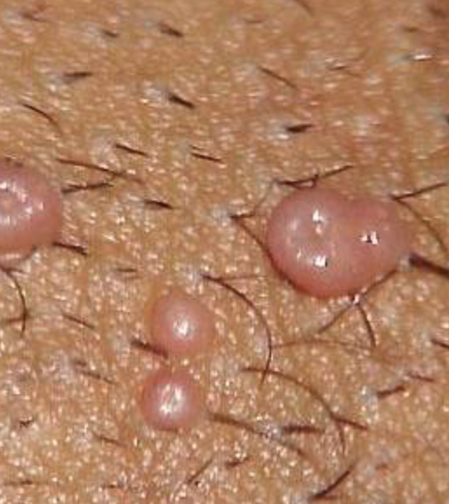
MOLLUSCUM CONTAGIOSUM
Common infection caused by poxvirus
Mainly in young children
Appears in clusters of small shiny papules with umbilicated centre
Exhibits koebner phenomenon
Usually self-limiting so no treatment
Treatment options
  Molludab (5% potassium hydroxide)
  Cryotherapy

Slide 16
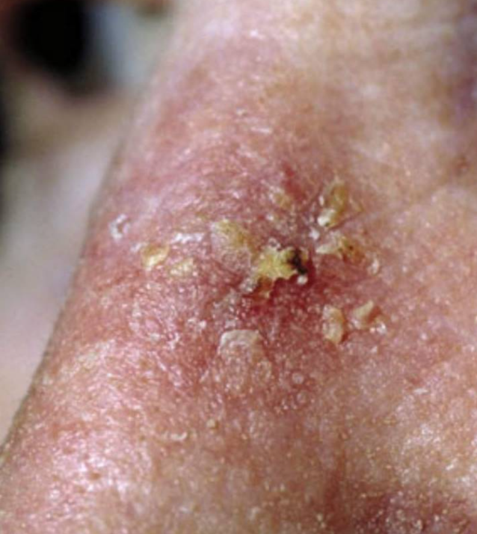
ACTINIC KERATOSIS
Common sun-induced scaly or hyperkeratotic lesion
Small potential to become SCC
Usually on sun-exposed areas ie head, face and neck
Classical appearance of flat lesion with rough surface scale on background of sun-damaged skin
Treatment include cryotherapy, Efudix or Imiquimod creams

Slide 17
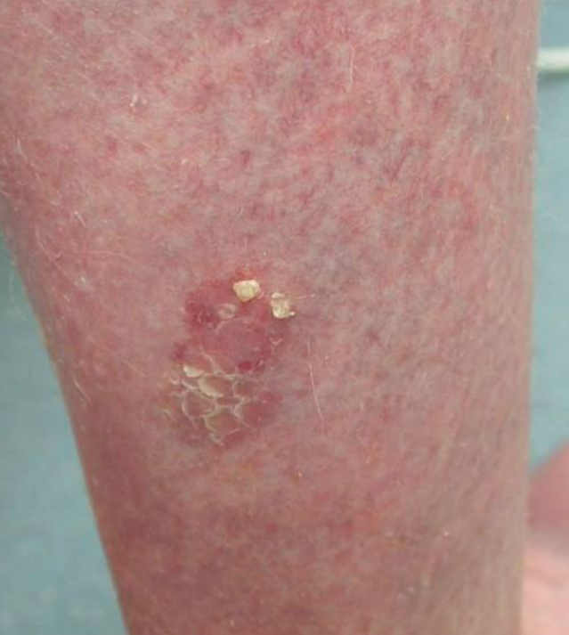
BOWEN’S DISEASE
SCC in situ of the skin
Rarely transforms to SCC
Usually on sun-exposed areas, especially lower legs in women
Flat, erythematous patch with rough scale
Treatment with Cryotherapy, Efudix cream and photodynamic therapy

Slide 18
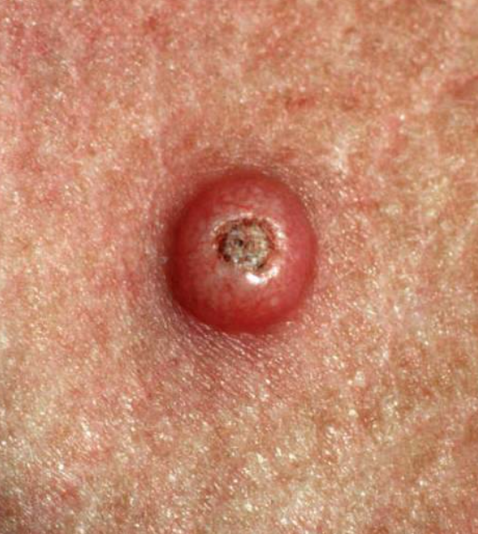
KERATOACANTHOMA
Rapidly growing tumour composed of keratinizing squamous cells
On sun-exposed areas
Symmetrical dome-shaped nodule with central keratin core
Self-limiting
Hard to differentiate from SCC so needs biopsy

Slide 19
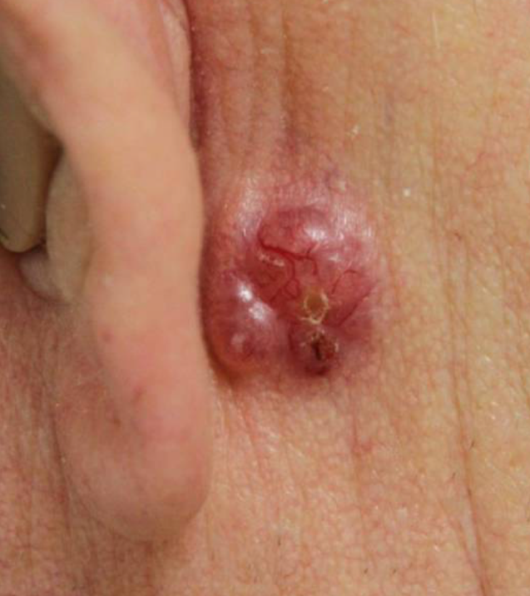
BASAL CELL CARCINOMA
AKA Rodent’s ulcer
Commonest form of skin cancer
Risk factors
  UV exposure
  Age
  Light-skinned individuals
  Smoking
  Immunosuppression
Typically pearly nodule with rolled telangiectatic edge, shiny in appearance

Slide 20
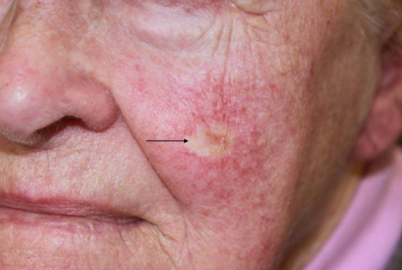
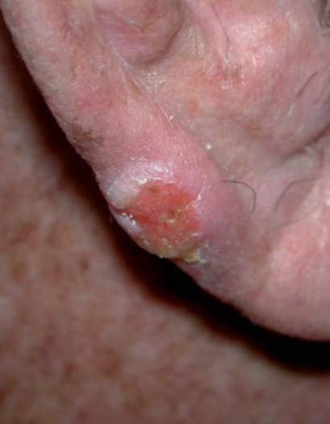
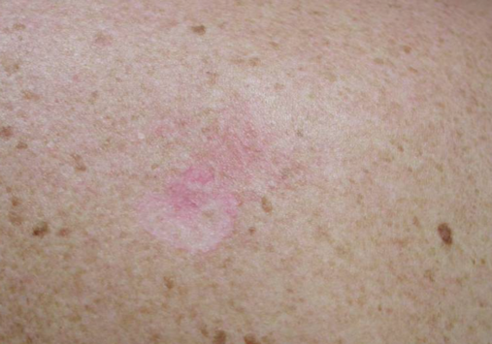
OTHER TYPES
Morphoeic BCC
Basosquamous BCC
Superficial BCC

Slide 21
MANAGEMENT
Surgical excision with 4mm margin
MOHs micrographic surgery
Low risk disease
  Curettage and cautery
  Cryotherapy
  Carbon dioxide laser
Imiquimod topical therapy
Photodynamic therapy
Radiotherapy

Slide 22
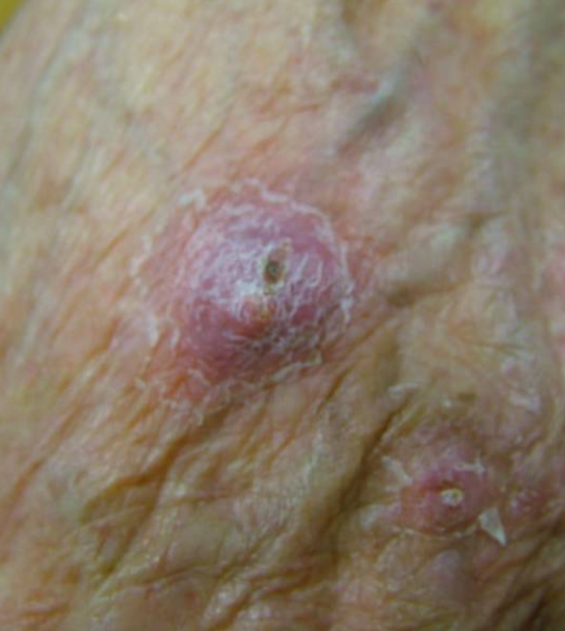
SQUAMOUS CELL CARCINOMA
Malignant tumour arising from keratinocytes
Second most common skin cancer
Risk factors
  UV exposure
  AK, Bowen’s disease
  HPV infection
  Smoking
  Fair-skinned individuals
Usually rapidly-growing ulcerated lesion
Firm to palpate

Slide 23
MANAGEMENT
Usually surgical excision
MOHS surgery for high risk tumour
Radiotherapy
Low risk tumour
  Curettage and cautery
  Cryotherapy

Slide 24
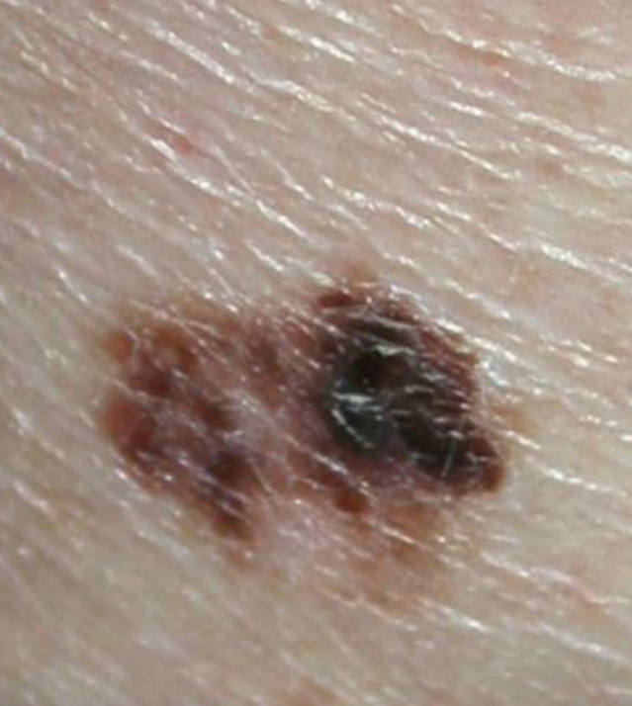
MELANOMA
Malignant tumour arising from melanocytes
Different subtypes
Remember ABCDE rule
  Asymmetry
  Borders
  Colours
  Diameter >6mm
  Evolving in size, shape
For Nodular lesions
  Elevation
  Firmness to touch
  Growth

Slide 25
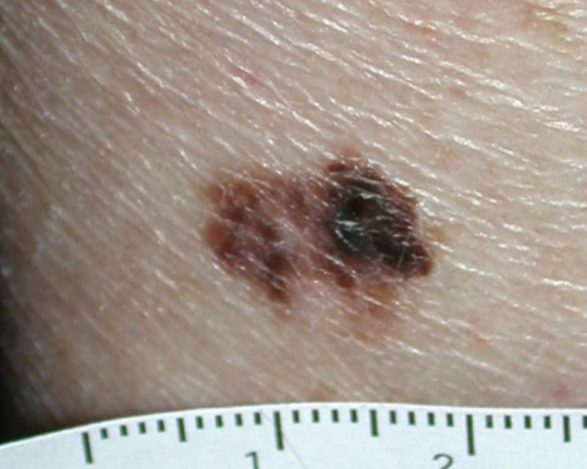
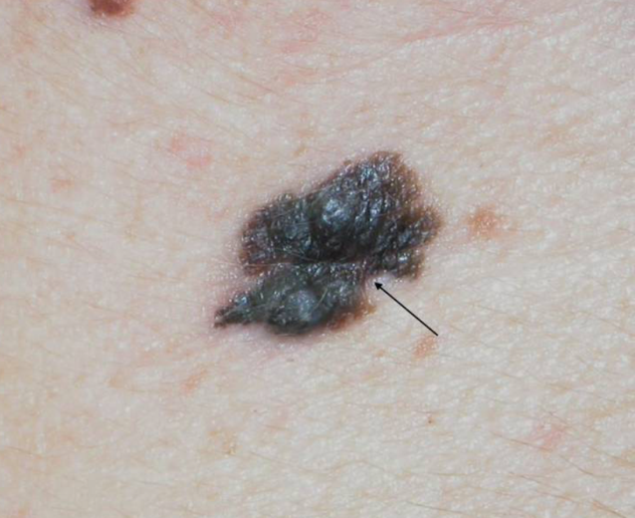
MELANOMA SUBTYPES
SUPERFICIAL SPREADING
NODULAR

Slide 26
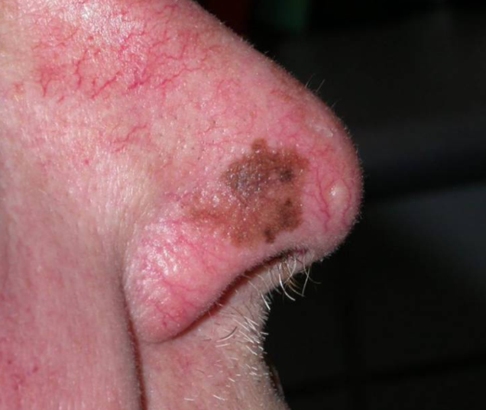
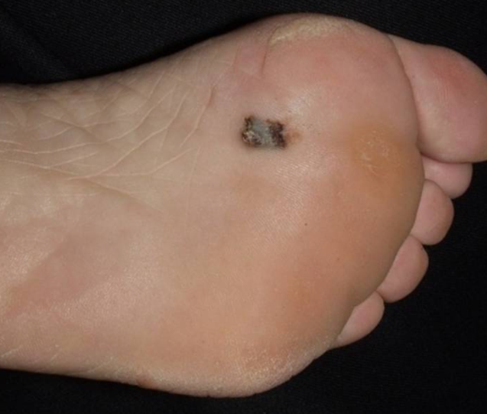
MELANOMA SUBTYPES
LENTIGO MALIGNA MELANOMA
ACRAL-LENTIGINOUS

Slide 27
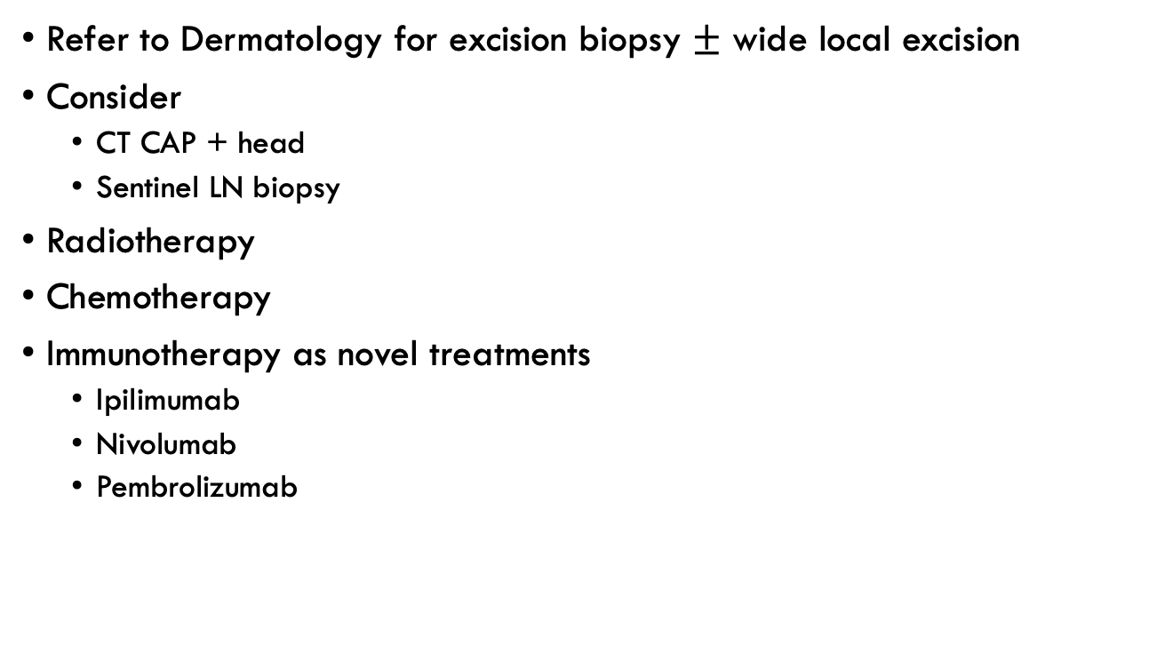
MANAGEMENT
Refer to Dermatology for excision biopsy $±$ wide local excision
Consider
  CT CAP + head
  Sentinel LN biopsy
Radiotherapy
Chemotherapy
Immunotherapy as novel treatments
  Ipilimumab
  Nivolumab
  Pembrolizumab

Slide 28
REFERENCES
https://dermnetnz.org
http://www.pcds.org.uk
https://www.bad.org.uk/healthcare-professionals/clinical-standards/clinical-guidelines

Slide 29
Thank you
Please fill out the feedback form for your certificate of learning

Slide 30
Get in touch!
Website
www.quackmeded.co.uk
Email
gg-uhb.quackmeded@nhs.net
Social Media
Twitter: @QUACK_ Med
Facebook: QUACK education

