Slide 1
Decompensated Liver Disease
Dr Matthew Priest
Consultant Gastroenterologist
QEUH

Slide 2
Disclaimer*
Please note that QUACK is a regional teaching programme operating across GG&C, Lanarkshire and Ayrshire & Arran.
This presentation outlines general management, though local variances e.g. antibiotic prescription may vary slightly depending on your local trust
Remember to check your local guidelines

Slide 3



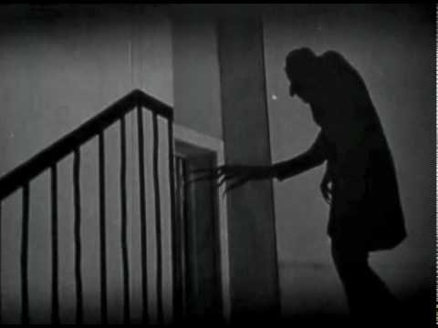


Slide 4
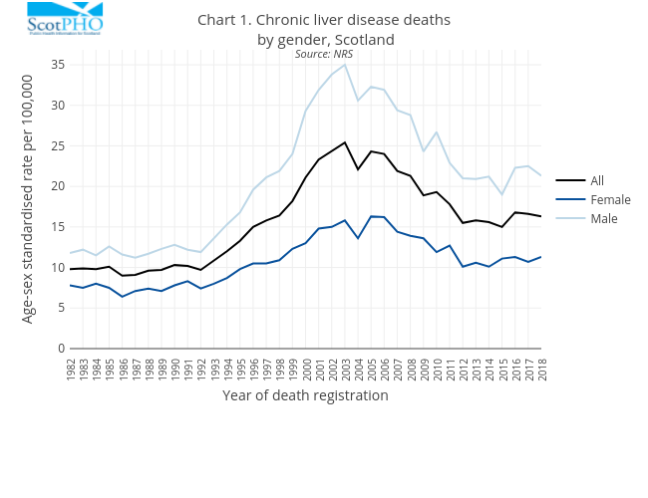

Slide 5
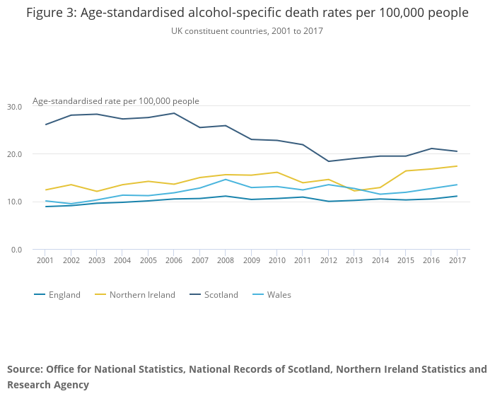

Slide 6
Liver disease is the only major cause of death still rising year on year
1 in 10 patients die in the year following diagnosis of cirrhosis
Ascites occurs in 50% patients with cirrhosis over 10years of follow-up
  50% mortality within 2y of diagnosis
  once refractory to medical therapy, 50% die within 6 months

Slide 7
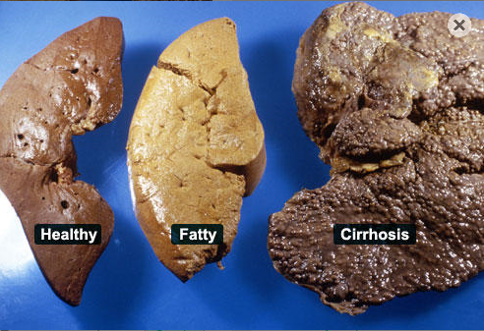
Cirrhosis is the final histological pathway for wide variety of liver diseases

Slide 8
Aetiology locally:
  Alcohol
  HCV (falling)
  Non-alcoholic fatty liver disease (rising)
LFTs often “normal” in cirrhosis
Management aims:
  identifying and treating underlying liver disease
  managing complications/decompensation
  screening: varices & HCC
  timely referral for transplant

Slide 9
Decompensated cirrhosis
Acute deterioration in liver function in patient with cirrhosis
Common
High inpatient mortality (10-20%)
Presenting features:
  Jaundice
  Ascites/peripheral oedema
  GI bleeding
  Sepsis
  Hepatic encephalopathy
  Renal impairment

Slide 10
Precipitants
Important to look for and treat precipitant of decompensation
Common precipitants:
  Hypovolaemia
    GI bleeding
    Infection/sepsis
    Dehydration
  Alcoholic hepatitis
  Drugs (particularly benzodiazepines, opiates, NSAIDS)
  Constipation
  Ischaemic liver injury (sepsis/hypotension)
  Infection
  Acute portal vein thrombosis
  Development of HCC
Notes:
*Chronic PVT: role of anticoagulation unclear (risk of recurrent thrombosis but also risk variceal bleeding so decision on case-by-case basis – risk of bleeding ‘v’ risk future thrombotic event ‘v’ liklihood of surving bleed or thrombotic event ‘v’ is transplant likely in future. Aim to to prevent recurrent thrombus, prevent thrombus extenions and promote recanalisation). Acute PVT in cirrhosis = anticoagulation but screen for and manage varices 1st (B-blockers rather than VBL given risk band associated oesophageal ulcers). Anticoagulation prevents extension of clot and allows recanalisation to reduce risk of intestinal infarction and development portal hypertension.

Slide 11
What are you going to do?

Slide 12

Joint BSG/BASL Care Bundle
7 point checklist which guides investigation and management in first 24 hours
Aim: ‘to help ensure that the necessary early investigations are completed in a timely manner and appropriate treatments are given at the earliest opportunity’
Complete bundle within first 6h of admission
Early intervention with evidence-based treatments for patients with complications of cirrhosis saves lives
http://www.bsg.org.uk/care-bundles/care-bundles-general/decompensated-cirrhosis-care-bundle-first-24-hours.html

Slide 13
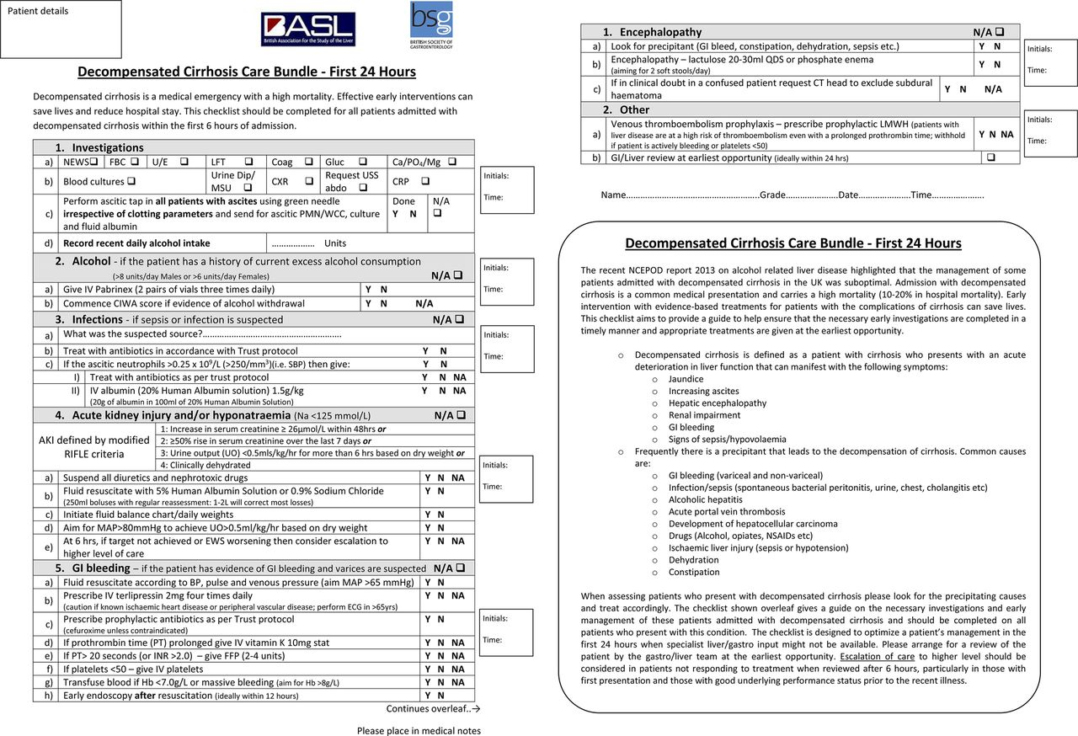

Slide 14
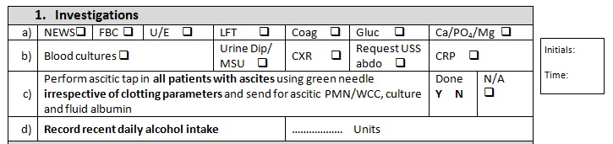
1) Investigations

Slide 15

2) Alcohol
Fixed dose as well as symptom triggered treatment in high risk patients
Use lorazepam instead of diazepam/chlordiazepoxide
  slower onset of peak effect but more rapid elimination as metabolism not impaired in liver disease
  10mg diazepam PO = 1mg lorazepam PO

Slide 16
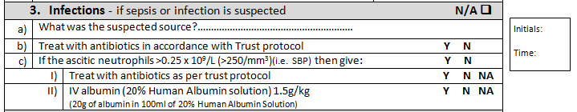
3) Infection

Slide 17

Ascitic Tap

Slide 18
If there is clinical ascites → tap it!
Do not need USS first if clinically detectable ascites
Tap regardless of clotting parameters
Takes maximum 5 minutes
Send ascites to micro:
  white top universal container (cell count & Gram stain)
  Blood culture bottles (C&S)
    Yield increases from 40% → 91%

Slide 19
Spontaneous Bacterial Peritonitis (SBP)
Neuts > 250 (or total WCC > 500) diagnostic
Treatment:
  Abx:
    IV amoxicillin 1g TDS and temocillin 2g BD (or IV ciprofloxacin 400mg bd and IV vancomycin if penicillin allergic)
  IV infusion salt poor albumin (100ml 20% albumin = 20g):
    1.5g/kg day 1
    1g/kg day 3
NNT = 5 to save 1 life (NEJM 1999)
Prophylaxis: long term prophylaxis indicated in patients with proven SBP
  Co-trimoxazole 480mg od
  Or Rifaxamin 550mg bd

Slide 20
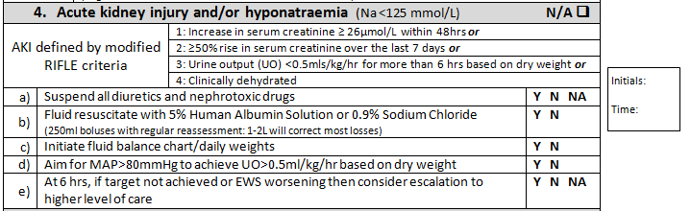
4) AKI/Hyponatraemia
Consider catheterisation

Slide 21
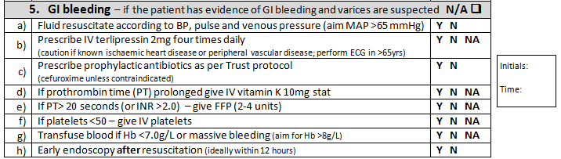
5) GI Bleeding
Antibiotic cover in GG&C:
  IV co-amoxiclav (ciprofloxacin if penicillin allergy)

Slide 22
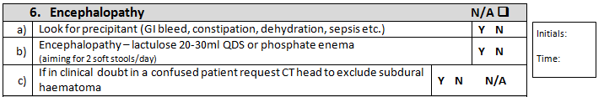
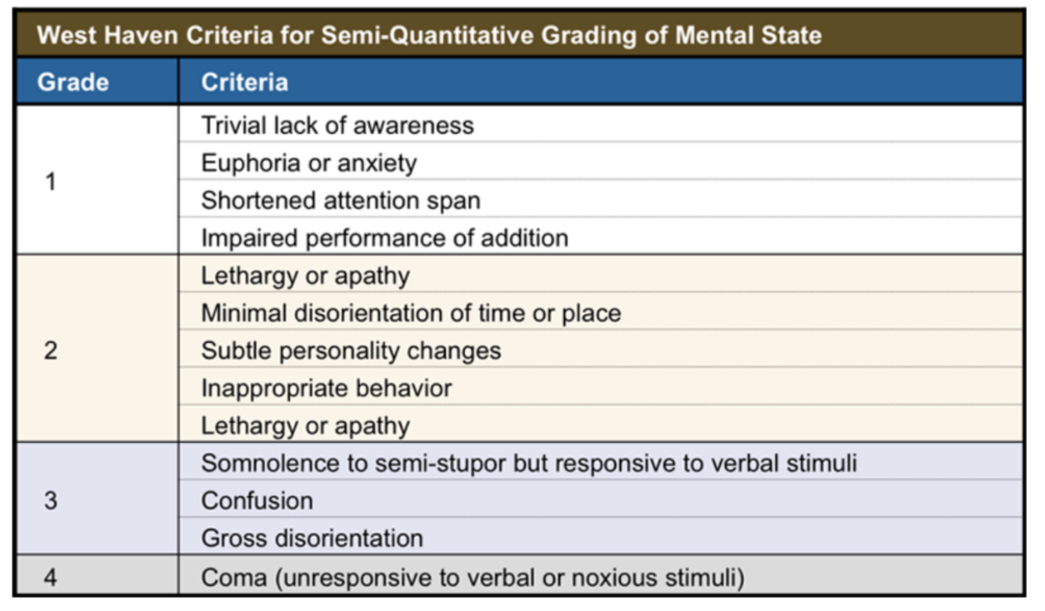
6) Encephalopathy

Slide 23
Pathophysiology not fully understood
  diseased liver doesn’t process blood effectively - number of toxins circulate
  collateral circulation often develops in context of portal hypertension – blood able to bypass liver without being metabolised
Lots of substances proposed as being implicated – most compelling evidence exists for ammonia
  colonic bacterial metabolism of protein/urea
  enters circulation via portal vein
  healthy liver clears majority of portal vein ammonia
    this mechanism fails in liver disease
    ammonia rises & reaches systemic circulation → crosses BBB → astrocytes → low level cerebral oedema
Arterial ammonia raised in 90% patients with HE

Slide 24
Consider rifaximin after 1st episode of HE (550mg bd)
  semi-synthetic derivate of rifamycin
  non-absorbed
  decreases intestinal production and absorption of ammonia
  prolongs remission & reduces hospital admission for HE

Slide 25

7) Other

Slide 26
Summary
Decompensated cirrhosis is common and carries high inpatient mortality
Early investigation and initiation appropriate therapy saves lives
  use BSG/BASL care bundle to guide initial Ix/Mx (aim to complete within 6h admission)
  print out bundle, complete & file in patient’s notes
  aim for GI review within 1st 24h admission
    For urgent (same day) GI review, contact on-call consultant via ARU (if in QEUH)
    Referral box on wall at nurses station in ARU 3 – aim to see within 24h

Slide 27
Liver Disease – Handy Apps/Webcasts
QEUH Gastro home page – via Staffnet
SSG: Digest This Webcasts
http://www.thessg.org/digest-this/digest
EASL: iLiver App
http://www.easl.eu/research/training-the-liver-study/easl-educational-tools/iliver-application
BSG: Gastroenterology Handbook: A Guide for Junior Doctors Based on the Ward
http://www.bsg.org.uk/sections/trainees-training/bsg-gastroenterology-handbook-a-guide-for-junior-doctors-based-on-the-ward.html

Slide 28
References
Public Health Information for Scotland: Chronic Liver Disease
http://www.scotpho.org.uk/health-wellbeing-and-disease/chronic-liver-disease/key-points
BSG – BASL Decompensated Cirrhosis Care Bundle – First 24 hours
http://www.bsg.org.uk/care-bundles/care-bundles-general/decompensated-cirrhosis-care-bundle-first-24-hours.html
BSG: Guidelines on the Management of Ascites in Cirrhosis (2006)
http://www.bsg.org.uk/images/stories/docs/clinical/guidelines/liver/ascites_cirrhosis.pdf

Slide 29
Thank you
Please fill out the feedback form for your certificate of learning

Slide 30
Get in touch!
Website
www.quackmeded.co.uk
Email
gg-uhb.quackmeded@nhs.net
Social Media
Twitter: @QUACK_ Med
Facebook: QUACK education

