Slide 1
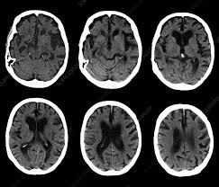
Dementia
Emily Wright
QEUH

Slide 2
Disclaimer*
Please note that QUACK is a regional teaching programme operating across GG&C, Lanarkshire and Ayrshire & Arran.
This presentation outlines general management, though local variances e.g. antibiotic prescription may vary slightly depending on your local trust
Remember to check your local guidelines

Slide 3
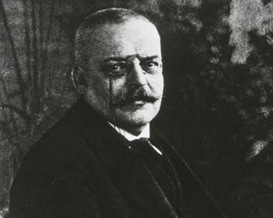
Dementia
Pathophysiology
Subtypes
Diagnosis
Management
Talking points

Slide 4
Defining Dementia
A progressive irreversible disorder causing impairment in one or more cognitive domains that is a decline from previous level of function of sufficient magnitude to cause difficulties in activities of daily living.
It affects 850,000 people in the UK. Prevalence is 1 in 16 adults over 65, rising to 1 in 6 people over 80

Slide 5
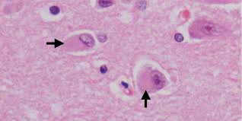
Pathophysiology of dementia
Depends on subtype
Alzheimer’s – 50-75% of cases
  Atrophy of cortex, amyloid plaque and neurofibrillary tangle formation causing reduction in acetylcholine production
Vascular – 20%
  Reduced blood supply secondary to large or small vessel disease
Lewy body dementia – 10-15%
  Cortical and subcortical formation of abnormal protein – Lewy bodies – in nerve cells

Slide 6
Pathophysiology of Dementia II
Fronto-temporal dementia – 2%
  Progressive degeneration of frontal +/- temporal lobes
Other less common causes
  CJD
  Normal pressure hydrocephalus
  Huntington’s disease
  Chronic sudural haematoma
  Neoplasia
  Infection e.g. HIV

Slide 7
Risk Factors
Age
Vascular risk factors
Genetics
  Mainly in rare syndromic subtypes
Physical activity
  A modifiable risk factor – regular physical activity, including walking, can reduce incidence by up to 40%
Loneliness
Excess alcohol
‘Use it or lose it’ – less likely in people with higher levels of cognitive stimulation
Mild cognitive impairment a ‘pre-dementia’ condition in 50%

Slide 8
Diagnosis
The patient may present to medical services with complaints of declining memory or function, those around them may have concerns or it may come to light during treatment for another health issue
A clinical diagnosis when other (reversible) conditions have been ruled out
Mimics include depression, delirium and anticholinergic drug burden

Slide 9
Diagnosis II - symptoms
Cognitive impairment
  Memory problems
  Language difficulties
  Apraxias – forgetting how to do familiar tasks
  Disorientation
Behavioural and psychological symptoms - BPSD
  Psychosis/delusional beliefs
  Stress and distress behaviours
  Disturbance of sleep/wake cycles
  Disinhibition
  Depression
Functional impairment

Slide 10
Diagnosis III – additional features in subtypes
Frontotemporal dementia
  Can present before age 65
  Typical personality change and behavioural dysregulation
Lewy Body dementia
  Hallucinations can occur
  Falls
  Memory impairment may be less pronounced
  Marked sensitivity to antipsychotics
Vascular dementia
  Classic ‘stepwise’ progression
  Possibly focal neurologic deficit

Slide 11
Diagnosis IV
Where dementia is suspected:
  The process should be patient-centred – what are their concerns and priorities?
  A validated form of cognitive testing should be carried out e.g. ACE III
    With more complex neuropsychiatric testing if indicated
  Appropriate investigations should be carried out to exclude reversible causes
    Blood tests
    Brain imaging, depending on patient CT head, MRI or SPECT might be preferred
  A collateral history should be obtained
    The IQCODE is a questionnaire completed by the relative which scores 16 common activities compared to how the person would have performed 10 years ago

Slide 12
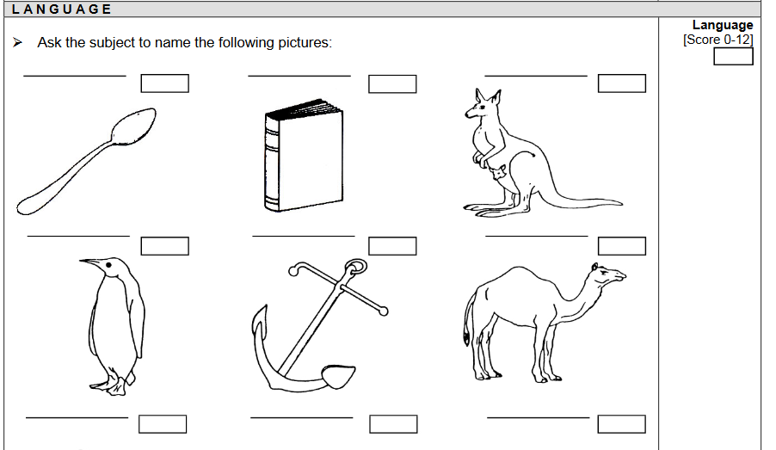
ACE - III

Slide 13
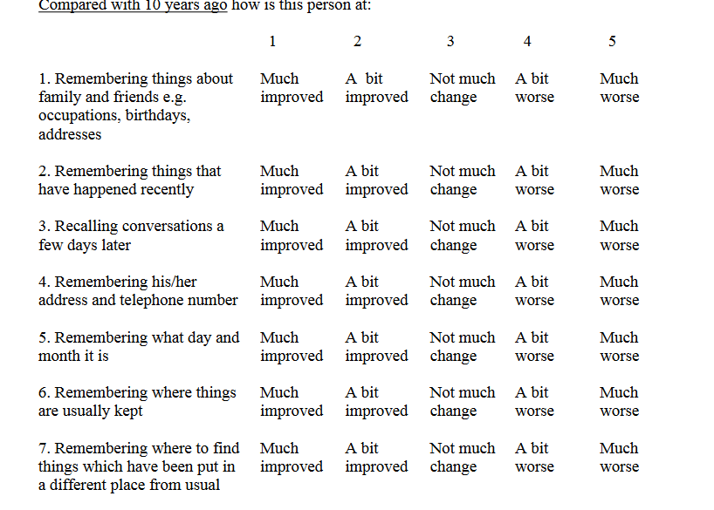
IQCODE

Slide 14
Management
Engagement with post-diagnostic support
  Resources, education, groups for patients, carer support
Encouragement of nominating POA and other elements of anticipatory planning
  Whilst the patient has capacity to engage in this
Limited role for cognitive enhancers – in Alzheimer’s these can slow progression but measurable effect is small
Monitoring and intervening where BPSD become problematic

Slide 15
Talking points
Do we think about dementia as a progressive incurable condition – ‘brain failure’?
  And is this helpful?
  Higher age-matched mortality rates in those with dementia
Is it inevitable?
  Ageing population, but improved vascular outcomes have reduced cases
  It’s not an inevitable part of ageing – even in the oldest group a minority are diagnosed with dementia - 41% of people over 95
  How do we challenge ‘senile’ stereotypes?
Controversy over cognitive enhancers
  France withdrew funding in 2018 to focus more resources in community support
Evidence from COVID pandemic that dementia is an independent risk factor for mortality

Slide 16
Dementia
Pathophysiology
Subtypes
Diagnosis
Management
Talking points

Slide 17
Bibliography
NICE guideline – Dementia 2019
Alzheimer’s UK website
NICE Clinical Knowledge Summary on Dementia available at https://cks.nice.org.uk/dementia
Office for National Statistics data on coronavirus

Slide 18
Thank you
Please fill out the feedback form for your certificate of learning

Slide 19
Get in touch!
Website
www.quackmeded.co.uk
Email
gg-uhb.quackmeded@nhs.net
Social Media
Twitter: @QUACK_ Med
Facebook: QUACK education

