Slide 1
Medicines, polypharmacy and continence in frail older people
Dr Aine McGovern
Consultant in Medicine for the Elderly
Glasgow Royal Infirmary

Slide 2
Disclaimer*
Please note that QUACK is a regional teaching programme operating across GG&C, Lanarkshire and Ayrshire & Arran.
This presentation outlines general management, though local variances e.g. antibiotic prescription may vary slightly depending on your local trust
Remember to check your local guidelines

Slide 3
Outline
Trends in medication prescription
Polypharmacy in frail elderly people
Practical advice re drugs and continence
Deprescribing
Case study
Summary

Slide 4
Why do we take drugs?
We are told to! We believe they will help us.
Informed Decision?
Appropriate medication will extend life expectancy and improve quality of life.
Medicine use should be optimised and prescribed according to best evidence.
Notes:
Otherwise we wouldn’t take them. But do people question why? Or what is the evidence behind it or the consequences? Generally not. Is it an ‘Informed’ decison?
That is if the medications are optimised and prescribed....and there is lots of good evidence for certain drugs
Patients’ beliefs about treatment influence treatment engagement and adherence.

Slide 5
We take more drugs than ever…
Aging population = increase no. drugs
  3 chronic diseases = 6 -13 drugs a day
  6 chronic diseases e.g. COPD, IHD, Osteoarthritis, Depression HTN and DM = 18 drugs a day
Healthy people taking preventative medication – increase awareness of health
Supplements – advertising / social media
Notes:
We are taking more drugs than ever! Why ?
Aging population - The proportion of older people in the UK is increasing. Estimates from the Office for National Statistics predict that by 2040, >75 years or older will have increased by nearly 90% to 10 million and the number >85 years or older will double to 3.6 million.) As you age , increase in no. of conditions, more conditions = more drugs …
Healthy people take more medication, primary prevention,
More awareness, herbal remedies
https://www.pharmaceutical-journal.com/news-and-analysis/features/deprescribing-the-fightback-against-polypharmacy-has-begun/20205686.article?firstPass=false
(1) Office for National Statistics, 2015. National population projections: 2014-based statistical bulletin [online]. Available: http://ons.gov.uk/ons/rel/npp/national-population-projections/2014-based-projections/stb-npp-2014-based-projections.html [Accessed 18 May 2016].

Slide 6
Prescribing medications are the most common clinical intervention in the NHS (1)
  Quadrupling in the number of people taking five or more medicines (from 12 to 49%).
  The number of people taking no medicines reduced from 1 in 5 to 1 in 13. (2)
One third of people aged over 75 now take at least six medicines, and over 1 million people now take 8 or more medicines a day. (3)
Notes:
Dramatic increase in use over the last two decades,…Quadrupling….
Although there is an increasing evidence base for many drug interventions. However, the evidence base for multiple interventions for several conditions in an individual patient is poor
National Institute for Health and Care Excellence. Medicines optimisation: the safe and effective use of medicines to enable the best possible outcomes. (NG5) 2015. https://www.nice.org.uk/guidance/ng5
Gao et al. Medication usage change in older people (65+) in England over 20 years: Findings from CFAS I and CFAS I. Age and Ageing. 47. 1-6
Health and Social Care Information Centre. Prescriptions dispensed in the community, statistics for England, 2004 – 2014. www.hscic.gov.uk/catalogue/PUB17644

Slide 7
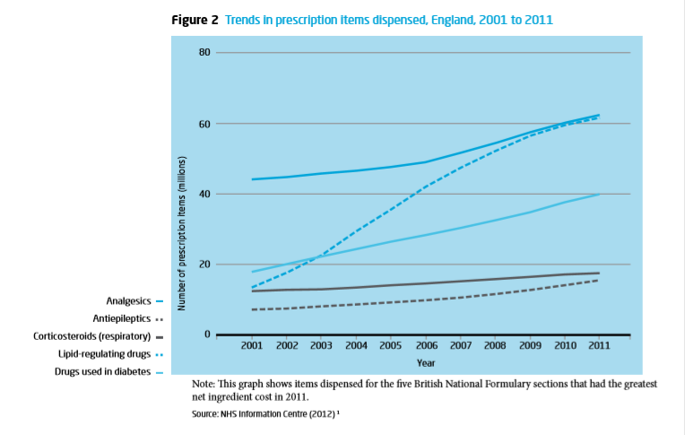
Trends in drug prescription
Notes:
This is a graph which shoes the trends in items dispensed in England over 10 years 2001 – 2011.
You can see all are in an upward trend. Steepest curve is for lipid-regulating drugs, ppl who have had a heart attack or those haven’t with HTN who want to avoid having one.
DM is also on the rise, due to the obesity epidemic and with that comes complications that require medications e.g. Neuropathy, nephropathy, HTN, Infections,

Slide 8
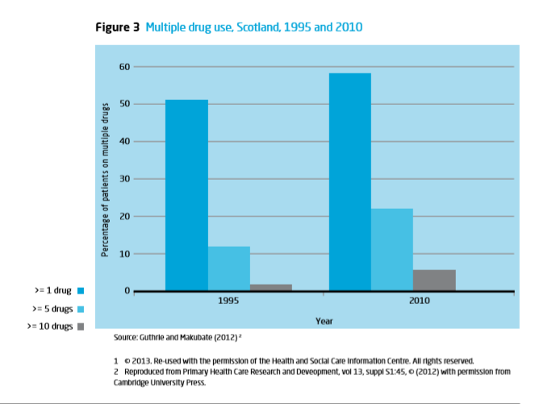
Trends in multiple drug use
Notes:
This graph compares the no. Of people on 1, >5 or >10 drugs from period of 1995 – 2010 in Scotland. All categories are increasing, can see >10 looks like its tripled

Slide 9

Although we have reasonable evidence for individual medications for individual conditions.....
but there is very little evidence correlating combinations of medicines or polypharmacy....
Notes:
And therein lies the problem...
We have multiple clinical guidelines based on single conditions, but what happens if you take all the medication recommended for the 6 chronic conditions? We don’t really know. How does that impact your frail elderly care home residents.

Slide 10
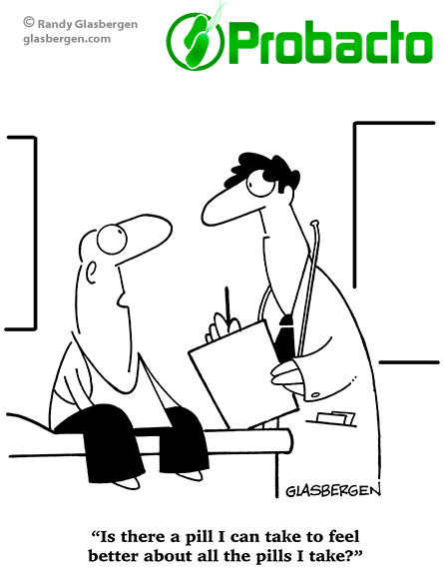

Slide 11
Polypharmacy
The concurrent use of multiple medication items by one individual.
In the past polypharmacy has been considered something to be avoided. It is now accepted that in many circumstances polypharmacy can be therapeutically beneficial
Appropriate polypharmacy
Prescribing for an individual for complex conditions or for multiple conditions in circumstances where medicines use has been optimised and where the medicines are prescribed according to best evidence.
Problematic polypharmacy
The prescribing of multiple medicines inappropriately, or where the intended benefits of the medicines are not realised.
Notes:
So what is Polypharmacy? Well, Polypharmacy is an expression that has been commonly used for many years in medicine. It used to be defined numerically ( more than 4, more than 10, more than 15). This old numerical approach does not consider the appropriateness of medications. So I would define it as the concurrent use of multiple....
In the past it was felt to be bad.. As i said at the start, there is good evidence for lots of drugs.
NICE uses the definitions of appropriate and problematic polypharmacy which were proposed in the King's Fund report on the subject of polypharmacy and medicines optimisation

Slide 12
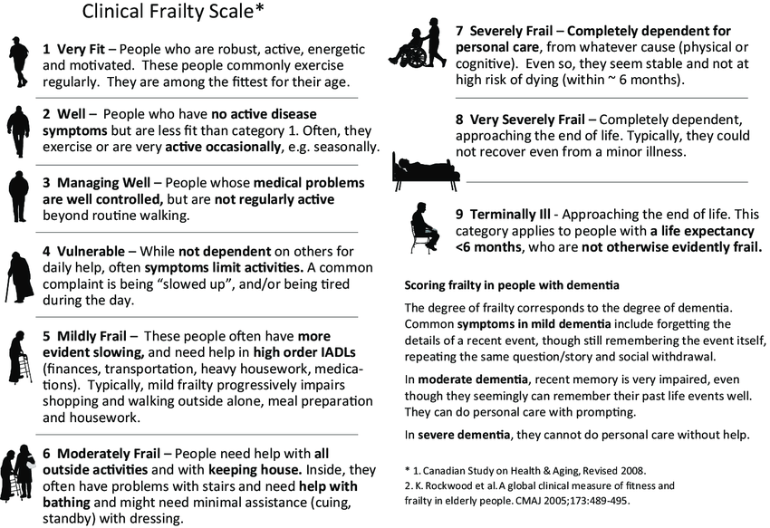
Frailty
Notes:
When prescribing medications it is all well and good to follow guidelines, important to be aware that the best evidence available to produce guidelines is often based on studies of younger fitter people.
Therefore the results are sometimes not applicable to the frail elderly patient that you look after, as geriatricains we are well aware of this and we tailor our prescriptions. I am not sure if that is true for the average cardiologist. Frailty is hallmarked by multi morbidity, or vice versa.
You will all look after patients from 5 up, and mainly probably 7 or 8. So I want to focus on polypharmacy in this group of individuals.

Slide 13
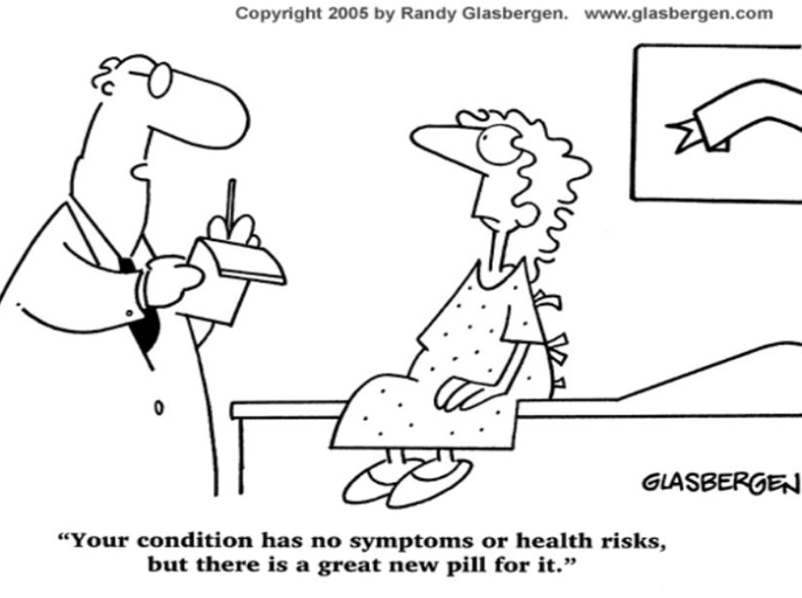
Problematic polypharmacy in frail elderly
Patient burden
Nurse/doctor burden
Cost to NHS
Harm
Notes:
So when is polypharmacy promblematic in the frail elderly patient?
This is a summery of issues arising from promblematic polypharmacy and i will touch on them each in more detail briefly now...
A person taking ten or more medications is 300% more likely to be admitted to hospital. Payne RA et al. Is polypharmacy always hazardous? A retrospective cohort analysis using linked electronic health records from primary and secondary care. British Journal of Clinical Pharmacology 2014; 77: 1073 – 1082.
(1) Most clinical trials focus on single interventions in people who have been chosen because they are not frail or old and have relatively few comorbidities. However, this is not representative of routine clinical practice and the impact of combining multiple interventions is rarely examined
(2) However, because of concerns about frailty, some drugs, which with careful monitoring would be safe to use, are sometimes inappropriately omitted (e.g. ACE inhibitors in heart failure).(1) (1) British Geriatric Society, 2014. Fit for Frailty [online]. Available: http://www.bgs.org.uk/index.php/fit-for-frailty [Accessed 18 May 2016].
Any use of over-the-counter drugs, herbal products, vitamins and mineral supplements may compound the problem.

Slide 14
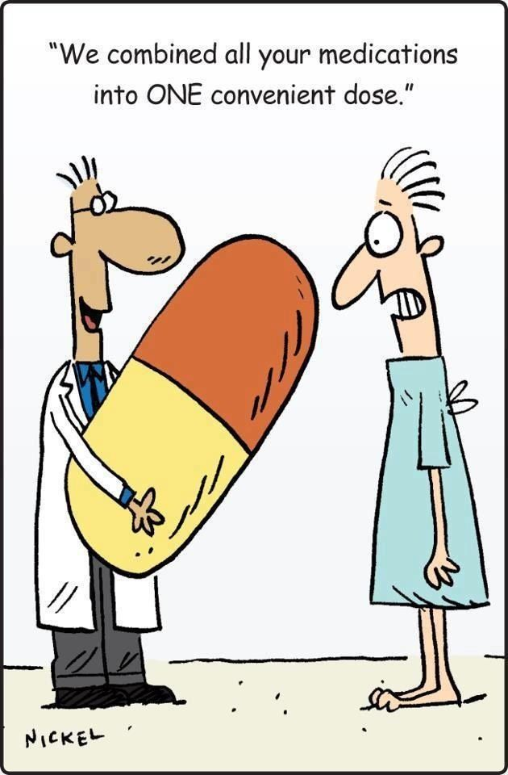
Patient, nurse, doctor burden and cost
It is increasingly recognised that the burden related to the time and effort required to organise complex medication regimens can have a significant impact on a patient's quality of life; Stress, Anxiety.
In addition, there may be considerable potential for medication errors due to confusion over regimens, poor dexterity or problems with vision.
Time taken for drug rounds, restocking medication trolley, ordering, monitoring
Notes:
It is increasingly recognised....
In addition to this, if the regimes are complex, more likely to have medication errors. Dexterity and poor vision can also interfere
How long do you spend in the care home on your drug rounds, restocking, ordering
Mohammed AM, et al
. Medication-related burden and patients' lived experience with medicine: a systematic review and metasynthesis of qualitative studies. BMJ Open 2016; 6: e010035.
Google Scholar
↵Mair FS,
May CR
. Thinking about the burden of treatment. BMJ 2014; 349: g6680

Slide 15
Cost…
Medication errors cost the NHS up to £2.5bn a year (1)
The cost of medicines in England in 2013 exceeded £15 billion
In 2013, over 1 billion prescription items were dispensed in the community in England. This is an average of 2.7 million items every day.
Estimated national figure of pharmaceutical waste to be £300 million.
This includes an estimated £90 million worth of unused prescription medicines that are retained in individuals’ homes at any one time, £110 million returned to community pharmacies over the course of a year, and £50 million worth of NHS supplied medicines that are disposed of unused by care homes. (2)
Notes:
Some figures...
...can you imagine what we could do with all that money if it wasn’t wasted...
The report, ‘Exploring the costs of unsafe care in the NHS’, published by Frontier Economics on 16 October 2014, assessed the potential costs in two ways: by adding up the documented costs of preventable adverse events; and by estimating the proportion of all care resulting in an adverse event.
The 2010 report Evaluation of the Scale, Causes and Costs of Waste Medicines produced
by York Health Economics Consortium and School of Pharmacy University of London

Slide 16
Harm…
Around 6.5% of all hospital admissions are for adverse effects of medicines
In patients 65 years and older, 10-20% of admissions due to adverse effects of medicines.
Interactions
      Drug drug
      Drug disease
      Prescription cascade
      Drug physiology
Notes:
Lets talk about harm to our patients...Around 6.5%...
Potential harm can happen in a few ways through interactions, adverse events and non-adherence.
There are different types of harm that I will briefly touch on that are particularly important to be aware of in your frail care home residents who require interventions to be tailored to their individual needs rather than strictly following guidance designed to manage single diseases.
.¹
The King's Fund 2013. Polypharmacy and medicines optimisation: making it safe and sound [online]. Available: http://www.kingsfund.org.uk/publications/polypharmacy-and-medicines-optimisation [Accessed 18 May 2016] Polypharmacy may be harmful in that it can increase the risk of drug interactions and adverse drug reactions, together with impairing medication adherence and quality of life for patients
(2) Pirmohamed et al. Adverse drug reactions as cause of admission to hospital perspective analysis of 18,820 patients. British Medical Journal 2004; 329:15.

Slide 17
Drug drug interactions
The effects of one drug is changed by the presence of a concomitant drug e.g. Becomes more potent or cancels it out
Warfarin and NSAIDS / metrondiazole / statins / Clairthromycin = bleed
Digoxin and clairthromycin / antifungals = dig toxic
Theophylline and Ciprofloxacin = theophyline toxic
Carbamazepine and Clairth/erythromycin = toxic levels carbamazepine
Tamoxifen and Fluoxitine = Decreased clinical effectiveness of tamoxifen
Cholinesterase inhibitors e.g. donepezil) and anti-cholingerics e.g. amitriptyline – cancel out
Metoclopramide and cyclizine – cancel out
Notes:
Warfarin interacts with everything – With NSAIDS, not only just increase risk of bleeding but in some individuals NSAIDs may actually alter the pharmacokinetics of warfarin and increase the INR. Metrondiazole, statins and clairthromycin all increase potency/concentration of warfarin and risk of bleeding.
Digoxin and clairthromycin/antifungals - Increased digoxin concentrations and risk of digoxin toxicity
Theo...
Carbo...
Tamoxifen...
Other drugs cancel each other out e.g. Cholinesterase inhibitors in dementia, where we want to increase the amount of ACH floating about and therefore reduce its breakdown by the enzyme cholinestearse so inhibit this enzyme but then we use anti-cholinergics that reduce the ACH.

Slide 18
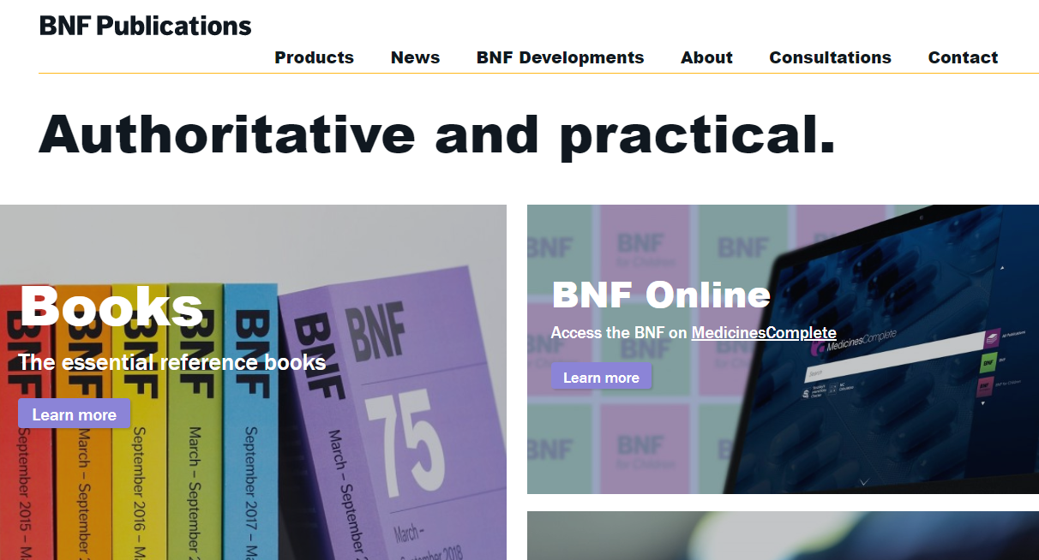
The BNF is your friend
Check ‘interactions’
Notes:
Always check the BNF!

Slide 19
Drug disease interactions
This is when a medication can make the management of another disease more difficult
NSAIDS e.g. Ibuprofen, diclofenac can make hypertension worse.
Calcium channel blockers e.g. Verapamil in patients with congestive heart failure
Bblockers e.g. Bisoprolol make COPD or Asthma worse
Trimethoprim and diuretics makes chronic kidney disease worse
Notes:
NSAIDS - ibuprofen
First generations calcium channel blockers e.g. Verapamil
Bblockers e.g. Bisoprolol
TMP make chronic kidney disease worse

Slide 20
The BNF is your friend
Check ‘contra-indications’
Notes:
Always check the BNF!

Slide 21
Prescribing cascade
Prescription cascade refers to the process whereby the side effects of drugs are misdiagnosed as symptoms of another problem resulting in further prescriptions and further side effects and unanticipated drug interactions.
Pain
HTN
Ace I
NSAIDS
Amilodpine
cough
GI upset
Swollen ankles
Inhaler
PPI
Furosemide
Thursh
Diarrhoea
Sando K
antifungal
With any new symptom/compliant ALWAYS THINK COULD THIS BE MEDICATION SE OR INTERACTION?
Notes:
A patient has a significant increase in pain and begins to take over the counter NSAIDs to help alleviate the new pain. After using the NSAID for a few days to weeks, the patient begins experiencing troublesome GI upset and heartburn type symptoms leading to an Rx of an H2 blocker of PPI. PPI
A patient has worsening hypertension that requires the Rx of Amlodipine. Following the amlodipine Rx, the patient begins developing troublesome edema that requires the addition of furosemide. Furosemide causes drop K+ therefore sando k. Or can effect the kidneys
Or…Ace I – cough – inhaler- thrush – antifungal
ALWAYS THINK; COULD THIS BE MEDICATION SE?

Slide 22
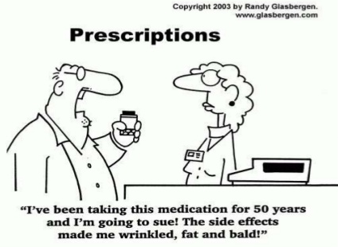
Drug physiology
Frail elderly patients more vulnerable because their physiology is altered
Absorption
Distribution
Metabolism
Elimination
Notes:
Absorption: Increased Gastric pH (sometimes due to medications such as proton pump inhibitors) due to atrophic gastritis. Decrease in gastric emptying.
Distribution: Probably the main physiological change that occurs with ageing that leads to adverse drug reactions.
Increase in body fat and decrease in body water (as a proportion of total body weight).
Volume of distribution of fat soluble drugs increases so medications such as benzodiazepines accumulate, so can still have an effect a long time after the medication has been stopped.
Volume of distribution of water soluble drugs is decreased so water soluble drugs e.g. such as digoxin need a reduced loading dose.
Metabolism
Reduced hepatic blood flow can reduce clearance of medications that have high hepatic excretion ratio e.g. Amitryptiline.
Elimination/Kidneys
As people age there is a reduction in renal mass and renal blood flow. eGFR decreases by 0.5% a year after age 20.
Affects clearance of water soluble drugs such as diuretics, digoxin and NSAIDs.

Slide 23
More practical tips about medications
Which drugs cause....
Urinary retention
Constipation
Diarrhoea
Urinary incontinence
                …and why?
Notes:
So to specifically now talk about side effects of drugs...whether you are on 15 drugs or just this one drug you can get the side effect.
Useful to know while you look after the care home patients

Slide 24
Drugs that cause urinary retention
Decreasing the force of the bladder detrusor contractions
  Antimuscarinics - Tiotropium and ipratropium. Solifenacin.
  Antipsychotics – chlorpromazine, clozapine, risperidone
  Antihistamines - chlorphenamine
Inducing smooth muscle relaxation
  Benzodiazepines – Diazapam, lorazapm
  Beta-adrenoceptor antagonists – propranolol, carvidolol
Inhibition of prostaglandin-mediated smooth muscle contraction
  NSAIDS – diclofenac, ibuprofen. Not aspirin
Notes:
Elderly patients are at higher risk for developing drug-induced urinary retention, It is estimated that up to 10% of acute urinary retention is drug-induced. ⁽¹⁾ And then in addition to that elderly men often have pre-existing co-morbidities such as benign prostatic hyperplasia which increases the risk.
Constipation is a major cause of urinary retention that elderly ppl are more prone to. We will talk about drugs that cause constipation next.
(1)Verhamme K, Sturkenboom M, Stricker B, Bosch R. Drug-induced urinary retention – Incidence, management and prevention. Drug Saf. 2008:31(5):373-88
Mechanism by which medications cause it include
decrease….antimuscarinics e.g. tiotropium/Ipratropium used in COPD, asthma. Even medication used to treat overactive bladder by relaxing the detrusor e.g. solfenacin. Others that relax bladder inc. antipychotics e.g. chlorpromazine, clozapine, risperidone. And sedating antihistamines, chlorphenamine
Benzodiazepines can cause urinary retention due to their muscle relaxant effects. Non cardio-selective beta blockers
Prostaglandins provoke contractions of the detrusor muscle. NSAIDs inhibit prostaglandin synthesis and therefore can relax the detrusor muscle, disrupting this process. Men using NSAIDs are twice as likely to experience acute urinary retention.^{1,3} The risk is not associated with aspirin, probably due to the low doses used for cardiovascular indications.³

Slide 25
Drugs that cause constipation
Opioid analgesics – MST, Oramorph, tramadol
NSAIDS– Ibuprofen, diclofenac
Antacids – sucralfate,
Anticholinergic effects – PD medications, antypschyotocs
Calcium-channel blockers – Amilodipine, verapamil, nifedipine
Diuretics - furosemide
Iron – ferrous fumerate or sulphate
5-HT₃ -receptor antagonists – Ondansetron,
Notes:
Constipation leads to urinary retention….by itself can also be troublesome and is a cause of delirium. As geriatrians we are obsessed with bowels.
Main culprit mediacations include
Opioids - Opioids cause constipation via several different mechanisms;
they reduce intestinal motility;
intestinal secretion;
increases intestinal fluid absorption.
Also believed to decrease the urge to defaecate by interfering with the rectoanal inhibitory reflex, which relaxes the internal anal sphincter.⁵
Estimates suggest that 40 to 90% of patients taking opioids develop constipation and other gastrointestinal adverse effects. If on an opioid, should be on a laxative.
2) NSAIDS - NSAID-Decrease in mucous secretion and gastrointestinal smooth muscle contraction results in constipation.
3) Antacids - Aluminium- and calcium-containing antacids (including sucralfate) can cause constipation and (in large doses) intestinal obstruction. Note the magnesium containing antacids cause diarrhoea
4) Drugs with anticholinergic effects exert an inhibitory effect on the parasympathetic branch of the autonomic nervous system. This results in a reduction in the tone and motility of the gastro-intestinal tract, leading to constipation.
5) Though the exact mechanism is unknown, calcium-channel blockers are suggested to cause constipation by reducing intestinal motility (particularly of the colon) resulting in an increased transit time and subsequent increase in fluid absorption.
6) Because diuresis dehydrates the body, it results in increased intestinal fluid absorption from the gastrointestinal tract. This increased fluid absorption can lead to faeces becoming congealed and impacted, thus causing constipation.
7) Iron salts can cause both constipation and diarrhoea. The mechanism by which constipation occurs is possibly through alteration of intestinal bacteria.
8) As a neurotransmitter of the brain-gut axis, serotonin regulates several functions within the gastrointestinal tract. Ondansetron and other 5-HT₃-receptor antagonists cause constipation by delaying gastrointestinal transit time through their action on 5-HT₃-receptors in the intestines.¹²

Slide 26
Drugs that cause diarrhoea
Osmotic diarrhoea - Artificial sweeteners, Magnesium-containing compounds e.g. Antacids, Mag Sulphate
Secretory diarrhoea – Digoxin, Prostaglandins
Motility diarrhoea - laxatives! Senna
Inflammatory diarrhoea - Antineoplastic drugs
Impaired digestion - Alpha-glucosidase inhibitors, Orlistat
Multiple mechanisms– antibiotics, Colchicine, Iron, NSAIDS
Unknown mechanisms – Metformin, lithium
Notes:
Acute diarrhoea—lasting less than 14 days
Persistent diarrhoea—lasting from 14 days to 4 week
Chronic diarrhoea—lasting for more than 4 weeks
The four main types of drug-induced diarrhoea are
osmotic - when the drug causes water to be drawn into the intestine¹
Secretory – balance of secrections and absorptions altered and there are excess of secretions. Digoxin affects sodium K+ pumps. Which is why at toxic drug levels and in elderly patients get diarrhoea
Motility - Drugs that increase or decrease intestinal motility
Inflammatory - occurs as a result of disruption of the epithelium of the intestinal lining
Impaired digestion - may cause diarrhoea by altering intestinal microflora, ⁵ or through malabsorption or maldigestion of fat or carbohydrate.⁵
Multiple mechanisms - Between 2 and 25% of patients taking antibacterials are estimated to develop antibiotic-associated diarrhoea.¹⁶ is overgrowth of the toxin-producing bacterium Clostridium difficile.¹⁸ Iron salts are best known for causing constipation but can also cause diarrhoea, Approximately 3% to 9% of patients taking an NSAID present with diarrhoea.¹

Slide 27
Drugs causing UI theoretically…
In principle, drugs could cause incontinence by lowering bladder outlet resistance and/or by increasing bladder pressure
Or drugs could cause disturbances of central nervous control of voiding or an overproduction of urine.
Evidence demonstrating a cause-effect relationship between drug usage and incontinence is sparse.
Most common situation is that drugs indirectly cause urinary incontinence
Notes:
…which disrupts the normal pressure relationship between the bladder and urethra and leads to urinary leakage…
…BUT… While many drug groups could theoretically induce urinary incontinence based upon pathophysiological considerations
https://www.uspharmacist.com/article/druginduced-urinary-incontinenceα₁-adrenoceptor antagonists, antipsychotics, benzodiazepines, antidepressants and hormone replacement therapy in postmenopausal women. However, other drug classes are not innocent in terms of causing urinary incontinence and physicians are well advised to closely monitor patients for the occurrence of incontinence after new prescriptions and/or major dosage changes

Slide 28
Drug causes of Urinary Incontinence
DRUG | MECHANISM | EFFECT
Ace - i | cough | Stress I
Alcohol | Increase urine volume, altered mental state | Freq, nocturia
Ca channel blockers –nifedipine | relax bladder, constipation | Overflow, Urinary retention
Anticholenergics | relax bladder | Overflow, retention
Antipsychotics | relax bladder, impaired mobility, sedation | Overflow, functional, retention
Caffine | Diuresis | Freq, nocturia, Urge I
Diuretics | Diuresis | Freq, urge, polyuria, Urge I
Cholinesterase inhibitors | Increase detrusor activity | Urge I
Lithium | polydipsia, nocturia | Urge I
Opiods | Confusion, constipation | Overflow, retention, functional
SSRIs – citalopram, sertraline | Increase detrusor activity | Urge I
Theophylline | Diuresis | Urge I
Notes:
This is a list of mainly theoretical indirect causes of UI. Many drugs make continence issues worse rather than directly cause the incontinence
E.G ace – I common 1 in 10 side effect is a cough, if prone to stress incontinence or weak pelvic floor this will be made worse.
E.G. diuretics and caffine don’t directly cause incontinence, but if you are passing and producing a lot of urine during the day and prone to stress or urge incontinence this will be made worse.
Opiods / morphine cause consitpation which can make urge sypmtoms worse and therefore cause Urge UI, or can cause urinary retention, which can cause overflow incontinence
Any drug that causes constipation can make urge symptoms worse
There is some evidence that SSRIs can directly cause Urge incontinence

Slide 29
The BNF is your friend
Check ‘side-effects’
Notes:
Always check the BNF!

Slide 30

The Top Ten!
The most common medicine groups associated with admission to hospital due to adverse drug reactions were:
NSAIDs 29.6%
Diuretics 27.3%
Warfarin 10.5%
ACE inhibitors 7.7%
Antidepressants 7.1%
Beta-blockers 6.8%
Opiates 6.0%
Digoxin 2.9%
Prednisolone 2.5%
Clopidogrel 2.4%
Notes:
So, we have spoken about drug-drug interactions, drug – disease interactions, prescription cascade, side effects and all the ways in which drugs can cause harm. And this is a list from a good study that showed the top ten offenders.
Not sure if you are surprised or not by the top 3 after what we have said and your own experience? These are the drugs that when you see in a patients kardex you need to think about.
https://www.ncbi.nlm.nih.gov/pubmed/15231615

Slide 31
What can you do?
Question every drug. What is it for? Is it needed? Is it working? Is it always being given? If not, why? Can we stop it?
Question every symptom. Is this a side –effect? Could there be an interaction?
Keep Bowel and bladder charts for every patient

Slide 32
Deprescribing
Deprescribing is a collaborative process, with the patient and/or their carer, to ensure the safe and effective withdrawal of medicines that are no longer appropriate, beneficial or wanted, guided by a person-centred approach and shared decision-making.​​
It is based on the patients physical functioning, co-morbidities, preferences and lifestyle.
It is not about denying medication. It’s about reducing harm and the use of unnecessary medicines.
Notes:
Deprescribing is the process of safe and effective cessation (stopping) of inappropriate medication. It recognises that much of the evidence to support stopping medicines is empirical.

Slide 33
People need to be supported to make an informed decision.
Some people do not have capacity to make decisions about their treatment. Their relatives should be involved in the decision-making process.
There should be clear documentation of the changes made, the reasons and any monitoring required.
There needs to be effective communication with all relevant parties. E.g. Community pharmacy, the staff responsible for ordering medication, GP’s

Slide 34
Barriers to Medicines optimisation or Deprescribing
Concern from clinicians to discontinue medications started by another provider
Time expenditure
Fear of drug-withdrawal side effects
Lack of resources
Resistance from patients or family members
Fear of losing patient-provider relationship
Notes:
Time – easier to not stop and think
‘drug withdrawal’
Lack of resources – pharmacy advice / GP availability
Resistance – goes back to belief

Slide 35

Case Study
Norman
Elderly care home resident
Dementia
Poor mobility – falls risk
Dis-engaged
Episodes of agitation / aggression
Care home staff did a medication and behaviour audit review.
What meds where patients on?
Did it need to be there?
Is there a benefit?
If not getting it, why?

Slide 36
Medications included ; Senna nocte and Movicol bd
Month one
17 episodes of loose stool
4 episodes agitation/aggression
7 episodes on ABC charts
2 falls
Intervention
GP stopped senna
Continued movicol

Slide 37
Month two
8 episodes unformed loose bowel movements
4 episodes agitation / aggression
1 fall
No ABC charts
Intervention
Stop movicol now

Slide 38
Month three
2 episodes of loose/unformed stool
3 falls
No episodes agitation/aggression
No ABC charts
Month four
No loose stool
1 fall
No episodes agitation/aggression
No ABC charts

Slide 39

Outcome
Happier Norman
Happier staff – reduced workload
Saving ££ for NHS
Less Harm and distress
Building relationships with GPs

Slide 40
Conclusion
Question every drug. What is it for? Is it needed? Is it working? Is it always being given? If not, why?
Question every symptom. Is this a side –effect? Could there be an interaction?
Ask medical staff to justify prescriptions
Remember the BNF is your friend
Keep bowel and bladder charts for all patients
Deprescribing is a team effort including patient/family
Support residents to make informed decisions

Slide 41
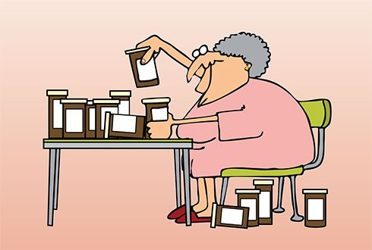
Questions?
Aine.mcgovern@ggc.scot.nhs.uk

Slide 42
Thank you
Please fill out the feedback form for your certificate of learning

Slide 43
Get in touch!
Website
www.quackmeded.co.uk
Email
ggc.quackmeded@nhs.scot
Social Media
Twitter: @QUACK_ Med
Facebook: QUACK education

