Slide 1

COPD Update
Dr Manish Patel
University Hospital Wishaw

Slide 2
Disclaimer*
Please note that QUACK is a regional teaching programme operating across GG&C, Lanarkshire and Ayrshire & Arran.
This presentation outlines general management, though local variances e.g. antibiotic prescription may vary slightly depending on your local trust
Remember to check your local guidelines

Slide 3
Learning Outcomes
Lanarkshire COPD guidelines – concentrating on new inhaled therapies
Clinical cases

Slide 4
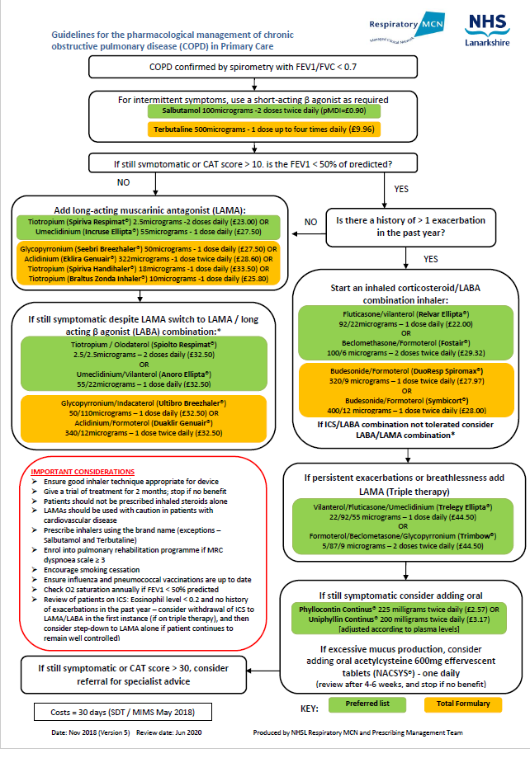

Slide 5
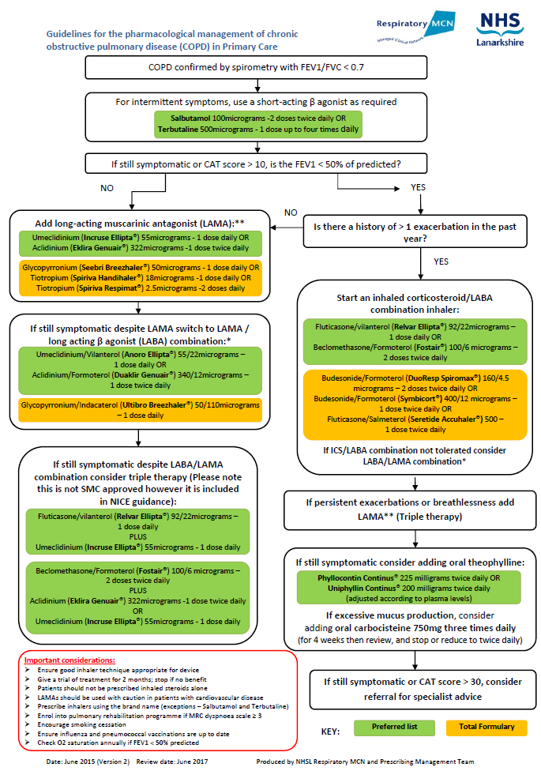

Slide 6
London Respiratory Team – COPD ‘value’ pyramid
Triple
Therapy
£7,000
- £187,000/QALY
QALY = quality-adjusted life year
LAMA or LABA
£5,000 - £8,000/QALY
Pulmonary Rehabilitation
£2,000 - £8,000/QALY
Non-pharmacological interventions are highly cost
effective
Stop Smoking support with pharmacotherapy
£2,000/QALY
Flu vaccination in at-risk population
£1,000/QALY
3. Pyramid adapted from: NHS Outcomes Strategy for COPD & Asthma 2012

Slide 7


How easy is it to maintain
good inhaler technique?
Some skills are learned once
and remembered for life…
Others need constant review
and re-training
Previous ability to correctly use an inhaler is not indicative of correct use during subsequent testing¹⁰
10. Crompton G et al. Respiratory Medicine; 2006; 100, 1479–1494

Slide 8
Train the trainers?⁵
Few healthcare professionals have sufficient knowledge of inhaler techniques to educate their patients effectively in their use
Number of HCPs in study=150
Inhaler evaluated: pMDI placebo Inhaler
5. Baverstock M, et al. Thorax 2010; Vol 65 Suppl 4. A118

Slide 9
Next Question ?
Exacerbation history

Slide 10

Global Strategy for Diagnosis, Management and Prevention of COPD
Combined Assessment of COPD
4
≥2
or ≥1 leading
to hospital admission
(C)
(D)
3
Risk
(GOLD classification
of airflow limitation)
Risk
(Exacerbation history)
1 (not leading to hospital admission)
2
(A)
(B)
1
0
CAT <10
CAT ≥10
Symptoms
mMRC 0–1
mMRC ≥2
Breathlessness
© 2014 Global Initiative for Chronic Obstructive Lung Disease
GOLD, Global initiative for chronic Obstructive Lung Disease;
mMRC, modified Medical Research Council Dyspnoea Scale
References:
GOLD. Global Initiative For Chronic Obstructive Lung Disease (GOLD): Teaching Slide Set. Available at http://www.goldcopd.org (Accessed December 2014)
10

Slide 11
Case 1
72 year old ex-smoker
Moderate airflow obstruction (FEV1 60%)
Salbutamol MDI PRN
Inhaler technique satisfactory
1 exacerbation in the last year
Rehabilitation programme & vaccinations up to date
Still symptomatic (CAT > 10) breathless MRC > 2

Slide 12
Medical Research Council Dyspnoea Scale⁴
Grade | Description of Breathlessness
1 | Not troubled by breathlessness except on strenuous exercise
2 | Short of breath when hurrying on the level or walking up a slight hill
3 | Walks slower than most people on the level, stops after a mile or so, or stops after 15 minutes walking at own pace
4 | Stops for breath after walking about 100 yds or after a few minutes on level ground
5 | Too breathless to leave the house, or breathless when undressing
4. Adapted from Fletcher C. M. (1952). Pro R Soc Med ,45, 577-584.

Slide 13
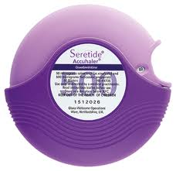
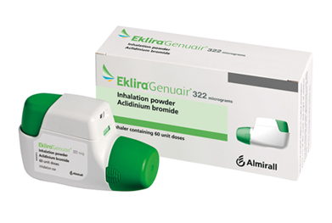
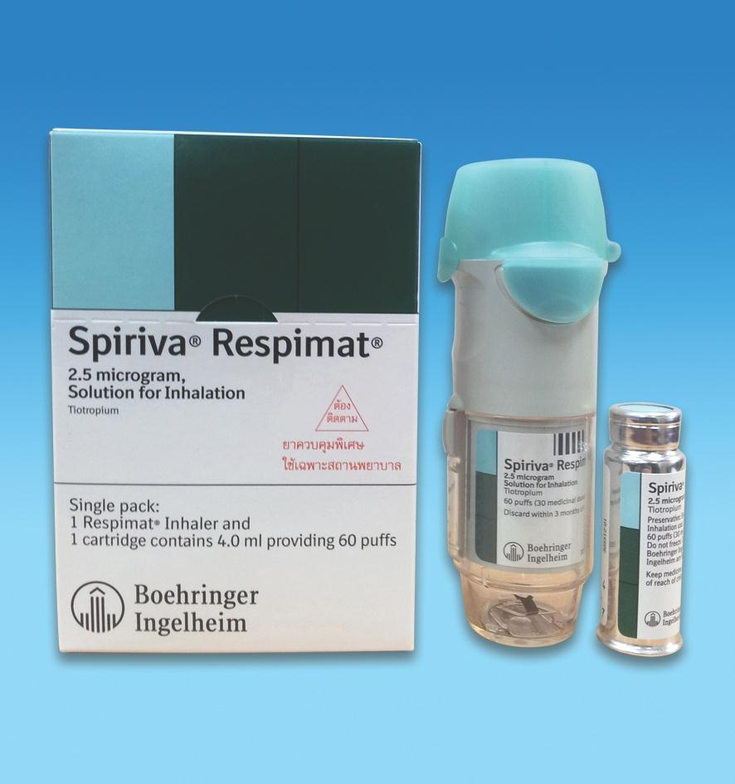
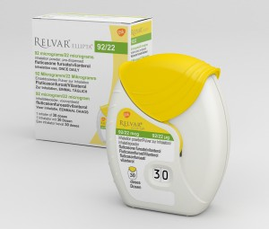
Next step
Notes:
Aclidinium
Respimat

Slide 14
Inhaler Technique Patient preference
4
≥2
or ≥1 leading
to hospital admission
(C)
(D)
3
Low risk, high burden
Risk
(GOLD classification
of airflow limitation)
Risk
(Exacerbation history)
1 (not leading to hospital admission)
2
(A)
(B)
1
0
CAT <10
CAT ≥10
Symptoms
mMRC 0–1
mMRC ≥2
Breathlessness

Slide 15
Case 1
Inhaler technique checked
Aclidinium commenced
2 months later – no benefit

Slide 16
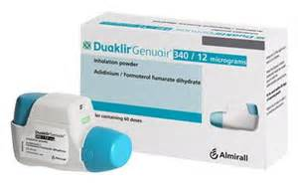
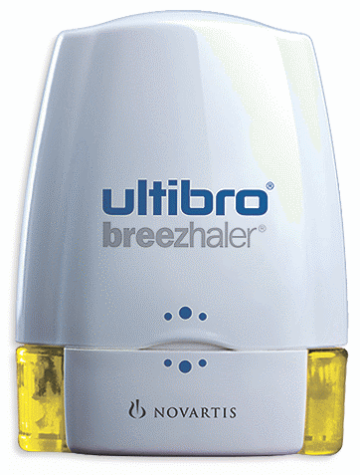
Next step

Slide 17
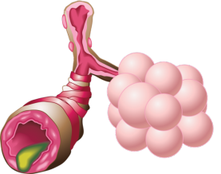
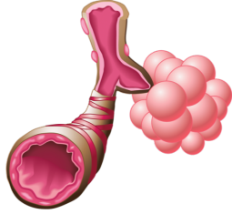
Bronchodilators

Slide 19
Case 2
72 year old ex-smoker
Severe airflow obstruction (FEV1 40%)
Salbutamol MDI PRN
Inhaler technique satisfactory
3 exacerbation in the last year
Rehabilitation programme & vaccinations up to date
Still symptomatic (CAT > 10) & breathless MRC > 2

Slide 20
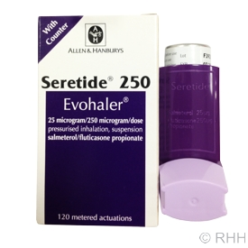
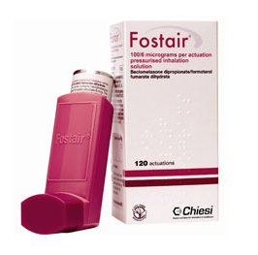
Next step
Notes:
Seretide evohaler

Slide 21
4
≥2
or ≥1 leading
to hospital admission
(C)
(D)
3
High risk, high burden
Risk
(GOLD classification
of airflow limitation)
Risk
(Exacerbation history)
1 (not leading to hospital admission)
2
(A)
(B)
1
0
CAT <10
CAT ≥10
Symptoms
mMRC 0–1
mMRC ≥2
Breathlessness

Slide 22
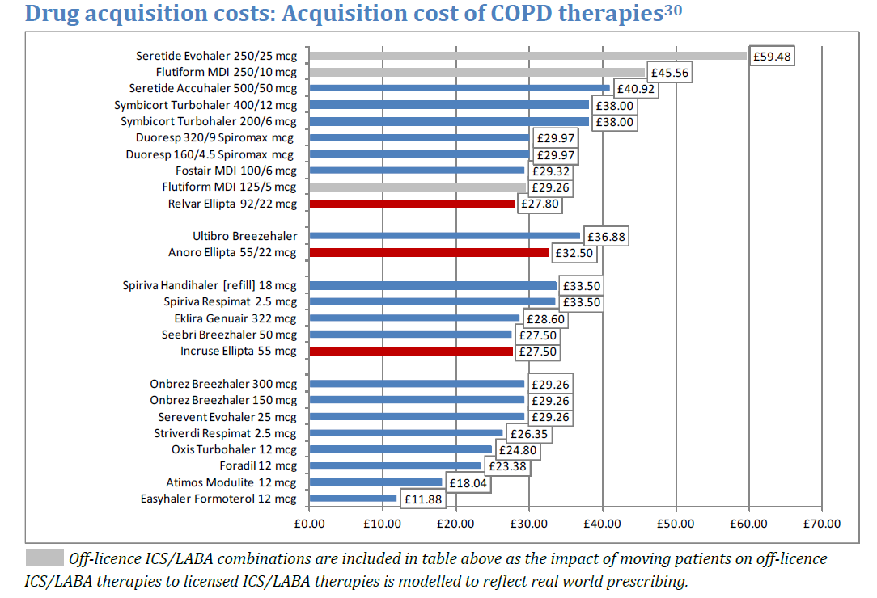

Slide 25
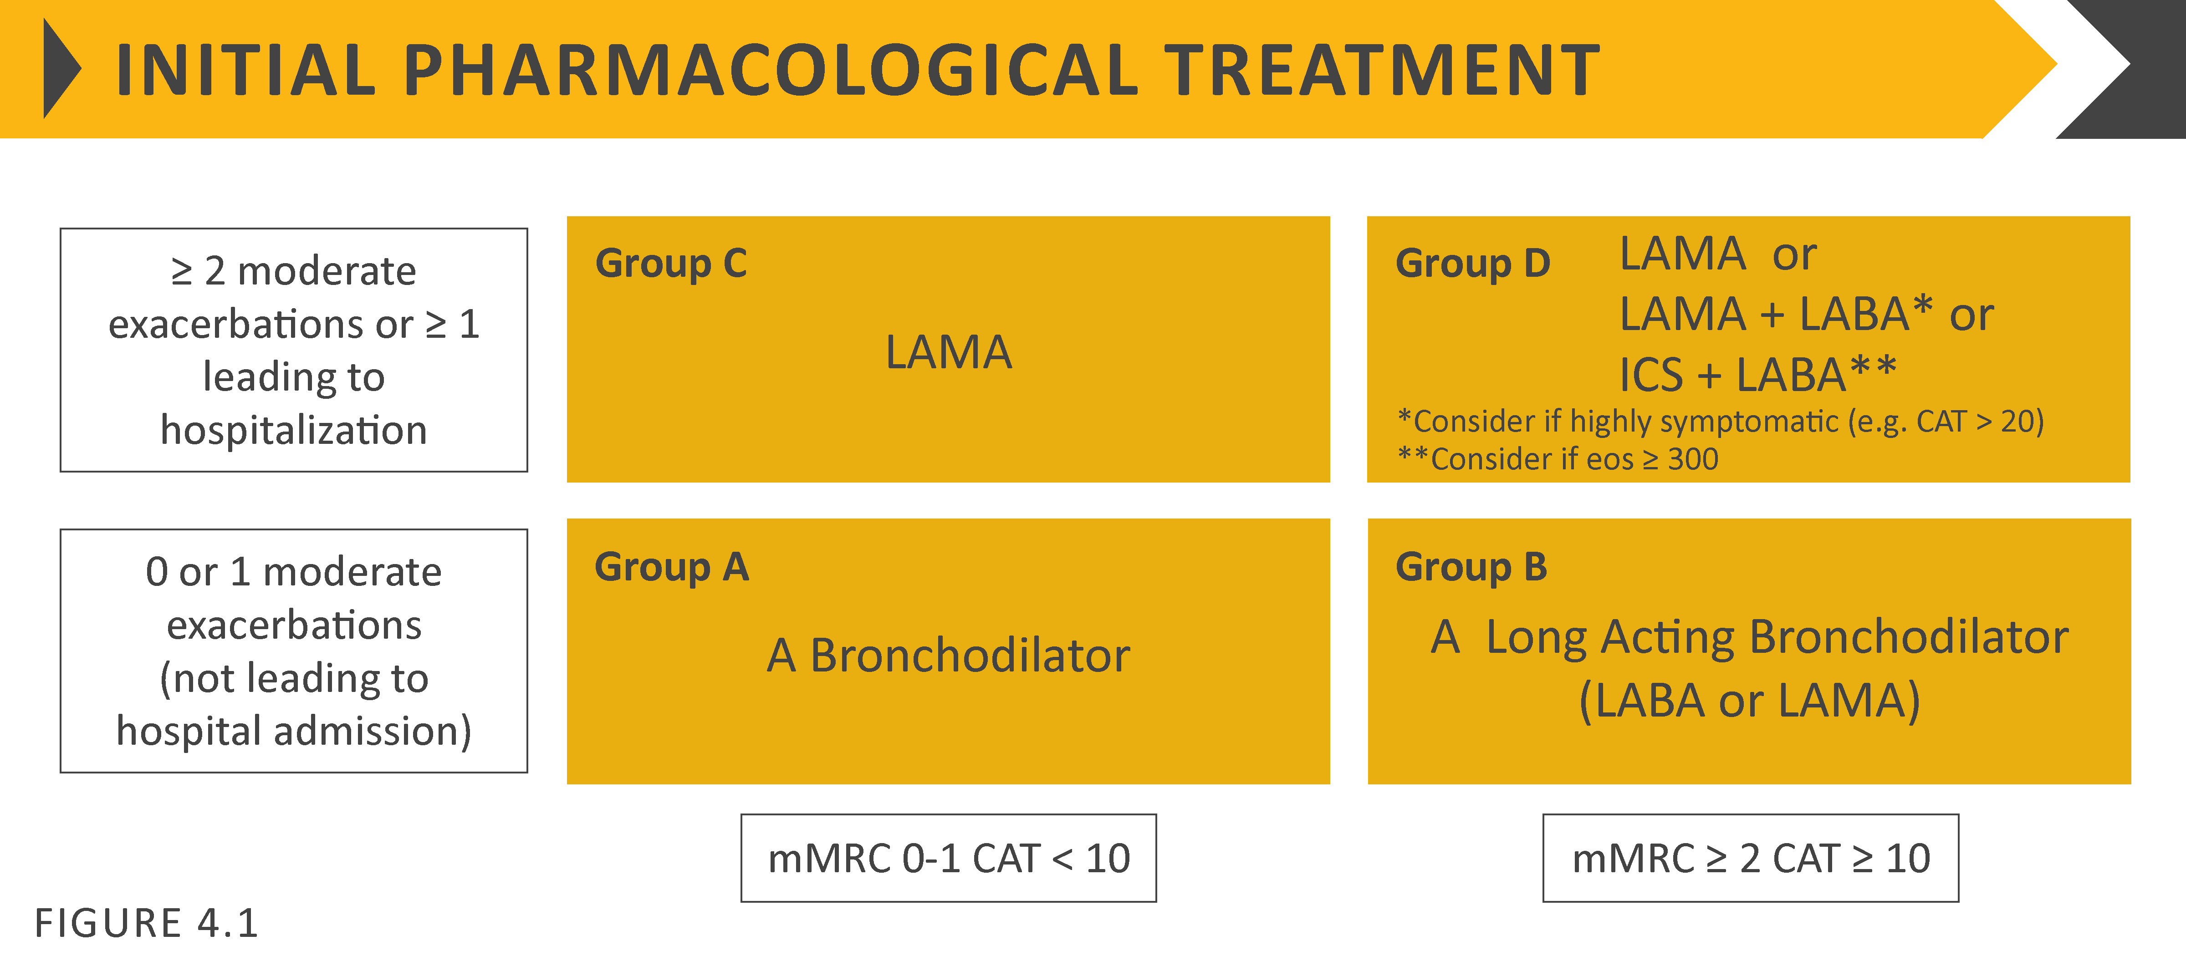

Slide 26
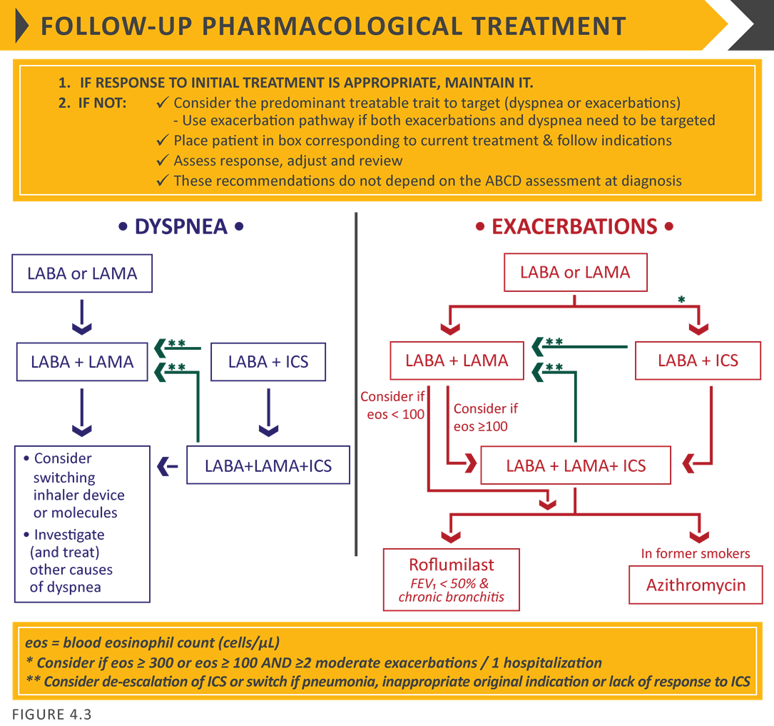
26

Slide 27
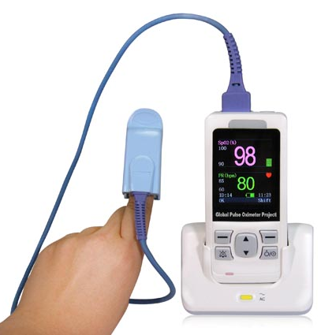
Indications for referral for a LTOT Assessment²
when clinically stable
Oxygen saturations ≤ 92% breathing air
Very severe airflow obstruction (FEV₁ < 30% predicted)
Cyanosis
Polycythaemia
Peripheral oedema
Raised jugular venous pressure
NICE Clinical Guideline 101 (2010) – Full Guideline

Slide 28
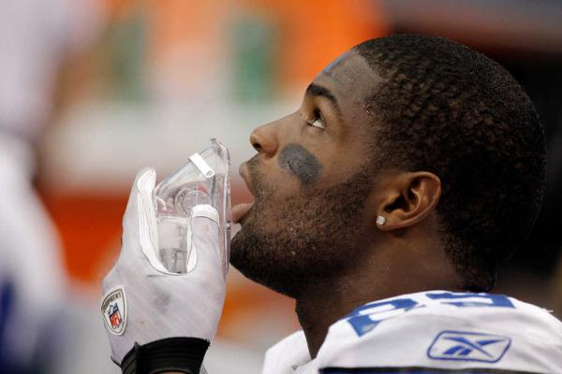
  The myth of oxygen and breathlessness
In someone with normal oxygen saturation levels, whether a breathless American footballer or a breathless COPD sufferer, oxygen is nothing more than an expensive placebo⁷
LTOT should only be prescribed to patients with oxygen saturation levels of ≤ 92%²*
*Patients prescribed LTOT should have their oxygen saturation levels regularly reviewed²
7. PCRS Opinion Sheet 44 (2011)
2. NICE Clinical Guideline 101 (2010) – Full Guideline

Slide 29
  Effect of LTOT on survival in COPD⁶
British MRC Study – Mortality in male patients
100
No oxygen [33]
Nocturnal oxygen (min 15 h) [33]
80
60
Patients surviving (%)
40
20
0
1
2
3
4
5
Years
0
500
1000
1500
2000
Days from admission to trial
Medical Research Council Working Party. Lancet 1981;i:681–6

Slide 30
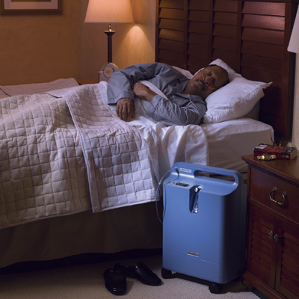
Patients shouldn’t underestimate the burden of LTOT^{2,8}
2. NICE Clinical Guideline 101 (2010) – Full Guideline
8. Pépin, J. et al. (1996). CHEST Journal, 109(5), 1144-1150

Slide 31
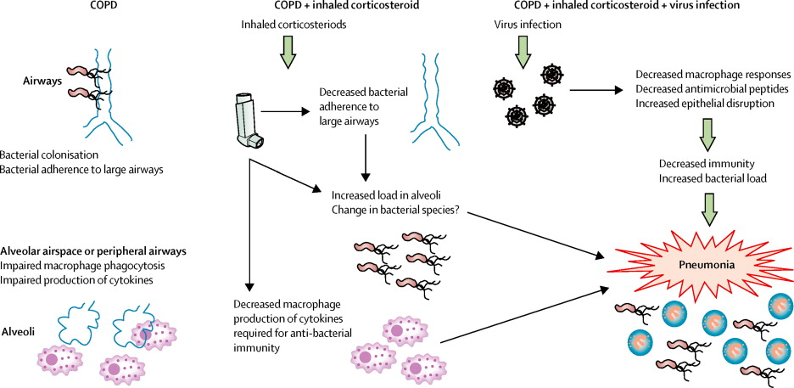
Seretide 500 Accuhaler: TORCH data
Hypothesis to aparent increased pneumonia signal
Adapted from Finney et al, The Lancet Respiratory Medicine, Nov 2014
31
Date of preparation: February 2015; ULT0046

Slide 32
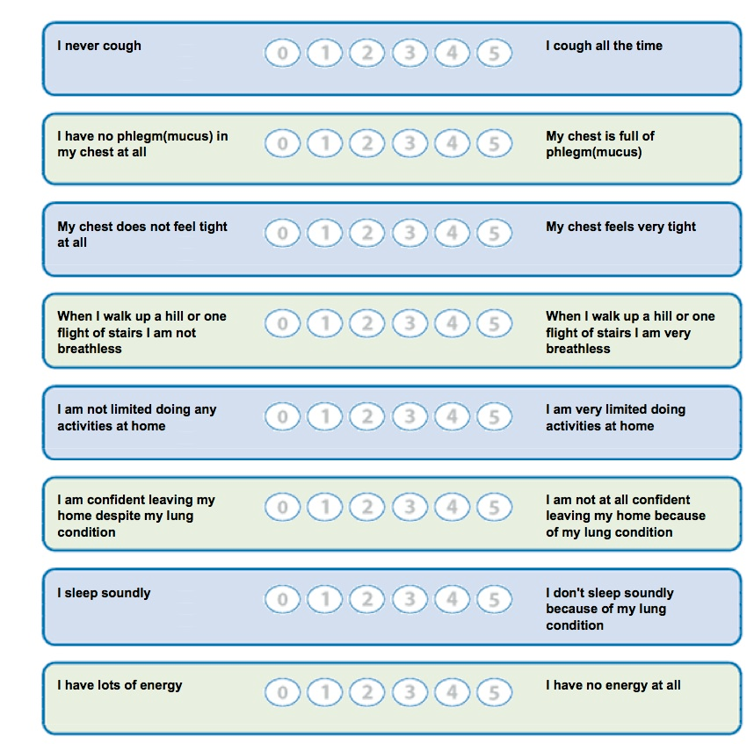
COPD Assessment Test (CAT) for symptoms, ADL,
and exercise tolerance⁵
COPD Assessment Test and CAT logo is a trade mark of the GlaxoSmithKline group of companies.
©2009 GlaxoSmithKline group of companies. All rights reserved.
5. Jones, P. W., et al European Respiratory Journal, 34(3), 648-654.

Slide 33
Thank you
Please fill out the online survey to obtain a certificate

Slide 34

Get in touch!
Website
www.quackmeded.co.uk
Email
ggc.quackmeded@nhs.scot
Social Media
Twitter: @QUACK_ Med
Facebook: QUACK education

