Slide 1
Acute Presentations in Gastroenterology
Roisin Campbell
Gastroenterology Registrar

Slide 2
Disclaimer*
Please note that QUACK is a regional teaching programme operating across GG&C, Lanarkshire and Ayrshire & Arran.
This presentation outlines general management, though local variances e.g. antibiotic prescription may vary slightly depending on your local trust
Remember to check your local guidelines

Slide 3
Learning Aims
To be aware of acute presentations of GI Problems
To be competent in the initial assessment of patients presenting with GI problems
To be aware of the initial management steps for these patients
To know where to source help in the management of these problems when required

Slide 4
You are the FY1/2 covering ARU3 on nightshift. Your middle grade is held up transferring a patient to HDU and the registrar is at a back door emergency…
The nurse comes into ARU and places a VERY URGENT magnet next to Mrs. A. She informs you she is NEWSing a 9 and needs to be seen urgently. She is a GP direct admission
Notes:
What are you going to do first?
ABCDE

Slide 5
Initial Assessment Mrs. A.
Airway: Clear and Patent
Breathing: RR 36 SO2 98% on 2L Trachea central Chest clear
Circulation: Cool to elbows. CRT 6s peripherally, 3s centrally.
Pulse tachy, 140bpm, Regular. BP 80/50mmHg. HS Normal.
Disability: GCS 15/15. No focal neurology. BM 8.0
Exposure: Temp 39.1 No rashes on exposure.
Anywhere else you would like to examine?
Abdomen: Tender RUQ, Murphy’s positive, No peritonism
Notes:
AMPLE History often helpful here

Slide 6
Next steps?
Notes:
Sepsis 6
O2
IVF Bolus
IV Abx: IV Amoxicillin, Gentamicin and Metronidazole
Cultures
Lactate
Catheter with hourly urine volumes

Slide 7
Sepsis 6
Oxygen
IVF
IV Antibiotics
Blood Cultures
Lactate
Catheterise
What would your initial fluid management be?
Which antibiotics?
Does she need catheterised?

Slide 8
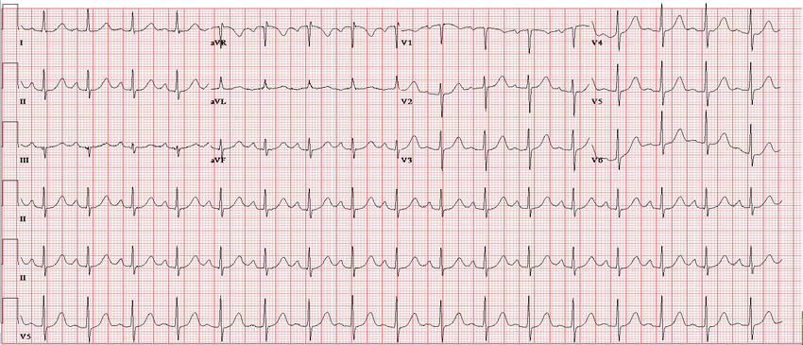
Investigations

Slide 9
Investigations
Hb 135
WCC 16.3
PLT 239
Urea 9.9
Creat 145
eGFR 52
CRP 215
Bil 145
ALT 64
AST 78
ALP 337
Amylase: N
Lactate 5.5
AUSS
MRCP
ERCP
Notes:
AUSS: GS in GB and dilated CBD
MRCP: CBD 11mm, stone

Slide 10
More information on Mrs A
53F
2/7 Hx RUQ/Lower R chest pain, rigors, fevers
Noted urine to be dark and stool pale
PMH: Biliary colic/Gallstones (Awaiting OP Lap Chole), Hypertension, BMI 30
DH: Ramipril 2.5mg OD, NKDA
SH: Non-smoker, occasional alcohol
Diagnosis?

Slide 11
Definitions
SIRS
Sepsis
Severe Sepsis
Septic Shock
Biliary colic
Cholecystitis
Cholangitis
Notes:
SIRS: RR> 20, pulse >90bpm, Temp >38 or <36, Altered mental state, Know or suspected neutropenia, WCC <4 or >12
Sepsis: SIRS plus infection
Sepsis with evidence of organ dysfunction: renal impairment, altered mental state etc
Septic shock: Severe hypotension non responsive to fluid resusitation

Slide 12
You are ready to see your next patient. Mr. B is a 55 gentleman referred in with confusion, reduced mobility and abdominal pain.

Slide 13
Mr. B
55M
PC: Confusion, reduced mobility, abdominal pain + swelling
PMH: Alcohol excess, Child’s B Cirrhosis, Oesophageal varices, Angina, Hypertension
DH: Carvedilol, Spironolactone, Thiamine, Aspirin, GTN, NKDA
SH: Smoker 20/day, still drinking 20+ units per day
What else would you like to know as part of history?
Notes:
Causes of Decompensation:
Ongoing acute alcohol intoxication
Infection: SBP, Other causes of sepsis
UGIB
Constipation
Subdural
Ecephalopathy

Slide 14
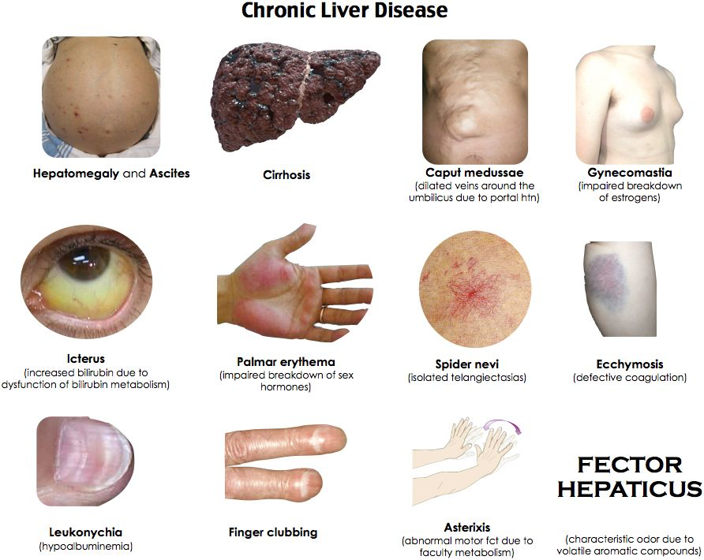
On Examination
GCS 12/15 (E3 V4 M6)
Stigmata chronic liver disease
Tense abdominal ascites
RR 18 Sats: 96% on 3L
BP 95/65 HR 90bpm
Temp 38.0
PR: No malaena. Some impacted faeces
Notes:
What would you like to do

Slide 15
Decompensation in Chronic Liver Disease
An acute deterioration in liver function that can manifest with the following:
Jaundice
Increasing Ascites
Hepatic Encephalopathy
Renal Impairment
GI Bleeding
Signs Sepsis/Hpovolaemia

Slide 16
Decompensation in Chronic Liver Disease
Common precipitants to decompensation include:
GI Bleeding (Variceal and non-variceal)
Infection/Sepsis (SBP, Chest, Urine, Other)
Alcoholic Hepatitis
Acute portal vein thrombosis
Development of HCC
Ischaemic liver injury
Dehydration
Constipation

Slide 17
Investigations
Bloods: FBP, U&E, CRP, LFT, Glucose, Coag, BP, Mg + Cultures
ECG/CXR (Exclude infection)
Urine dip (Exclude infection)
ASCITIC TAP (Regardless of Coagulation screen)
AUSS (Exclude portal vein thrombosis, screen HCC w AFP)
Consider OGD
Consider CTB

Slide 18
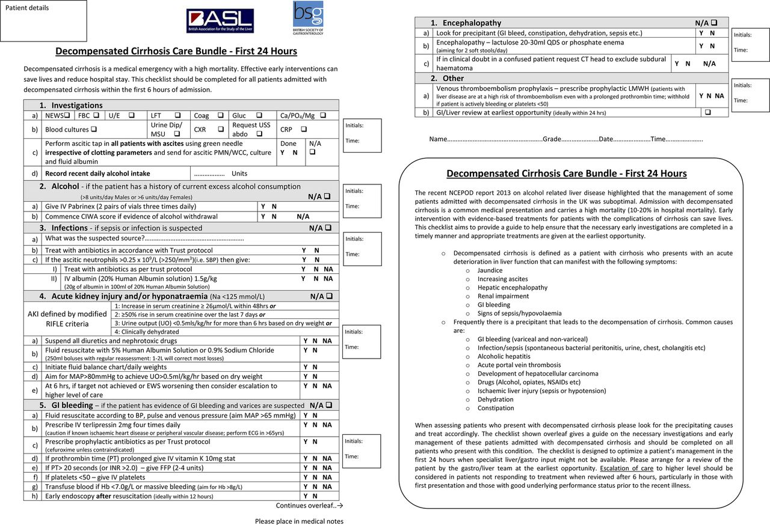

Slide 19
Mr. C
45M
PC: Haematemesis x2 (500ml) ?
HPC: What would you want to know as part of history?
(Abdo pain, Malaena, Dysphagia, Collapse, Jaundice, NSAID/Aspirin/Anti-coagulant use, Prev OGD/Colonoscopy, Hx CLD/GORD/ETOH)
PMH: NAFLD Cirrhosis (Previous UGIB 2y Varices, SBP), T2DM, Asthma
DH: Co-trimoxazole, Metformin, Salbutamol, Fostair, NKDA
SH: No alcohol, smokes 5/day, lives with wife, independent
Obs: RR 24, Sats 98% air, HR 140, BP 90/70mmHg, Temp 37, Alert
Next steps?
Notes:
ABCDE

Slide 20
Initial Assessment
A: Clear.
B: RR 24 Sats 98% air. Chest clear, good AE
C: CRT 4s peripheral. <2s central. HS N. No signs overload. BP 90/70. HR 140bpm
D: BM 5.6. GCS 15/15. No focal neurology.
E: Temp 36.0. Abdomen: Tender epigastrium. Other wise SNT. BS active.
PR: Malaena. No fresh blood.
Signs Chronic Liver Disease
Immediate Actions?
Notes:
Fluid Bolus
Re-assess

Slide 21
Investigations
Bloods: FBC, U&E, LFT, CRP, Coag/INR, BP, Mg, G&S with Cross-match
ECG
Errect CXR
Request OGD (AND ENSURE FASTED!)
Hb 83 (140) Plt 100 WCC 13.5
Na 135 K 4.2 Ur 17.3 (5.5) Cr 67 Egfr 54
Bil 28 ALT 42 AST 67 ALP 140 Alb 30
PT 18.2 APTT 42.7
Electrolytes N
ECG: Sinus Tachy
Erect CXR: No free air

Slide 22
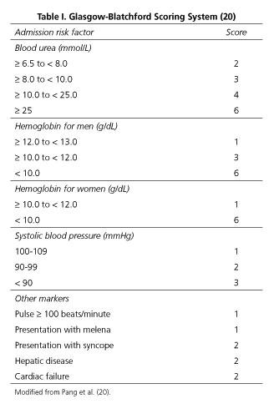
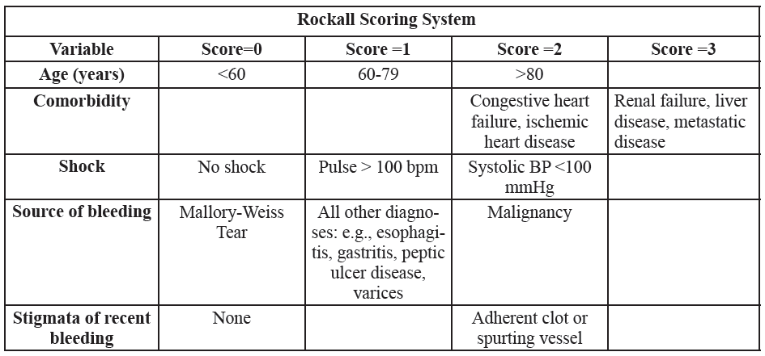
Severity Scoring
Notes:
MD Calc

Slide 23
Management
IVF Resusitation + REVIEW
AUGIB
Transfuse if Hb<70, aim 70-100g/L
Calculate Blatchford
Suspend anti-platelets/anti-coagulants and reverse where required
Cirrhosis: IV Terlipressin 2mg QDS, IV co-amoxiclav
OGD request for scope within 24h and refer GI

Slide 24
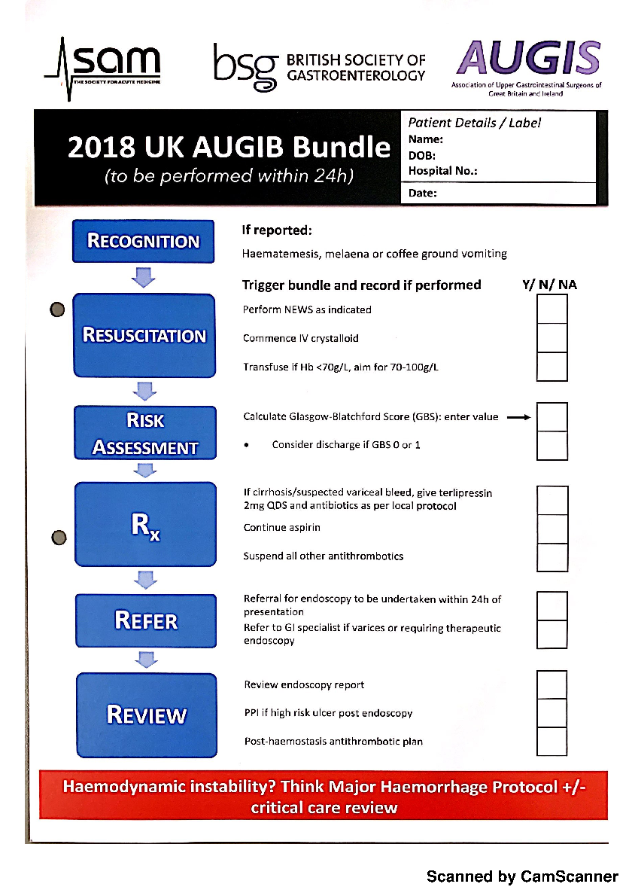
Acute Upper GI Bleeding Bundle

Slide 25
Miss D
25F
Took 30x500mg Paracetamol tablets at 12:30 after being on a time out from the psychiatry ward
BG: Emotionally unstable personality disorder
Next actions?

Slide 26
Results
FBP Normal
Urea 3.5, Creat 156
AST 67, ALT 75, Bil 14, Alb 34
PT 12.4, APTT 22.6 , INR 1.1
Lactate 2.1, pH 7.35
Paracetamol level is above the treatment line
What if paracetamol level is below line but overdose is staggered?

Slide 27
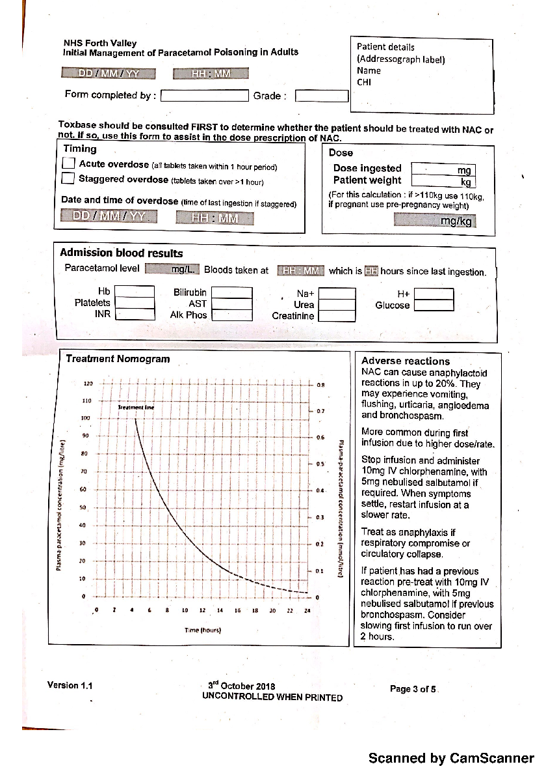
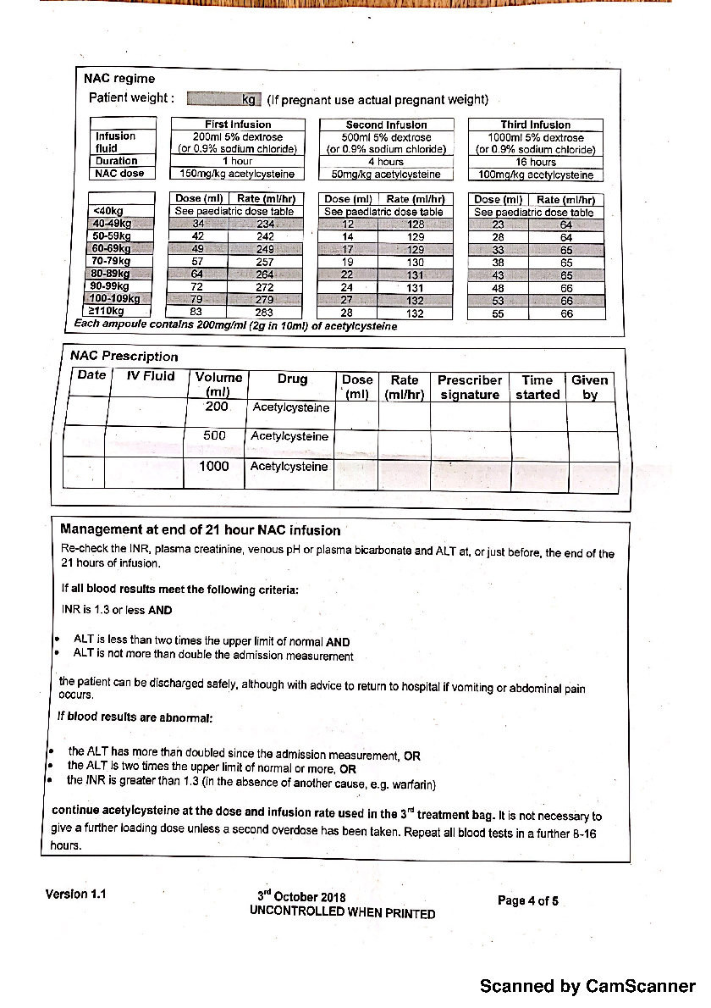
NAC Protocol (check local guidelines)

Slide 28
You are called to re-assess the patient. During the first bag of NAC she has developed a widespread urticarial rash. What would you do?

Slide 29
Management
Assess for signs of anaphylaxis using ABCDE
Assuming no anaphylaxis…
Piriton
Stop the infusion temporarily and restart at a slower rate

Slide 30
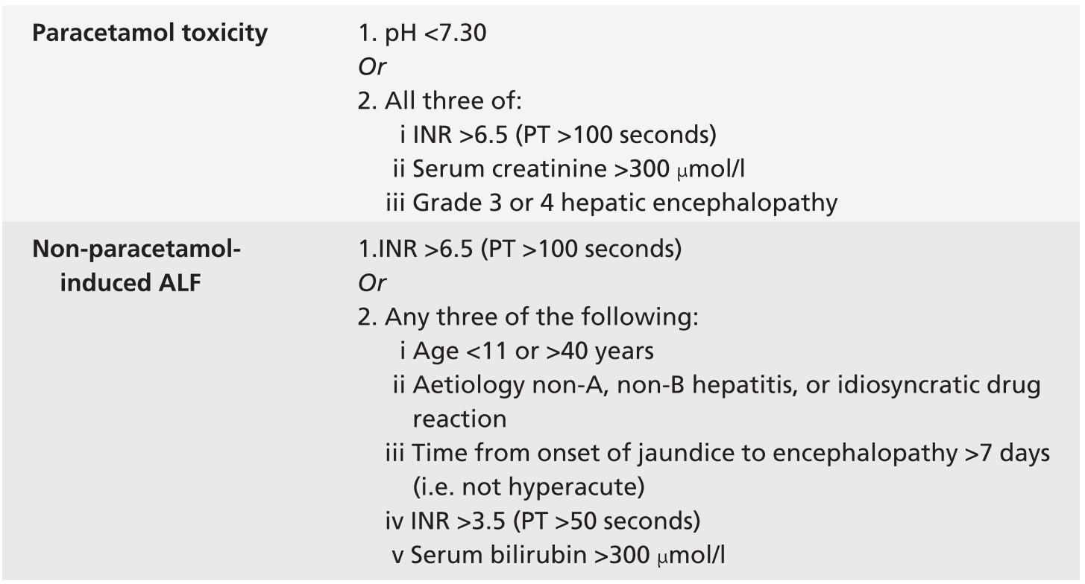
Ongoing Management

Slide 31
Mr. E
27M
Presents with increasing frequency of loose stools
BO 12/Daily with intermittent PR bleeding
No vomiting. Generalised abdominal pain
BG: Ulcerative colitis
DH: Mesalazine
NKDA
SH: Smoker, moderate alcohol, works as plumber

Slide 32
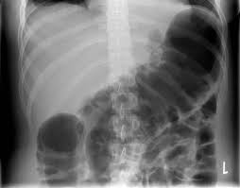
Management
Bloods: WCC 15.4, CRP 234, Urea 10.4, Creat 160, eGFR 52, LFT N, ESR 24
VBG: Lactate 2.1
CXR: No free air
AXR🡪

Slide 33
GGC Guidelines
http://www.staffnet.ggc.scot.nhs.uk/Acute/Emergency%20Care%20Med%20Specialities/QEUH_Gastro/Documents/QEUH%20Acute%20Severe%20Colitis%20Bundle.pdf

Slide 34
Management
IV Methylprednisolone
IV Triple therapy
Early surgical review
Stool for C+S, C. Diff, Norovirus
Stool chart
Daily severity review
If no improvement consider IV Biologic +/- Surgery

Slide 35
Get in touch!
Website
www.quackmeded.co.uk
Email
ggc.quackmeded@nhs.scot
Social Media
Twitter: @QUACK_ Med
Facebook: QUACK education

