Slide 1
Delirium
Gemma McGrory
Acute Medicine Registrar

Slide 2
Disclaimer*
Please note that QUACK is a regional teaching programme operating across GG&C, Lanarkshire and Ayrshire & Arran.
This presentation outlines general management, though local variances e.g. antibiotic prescription may vary slightly depending on your local trust
Remember to check your local guidelines

Slide 3
Case
Robert is 88 and has been referred with new onset confusion
It has happened acutely over 2 days
He is very agitated and plucking at the bedclothes
His investigations are as follows:

Slide 4
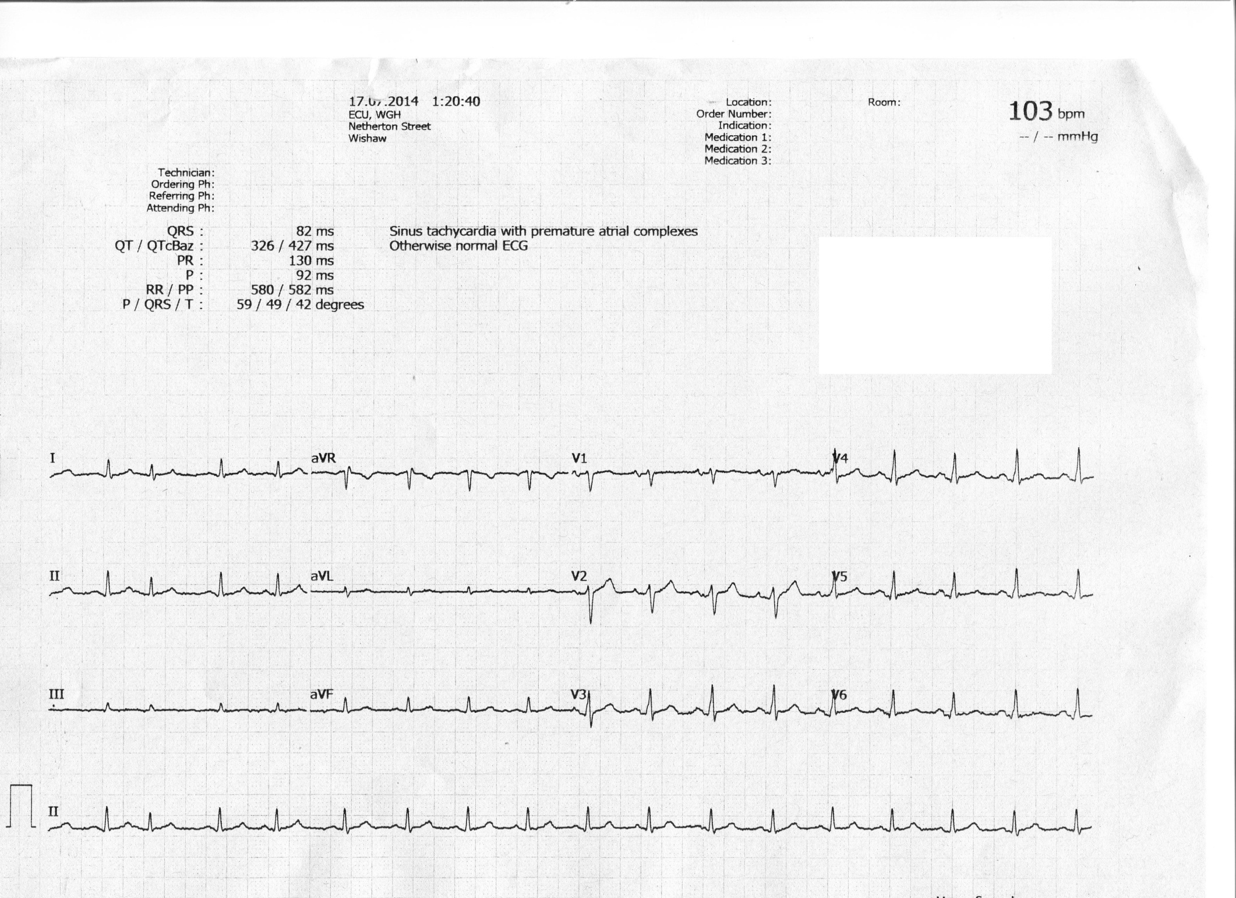

Slide 5
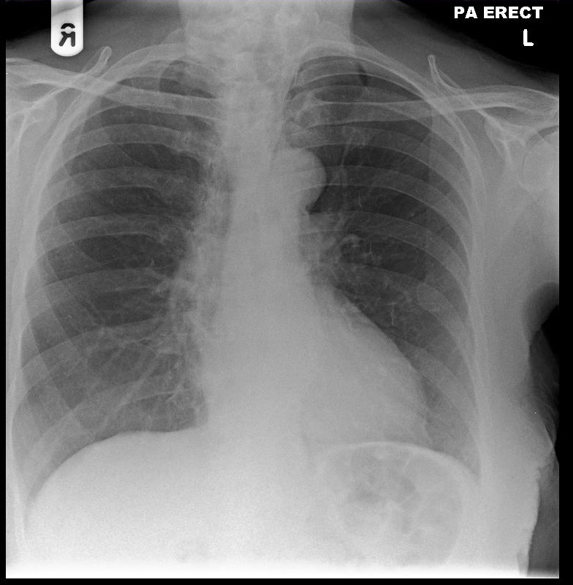

Slide 6
Blood Results
Parameter | Value
Sodium | 117
Potassium | 3.8
Bicarbonate | 21
Urea | 7.8
Creatinine | 224
eGFR | 31
Calcium | 2.97
Haemoglobin | 9.4
White Cell Count | 9.2
Platelets | 325
Glucose | 6.4
PT | 10.1

Slide 7
Diagnosis?

Slide 8
Diagnosis?
Delirium
Hyponatraemia
Anaemia
Hypercalcaemia
AKI

Slide 9
Delirium
Definition:
  An acute decline in cognition and attention
  (‘acute confusional state’)*
Characteristics:
  A common problem
  Often unrecognised
  With serious complications
  Multi-factorial aetiology
  Preventable

Slide 10
Types of Delirium
Hyperactive (meerkat-like)
Hypoactive (in bed; carphology)
Mixed
Hypoactive delirium more likely to go unrecognised and thus has a worse outcome

Slide 11
Simplified diagnostic criteria: the short Confusion Assessment Method (CAM)
Criteria | Present?
Acute onset and fluctuating course (Is there an acute change in mental state? Did this fluctuate during the past day?) | Y / N
2. Inattention (Is the patient easily distracted or does he have difficulty keeping track of what is being said?) Inattention can also be detected by asking for the days of the week to be recited backwards | Y / N
3. Disorganised thinking (Is the patient’s speech disorganised, incoherent, rambling, irrelevant, unclear/illogical or unpredictable switching between subjects?) | Y / N
4. Altered level of consciousness (Is the patient vigilant (hyper-alert) or lethargic/drowsy?) | Y / N
1 + 2 + either 3 or 4 must be present to diagnose delirium.

Slide 12
Aetiology
Multifactorial
Drugs (any)
  Particularly new drugs
  Opioids
Acute infections
Metabolic
  TFTs, Calcium, Sodium
Raised intracranial pressure
CVA/TIA

Slide 13
Investigations
Get 3rd party history
Routine obs
Physical examination
Bloods, MSU, imaging
Review notes

Slide 14
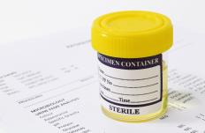
The dreaded UTI…
Bacteriuria (bugs in the urine), manifest as nitrites and leucocytes in the urine, is a common normal finding in old ladies (50% NH residents), and some old men
Therefore UTI cannot be diagnosed on the basis of a through test of urine (dipstick) alone in older people.

Slide 15
Management
First: ABCDE
Is the situation medically stable?
Where would it be appropriate to manage the patient?
Are there enough staff to ensure a safe environment?
THEN think about medication – is emergency sedation necessary?
Notes:
If patient is delirious it may also be appropriate to use the mental health act and detain the patient for their safety if they are trying to leave – discuss with senior or liaison psychiatry - EDC

Slide 16
Management
Nurse people in single room
Consistency of staff
Brightly lit or light beside bed
Try not to move around ward or board
Clocks / windows
Make sure they have glasses, etc.
Feeding, hydration, bowels, bladder
Notes:
Never happens in practice but have to do your best

Slide 17
Management
Depends on cause
  DTs, UTI, URTI
Consensus guidelines
  APA guidelines: drug of choice is haloperidol
  not much evidence base
  Can also use low dose lorazepam
Do not prescribe for low levels of staffing
  Emergency sedation for agitation only

Slide 18
Impact
Studies show delirium is associated with poor outcomes. People who develop delirium are more likely to:
Stay in hospital or critical care for longer
Have an increased incidence of dementia
Have more hospital-acquired complications e.g. falls,
pressure ulcers
Be admitted to long term care
Die* (mortality among hospitalised patients is 22-76%, as high as MI or sepsis. One-year mortality 35-40%)

Slide 19
This case?
Needs workup for hypercalcaemia, AKI, anaemia and hyponatraemia
Suggestions?

Slide 20
This case
Hypercalcaemia
  Myeloma screen
AKI
  Urine dip, MSSU, USS
Hyponatraemia
  Serum/urine osmolality, TFTs
Anaemia
  B12/folate/ferritin/blood film

Slide 21
Management
IV fluids
Needs large volume replacement to dilute out hypercalcaemia but need to be careful of hyponatraemia...
  Why?

Slide 22
Management
IV fluids
Needs large volume replacement to dilute out hypercalcaemia but need to be careful of hyponatraemia...
  Central pontine myelinosis (osmotic demyelination)

Slide 23
Hyponatraemia
Mild - anorexia, headache, nausea, vomiting, lethargy
Moderate - personality change, muscle cramps and weakness, confusion, ataxia
Severe - drowsiness

Slide 24
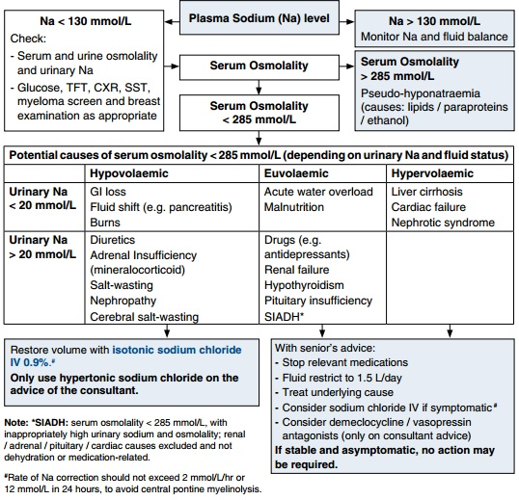
GGC Therapeutic Handbook

Slide 25
Hypercalcaemia
Primary hyperparathyroidism
  ‘Stones, bones, moans and groans’
Malignancy (most common)
  Metastases
  Myeloma
Rare causes
  Sarcoid
  TB

Slide 26
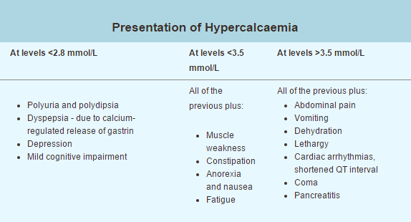
GGC Therapeutic Handbook

Slide 27
Hypercalcaemia - Ix
ECG & Cardiac monitoring
Look for underlying malignancy if suspected
Bloods:
  Serum immunoglobulins, serum free light chains, ESR, urinary Bence Jones protein
  PTH

Slide 28
Hypercalcaemia - Rx
Normal Calcium is 2.1-2.6
IV fluid rehydration 2l over 24 hours minimum
Stop precipitants
  Thiazide diuretics or calcium supplements
If no improvement after IV fluids
  Consider IV dose zolendronic acid
  Takes 4 – 7 days to work

Slide 29

Get in touch!
Website
www.quackmeded.co.uk
Email
gg-uhb.quackmeded@nhs.net
Social Media
Twitter: @QUACK_ Med
Facebook: QUACK education

