Slide 1
Brugada Syndrome
John McFeely
Speciality Registrar in Acute/Internal Medicine

Slide 2
Disclaimer*
Please note that QUACK is a regional teaching programme operating across GG&C, Lanarkshire and Ayrshire & Arran.
This presentation outlines general management, though local variances e.g. antibiotic prescription may vary slightly depending on your local trust
Remember to check your local guidelines

Slide 3
Background
24-year old male
Past medical history:
  Asthma
  Sebaceous cysts
  Previous AKI - ?post-infectious glomerulonephritis
  Cannabis use
  Anxiety issues
Drug history:
  No regular prescription meds, NKDA

Slide 4
Before hospital
Finished night shift (road worked) – went to restaurant and ordered breakfast sandwich
Sudden collapse to floor after first bite – bystanders called 999
Pinpoint pupils noted by paramedics, reactive to pain
  CBG 3.7 in Ambulance
  IM glucagon/Narcan in ambulance – little effect
  Still GCS 7 on arrival at ED

Slide 5
Emergency Department
In Police custody – emerged there was warrant out for patient’s arrest
GCS 8 in ED (E1, M5, V2)
  PERLA 1mm
  CBG 5.2
  Moving all 4 limbs independently
Police had confiscated white tablets, cannabis and pink tablets from patient’s pockets
Notes:
Physical examination was otherwise unremarkable in terms of cardiovascular/respiratory/abdominal

Slide 6
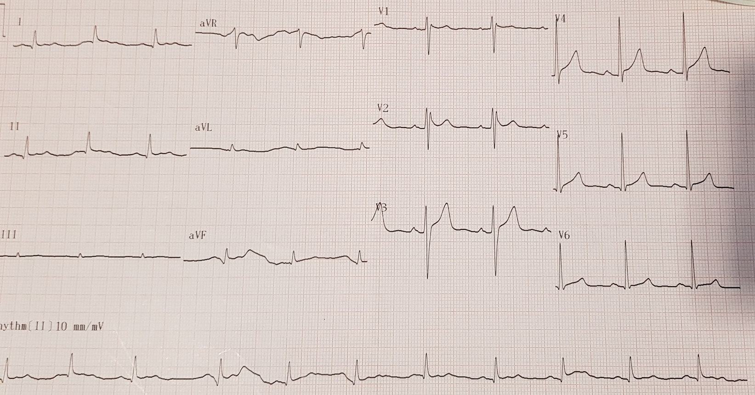
ECG in ED
Notes:
Note the ECG is not entirely abnormal – there is an RSR1 pattern and some subtle saddle-shaped ST elevation in leads V1 and V2.

Slide 7
Referred to Medical Receiving Unit
RR 16/min; SpO₂ 98% on air; Temp 36.5ºC; HR 75bpm; BP 120/75mmHg
CVS/Resp/GI examinations normal
No further hypos
GCS 12
  Remained very sleepy
  Waking to loud voice/pain
  Moving limbs but not obeying commands/compliant with neuro exam
  Pupils large/slowly reactive

Slide 8
Investigations
Bloods
  FBC/coag screen - normal
  U&Es/LFTs – normal
  Lactate 0.9
  CRP <5
  Paracetamol <7
  CK 425
CXR – Prominent vasculature, similar to previous

Slide 9
Medical Receiving Unit cont.
Impression: Collapse due to diazaepam OD – GCS improving
Consultant review – further history obtained now patient awake:
  Patient planned to turn self into Police – took 6 diazepam so he would “get a sleep in the cells”
  No other symptoms before/after event
  Now GCS 15, HS pure, chest clear
  Impression- TLOC with abnormal ECG, though drug cause for LOC most likely
  Plan – repeat ECG, telemetry, echo, repeat trop/U&Es, CK
Notes:
Denied any pre-syncope, chest pain or breathlessness before or after the collapse.
TLOC = Transient Loss of Consciousness

Slide 10
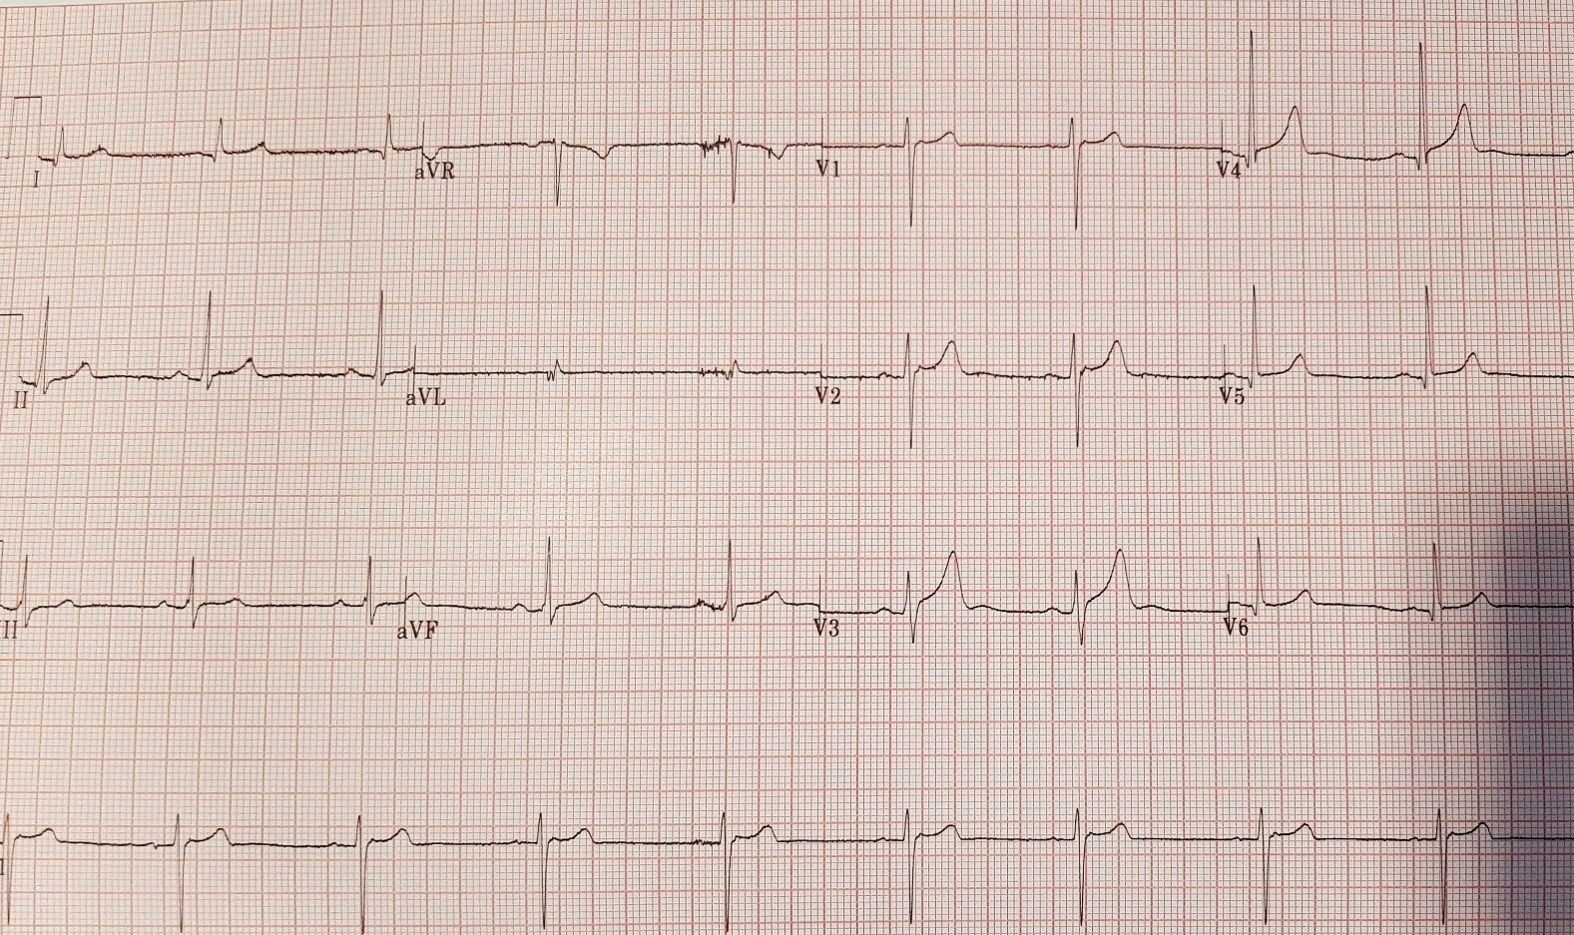
ECG in CAU
Notes:
Repeat ECG showed resolution of the RSR1 pattern in leads V1 and V2. The slightly atypical-looking ST segments in the other leads were felt to represent high-take off given the patient’s young age.

Slide 11
Medical Receiving Unit - The next day
Reviewed on junior ward round
No further syncopal events overnight
Telemetry reviewed – sinus bradycardia overnight only – no pauses/tachys
Obs remain normal
Uncomplaining, keen for discharge
Repeat U&Es, trop, CK normal
Plan – Repeat ECG, await echo, home if normal
Echo – Normal dimensions/function
Notes:
Echo showed normal chamber dimensions/wall thickness and normal systolic and diastolic function in both ventricles. No valvular abnormalities were detected.
Telemtery showed sinus bradycardia overnight only when the patient was asleep. When awakre, heart rate was normal.

Slide 12
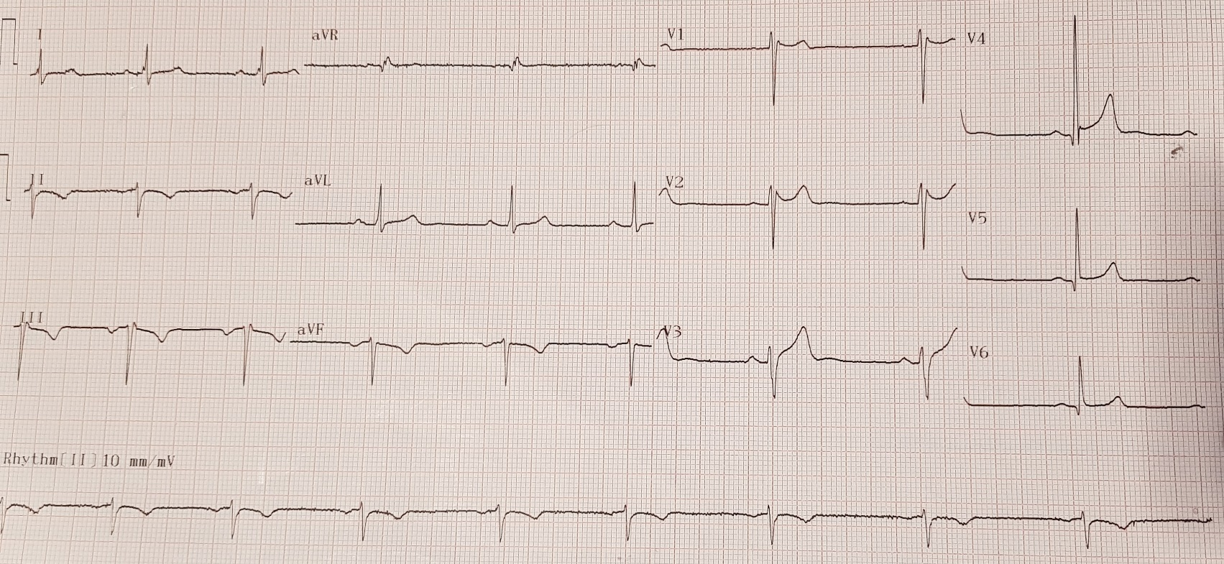
Almost home…
Notes:
Note recurrence of RSR1 pattern in leads V1-2 and saddle-shaped ST elevation. Also new T-wave inversion in inferior leads (the T-wave inversion was later found to be due to lead misplacement)

Slide 13
… but not quite
Discussed with cardiology
  Identified Brugada pattern ECG
  Unclear if Brugada variant vs. Brugada syndrome
Family history revisited
  Father – sudden death from “heart attack” aged 31
Transferred to CCU for Flecainide provocation test
  Negative
Discharge diagnosis: “Type III Brugada pattern ECG, with negative provocation test and structurally/functional normal heart on echo”
Follow-up: OP Cardiac MRI, genetic testing for channelopathies
Notes:
Brugada variant = presence of Brugada-pattern changes on the ECG without symptoms;
Brugada SYNDROME = presence of Brugada-pattern changes on the ECG with associated symptoms of pre-syncope, collapse, arrhythmia or sudden death
The patient did not know the exact cause of death in his father, but note that it occurred at a young age.
A flecainide provocation test involves connecting a patient to continuous cardiac monitoring and administering a dose of IV flecainide – the monitor is then reviewed to assess for the emergence of “Type 1” Brugada features (outlined below). This patient’s test was negative, i.e. no Brugada-pattern ECG changes were seen after IV flecainide was administered.
Type 3 Brugada pattern will be described below.
Genetic testing and cardiac MRI were requested for this patient, even with his negative provocation test, due to the concern about his father having potentially suffered sudden cardiac death at a young age.

Slide 14
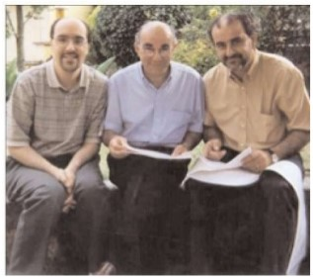
The Brugada Brothers
Notes:
The Brugada brothers are 3 cardiologists from Spain.
An association between the characteristic ECG appearances (that we now term the Brugada pattern) and sudden cardiac death was first reported in 1989.
Pedro (middle) and Josep (right) first described the condition in 1992.
Ramon, on the left, was the first to describe one potential genetic cause of the condition in 1998.

Slide 15
Brugada Syndrome
A genetic cardiac channelopathy resulting in increased risk of SCD in otherwise structurally normal heart
Accounts for 8% of all cases of SCD
Incidence 1-30 per 10,000 people, more common in Asian populations
  Philippines: “Bangungut” (To rise and moan in sleep)
  Japan: “Pokkuri” (Sudden and unexpectedly ceased phenomena)
  Thailand: “Lai Tai” (Death During sleep)
Onset usually in adulthood – mean age of SCD 41yo
Family history is present in 25% of cases
In childhood, M=F; Adults M>F
Most commonly involved gene is SCN5A
Notes:
SCD = Sudden Cardiac Death
Brugada syndrome is so common in some areas of Asia that localised colloquialisms describing the condition arose – these often reflect a tendency for fatal arrhythmias to arise during sleep.
Patients are born with the condition, although it is rare for symptoms to manifest in childhood.
Although 25% will have a family history, many cases arise as a new mutation.
The higher incidence of males affected in adulthood is believed to be related to higher testosterone levels in males.
SCN5A = a gene which encodes one of the cardiac sodium channels

Slide 16
Brugada Syndrome - Genetics
Autosomal dominant inheritance
Can arise as new mutation
Variable penetrance
Most mutations are found in the SCN5A gene (Cardiac sodium channel)
  Only 20% of cases of Brugada Syndrome are associated with this gene
  Most patients undergoing testing do not have a gene identified
  Over 290 mutations in SCN5A have been discovered
Other gene mutations may affect other channels (e.g. Ca²⁺, K⁺) or form proteins that interact with ion channels
May overlap with other conditions, e.g. long-QT, ARVC
Notes:
Brugada syndrome can arise de novo in previously unaffected families
Because penetrance is variable, not all affected family members will exhibit the same symptoms – some may have none at all, some may have severe symptoms including sudden death
Most of the IDENTIFIED mutations are found in the SCN5A gene, although this is only found in 1 in 5 cases. Most cases do not end up with a mutation being identified.
There are over 290 different mutations within the SCN5A gene alone that have been identified.
Most of these mutations are “loss of function” mutations which result in reduced flow of sodium ions across the sodium channel.
ARVC = Arrhythmogenic Right Ventricular Dysplasia
It is thought that she sheer number of different mutations accounts for the significant variability in severity in those affected by the condition.

Slide 17
Brugada Syndrome – Signs/Symptoms
TLOC
  Dysrhythmia
  Hypotension
Sudden cardiac death
  Ventricular Fibrillation
  Polymorphic Ventricular Tachycardia
Dysrhythmias tend to occur in situations where vagal tone is higher
  Rest
  After heavy meals
  Sleep
Other provoking factors
  Extremes of temperature (high or low)
  Excessive alcohol
  Certain medications (e.g. Calcium channel blockers, Beta-blockers, nitrates, many others)
Notes:
TLOC = Transient Loss of Consciousness
Recall the colloquial names for the syndrome in many Asian countries which make reference to death occurring during sleep – this is because arrhythmias associated with Brugada syndrome tend to occur in situations in which vagal tone is increased.

Slide 18
Brugada Syndrome - Diagnosis
Begins with the ECG
ST elevation V1-V3 with RBBB appearance
May have prolonged PR interval (slowed conduction)
  Changes may not always be consistently present
  Medications can be used to reveal the ECG changes
Beware mimics
  Electrolyte disturbances, e.g. hypokalaemia
  Poor cardiac blood supply, esp. to Right Ventricular Outflow Tract
  Excessive alcohol/cocaine use can induce similar ECG changes
Notes:
ECG changes in Brugada syndrome may be consistently present, or intermittent and provoked by certain precipitants (e.g. drugs, fever).
The main leads to scrutinise are V1-V3, which typically show ST elevation in a Right Bundle Branch Block pattern.
Similar ECG appearances may arise in individuals who do not have Brugada syndrome, so be wary.

Slide 19
Mechanisms of Arrhythmia – Depolarisation vs. Repolarisation Hypothesis
Depolarisation Hypothesis
  Abnormally slow electrical conduction through RV
  Short circuits form
  May explain onset in middle age - Greater incidence of scarring/fibrosis
Repolarisation Hypothesis
  Increased difference in action potentials between epicardium and endocardium
  Brief periods of current flow from endocardium to epicardium
Cardiac structure may change, esp. RV outflow tract
Mechanisms may vary between patients (different mutations)
Notes:
As well as an increase in SCD due to malignant arrhythmia, there are also increased rates of less serious causes of palpitations in these patients. Some patients may also have bradycardia due to AV nodal conduction issues.
There are 2 competing schools of thought on how symptoms arise in Brugada Syndrome:
The depolarisation hypothesis suggests that:
Abnormally slow RV conduction allows for formation of “short circuits” which block conduction in some areas whilst allowing it to pass in others.
This can be exacerbated by other conditions which cause cardiac scarring or fibrosis, perhaps explaining why symptoms are less common in children and tend to present later in life.
The repolarisation hypothesis suggests that:
There is an increased difference in action potentials between the epicardium and endocardium, which allow for periods in the cardiac cycle where electrical current can flow from the endocardium to the epicardium (i.e. the wrong direction)
If the difference is large enough, arrhythmias may be provoked through blocking of electrical impulses in some regions but not others.
It is entirely possible/likely that mechanisms of arrhythmia vary between patients depending on the gene mutation they have.

Slide 20
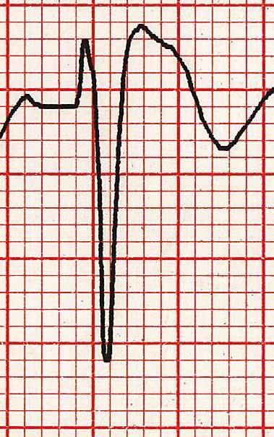
ECG Changes – Type 1
Coved ST elevation
  >2mm at J-point
  In >1 of V1-V3
  Gradually descending ST-segment
  Followed by a negative T-wave
AKA “Brugada sign”
Potentially diagnostic
  Clinical context is crucial
Notes:
Type 1 Brugada pattern ECG changes are generally seen as diagnostic of Brugada syndrome, either if present spontaneously or medically-induced.
Brugada syndrome is diagnosed if the above changes are present in association with:
Documented VF or polymorphic VT
Family history of SCD younger than 45 years old
Coved-type ECG in family members
Inducibility of VT with programmed electrical stimulation
Syncope
Nocturnal agonal respiration

Slide 21
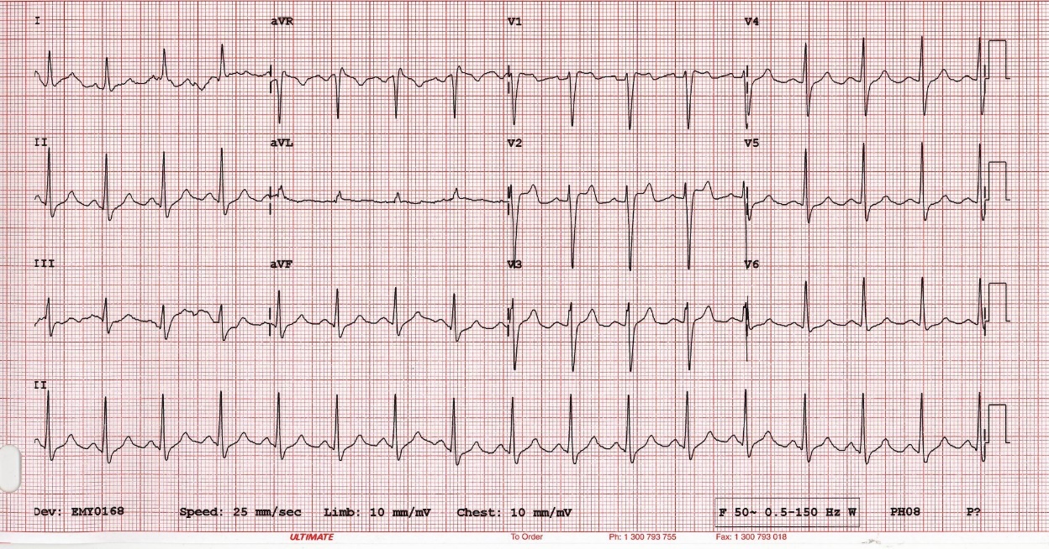
ECG Changes – Type 2
>2mm of saddle-shaped ST elevation
Positive or biphasic T-wave
May appear in healthy subjects
Notes:
Type 2 Brugada pattern changes may be seen in some normal healthy individuals

Slide 22
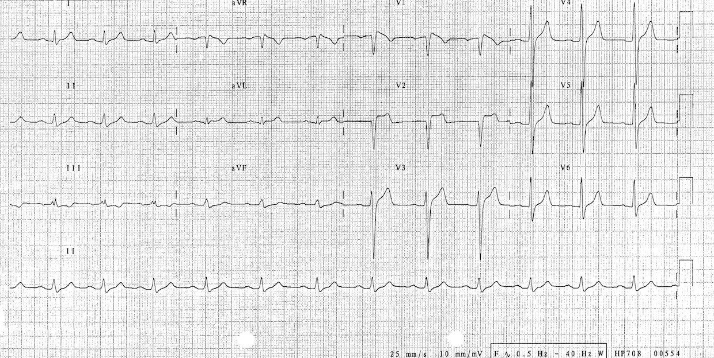
ECG Changes – Type 3
The morphology of Type 1 or 2(i.e. coved or saddle-shaped)
BUT with <2mm ST elevation
May occur in healthy subjects
Notes:
Although this ECG appearance may occur in healthy individuals it should still prompt consideration of a Brugada syndrome if there is a relevant history and you should explore the patient’s history for relevant risk factors (e.g. family history of sudden cardiac death) that would suggest that provocation testing may be needed.

Slide 23
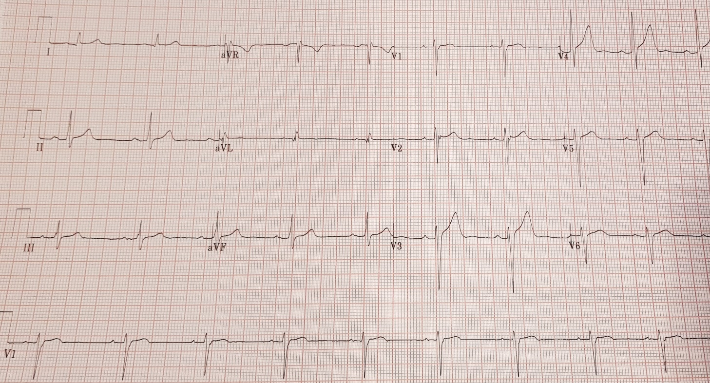
Discharge ECG
Notes:
This is the ECG from our case-study patient – again note that the RSR1 pattern and ST elevation have resolved. The T-wave inversion in the inferior leads is also no longer seen – it emerged that the lead placement on the previous ECG was incorrect, and that this accounted for the T-wave inversion seen there, as inferior TWI is not commonly seen in Brugada pattern.

Slide 24
Provocation Testing
Medications that block the cardiac sodium current can reveal type-1 Brugada pattern in susceptible individuals
Agents include Ajmaline, flecainide and procainamide
Examples of indications
  Survivors of unexplained cardiac arrest
  Family members of known Brugada syndrome patients
Only in monitored environment
Notes:
Some evidence suggests that Ajmaline may be the most effective agent for provocation testing.
There is a risk of inducing potentially fatal arrhythmias during a provocation test – therefore it should only be carried out in daylight hours, in a CCU environment with continuous monitoring and defibrillation/resuscitation facilities available, and under the supervision of a specialist.

Slide 25
Other investigations
Genetic testing
  Mostly indicated in screening of family members
  Interpret with caution
  Can be used in the investigation of unexplained deaths
Invasive Electrophysiological Studies
Ambulatory ECG/loop recorder
Signal-averaged ECG – for risk stratification
Notes:
Genetic testing must be interpreted with caution due to the variable penetrance of the gene mutations – even if a patient is identified as having a gene mutation, it does not necessarily mean they will go on to experience any symptoms – i.e. it does not mean they necessarily have the Brugada SYNDROME.
Also, some genetic variants that are seen in some people with Brugada syndrome are not actually the cause of the disease, but are instead a normal variant and may be seen in other healthy individuals.
In invasive electrophysiological studies, wires are fed through the venous system to stimulate and record electrical signals from the heart, and can be used to assess the risk of arrhythmias.
Tapes and loop recorders are helpful in establishing whether symptoms of palpitation/syncope in someone with Brugada actually coincide with a causative dysrhythmia and help distinguish these from simple vasovagal episodes.

Slide 26
Management
Incurable
  Aim is to reduce risk of arrhythmias and SCD
  Identification of at-risk relatives is important
Lifestyle advice
Implantable Cardiac Defibrillator
Isoprenaline infusion
Catheter ablation
Notes:
High-risk relatives may also warrant preventative measures to prevent SCD.
Lifestyle advice centres on minimising alcohol and illicit drug use, avoiding certain medications and managing temperature aggressively with paracetamol to prevent high fevers. Moderate exercise can be advised, although excessive high-intensity exercise can be associated with arrhythmias and should be discouraged.
ICDs are reserved for those felt to be at high risk of SCD or who have already had life-threatening arrhythmias. ICDs can also be inserted for those with troublesome bradycardia to provide pacing.
Quinidine can be used in patients who have ICDs and have experienced several episodes of life-threatening arrhythmia. However it may also be considered for patients felt to be high risk in whom an ICD is felt not to be appropriate.
Isoprenaline infusions can be used in acute emergencies in cases of frequent, repeated arrhythmias (electrical storm)
Ablation therapy aimed at arrhythmogenic areas of cardiac tissue tends to be reserved for those experiencing frequent ICD firings.
If you are aware of a patient having Brugada syndrome, always think twice when prescribing – visit brugadadrugs.org for advice or if in doubt, speak to a pharmacist.
Commonly used drugs to be aware of that may not be suitable are:
Verapamil
Propranolol
Amitriptyline
Flecainide
Also avoid drugs which enhance vagal tone, e.g. acetylcholine

Slide 27
Take Home Messages
If you see ST elevation in V1-V3 – be suspicious of Brugada
Family history can be very helpful, but may be unremarkable
Get specialist opinion early – ECGs can be misleading
Be very careful with your prescribing!
Notes:
Remember that a negative family history does not exclude Brugada syndrome as the mutation may arise De Novo.
There are many mimics which can result in similar ECG appearances, don’t be afraid to seek specialist opinion.
No one is expecting you to be a specialist in managing Brugada Syndrome, the main thing to be aware of is your prescribing choices, and to seek advice on these. Also remember to aggressively manage fever. Make sure it is well-highlighted to all staff involved in the care of the patient that they have Brugada syndrome so that any prescribers (e.g. in the out of hours situation) can be alerted to it.

Slide 28

Get in touch!
Website
www.quackmeded.co.uk
Email
gg-uhb.quackmeded@nhs.net
Social Media
Twitter: @QUACK_ Med
Facebook: QUACK education

