Slide 1

Delirium
Emily Wright
QEUH

Slide 2
Disclaimer*
Please note that QUACK is a regional teaching programme operating across GG&C, Lanarkshire and Ayrshire & Arran.
This presentation outlines general management, though local variances e.g. antibiotic prescription may vary slightly depending on your local trust
Remember to check your local guidelines

Slide 3
Overview
Defining delirium
The importance of delirium as a clinical problem
Causes
Addressing delirium
Communicating about delirium

Slide 4
Defining Delirium
An acute (hours-2 days) alteration in mental state with a fluctuating course causing either agitated or hypoactive state usually occurring in the context of acute physical illness
Compare with acute psychosis – attributable to mental illness and likely onset less acute (ICD-10 states onset <2 weeks); or dementia – insidious onset and progressive rather than fluctuant course; non-reversible

Slide 5
What causes delirium?
The molecular mechanism of delirium is not fully understood and we are potentially categorising heterogenous conditions under an umbrella description
It is posited that increased BBB permeability occurring as part of the ageing process increases susceptibility to neuropsychiatric effects of physical illness, or that neurotransmitters or neural pathways are disrupted at times of physiological stress, with patients where this is already abnormal at increased risk

Slide 6
The importance of delirium as a diagnosis
Delirium is common – estimates 20-30% of medical inpatients and 10-50% of surgical patients
Negative impact of delirium
  Increased length of hospital stay
  Distress to patient and family
  Increased risk of inpatient complications eg falls, pressure ulcers
  Increased risk of discharge to a care home
  Increased likelihood of subsequent dementia diagnosis
  Increased mortality compared to patients who do not suffer from delirium
  Mortality increases by 11% for every 48 hours of delirium

Slide 7
Risk factors for delirium
Older age
Pre-existing dementia
Sensory impairment
Injury – especially hip fracture
Severe illness

Slide 8
The Physiological reserve model
Comparative insult to cause delirium
UTI
93 year old female Diabetes, CCF,
Frailty
Polytrauma; ITU admission
30 year old male with no chronic conditions

Slide 9
Recognising Delirium
The ‘SQuID’ – single question to identify delirium – ‘Do you think [insert name] has been more confused or drowsy recently?’
TIME bundle – frequent mentions, infrequent use. Good news is it’s usually happening, just not being labelled as such
  Think delirium (a 2010 study suggested up to 75% of cases not recognised)
  Investigate
  Manage
  Engage with family

Slide 10
Recognising Delirium II
The 4AT is validated to screen for delirium.
Benefits include ‘testing the untestable’
Drawbacks include counter-intuitive marking scheme
4 elements:
  Alertness – normal to clearly abnormal, 0-4
  AMT 4 – all correct to untestable, 0-2
  Attention – all correct to untestable, 0-2
  Acute change or fluctuating course? 0-4

Slide 11
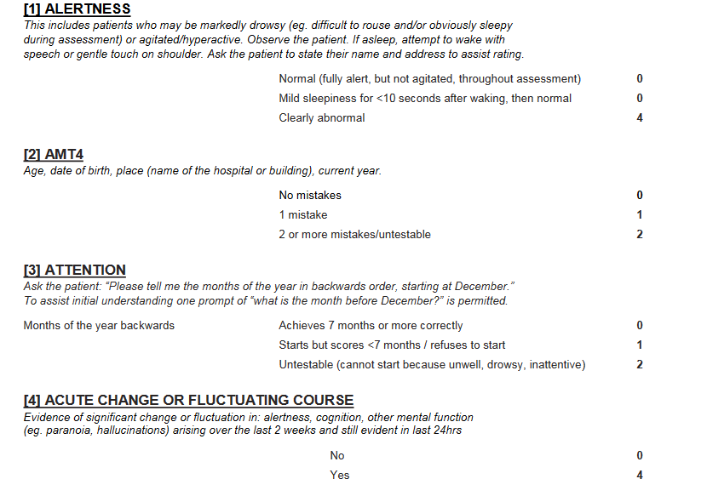

Slide 12
Causes of Delirium
D – drugs, dehydration, deficiencies
E – electrolyte abnormalities, elimination problems
L- lungs, liver
I – infection, iatrogenic
R – renal failure, restraint
I – infarction, injury, intoxication
U – UTI, unfamiliar environment
M – metabolic, metastases

Slide 13
Drugs and Delirium
Acute withdrawal of benzodiazepines can precipitate delirium
Anticholinergic meds eg TCAs, oxybutynin
Sedative medications
Opioid analgesia
Antihistamines
Parkinson’s meds eg L-dopa
Other possible drug causes include Quinine, Prednisolone, atropine

Slide 14
Addressing Delirium
Identifying and addressing the physical precipitant is fundamentally the correct course of action
Try and avoid the ‘off legs ? UTI’ school of thought and go for a more individualised and nuanced approach to the patient
Careful history taking, collateral history, physical exam and basic initial investigation may well identify the acute precipitant; cognitive assessment on admission is also a must for >65s

Slide 15
Addressing Delirium II
Treating agitation should always involve non-pharmacologic methods.
  Quiet well-lit environment, avoid frequent moves, frequent re-orientation, allow family to stay longer, provide glasses and hearing aids, allow to mobilise unless actively unsafe
  Only if these fail and the patient poses a danger to themselves and others should sedation be considered
  Emergency sedation can be given under common law; however ongoing pharmacological management of delirium should be done under AWI legislation

Slide 16
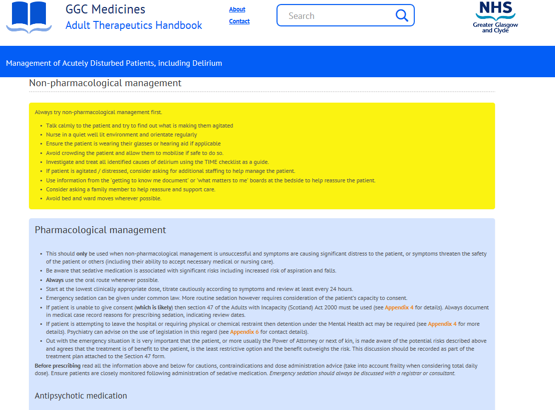

Slide 17
Pharmacologic Management
Indications for Haloperidol have recently been revised; use of Haloperidol in patients with pre-existing prolonged QT or co-prescribing with medications which prolong QT (from amantadine to zuclopentixol!) is now off-licence
Oral route first line
  Haloperidol 500mcg to 1mg PO/500mcg IM
  Risperidone 250mcg – lower risk for QT but still require an ECG during treatment
  Benzodiazepines should be QT neutral and can be used in patients with Parkinson’s/ PD+ syndromes

Slide 18
Communicating about Delirium
We all have a lot of experience of seeing patients with delirium
However for patients themselves, and for their loved ones, it is often a shocking and frightening experience
If you think a patient has delirium, explaining the condition and sharing why you think it is present to the patient’s family can go a long way to alleviate their concerns and interpret this upsetting and unfamiliar situation for them

Slide 19
Summary
Defining delirium
The importance of delirium as a clinical problem
Causes
Addressing delirium
Communicating about delirium

Slide 20
References
NICE guideline 103 Delirium: prevention, diagnosis and management 2010 available at https://www.nice.org.uk/guidance/cg103/chapter
British Geriatric Society guidelines available at www.bgs.org.uk
Scottish Delirium association website available at www.scottishdeliriumassociation.com
The 4AT available at 4AT.org
Cognitive assessment of older people Young J, Meager D, MacLullich A BMJ 2011; 343 d5042
Essential Geriatrics 2nd edition Woodford H Oxford 2010
GGC Adult Therapeutics Handbook available on GGC intranet

Slide 21
Thank you
Please fill out the feedback form for your certificate of learning

Slide 22
Get in touch!
Website
www.quackmeded.co.uk
Email
gg-uhb.quackmeded@nhs.net
Social Media
Twitter: @QUACK_ Med
Facebook: QUACK education

