Slide 1
Acute Inflammatory Dermatoses
Dr Myranda Attard
Dr Amrita Randhawa
Queen Elizabeth University Hospital, Glasgow
September 2020

Slide 2
Disclaimer*
Please note that QUACK is a regional teaching programme operating across GG&C, Lanarkshire and Ayrshire & Arran.
This presentation outlines general management, though local variances e.g. antibiotic prescription may vary slightly depending on your local trust
Remember to check your local guidelines

Slide 3
Content
Eczema/dermatitis
Blistering skin
Cutaneous vasculitis
Urticaria

Slide 4
Eczema/ Dermatitis
Types:
Atopic (most common)
Contact – Allergic/ Irritant
Discoid
Seborrheoic
Venous
Pompholyx

Slide 5
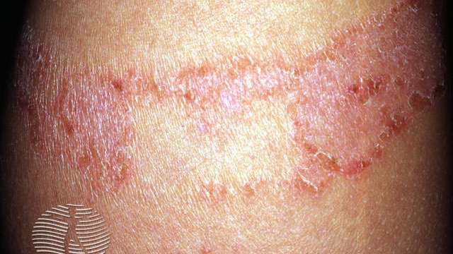
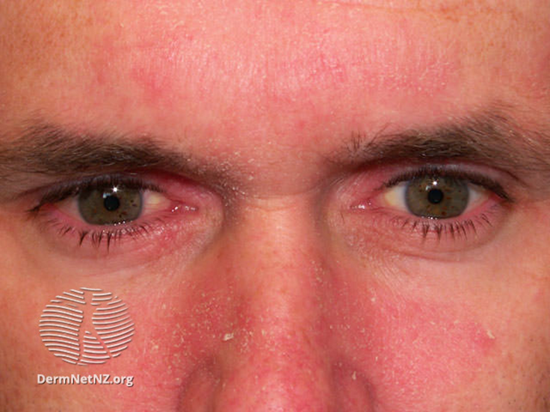
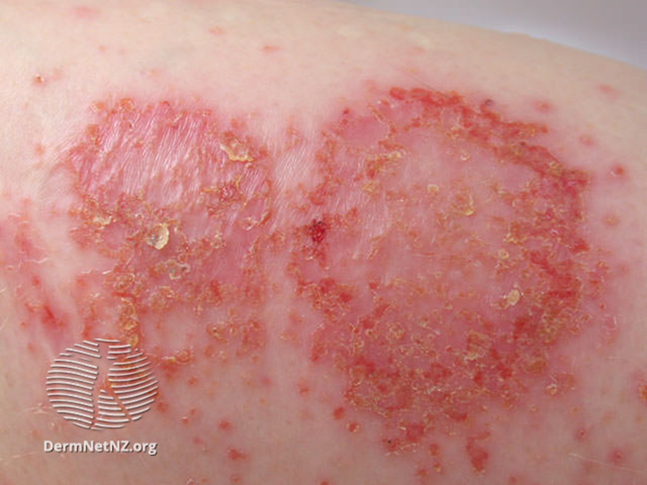
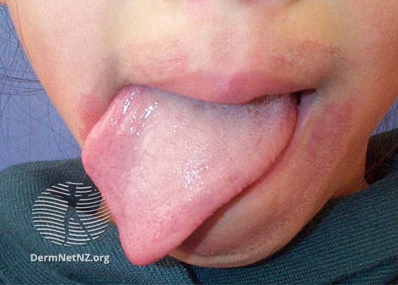
Contact dermatitis to plaster
Seborrhoeic dermatitis
Discoid eczema
Irritant dermatits

Slide 6
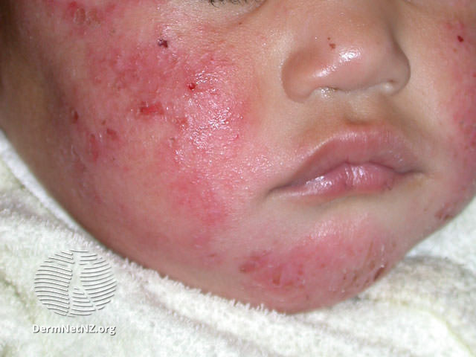
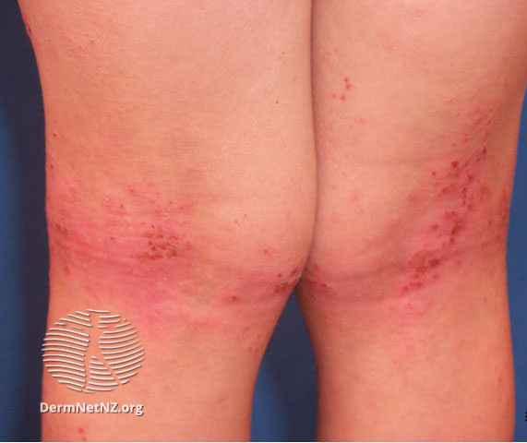
Atopic eczema

Slide 7
History – causes, severity, complications
Presenting complaint:
Onset, duration, new / chronic, persistent / intermittent?
  Sites - body surface area involved
  Symmetrical vs asymmetrical? Localised vs generalised? Flexures vs extensors?
  Symptoms – Itch? Sleep disturbance? Tender?
  Blistering, Vesicles? Crusting, Weeping?
  Associated signs: nails, hair, mucosal, joints, lymph nodes?
  Prodrome? Fever?
  Any obvious trigger? Photosensitive? Cold sore?
PMH:
  Atopy – asthma, hay fever etc
  History of eczema/ psoriasis

Slide 8
History (cont)
FH:
  Atopy/eczema
  Other house members unwell? Similar rash
SH:
  Occupation – any chemical exposure?
  Change in shampoo, shower gels, detergents
  Acrylic nails, Hair dye
  Smoker? TOPICAL TREATMENT IS FLAMMABLE
DH:
  Treatment to date - compliance?
  New drugs +/- increased doses?
  OTC drugs
  Allergies

Slide 9
Investigations – 3Bs
Bedside:
  Full skin examination
  Observations
  Bacterial and viral skin swabs
  Skin scraping/ Nail clippings for mycology
Bloods:
  FBC, U&Es, LFTs, CRP – only if indicated
Biopsy:
  Dermatitis is generally a clinical diagnosis
  Occasionally required in difficult cases or if not responding to treatment

Slide 10
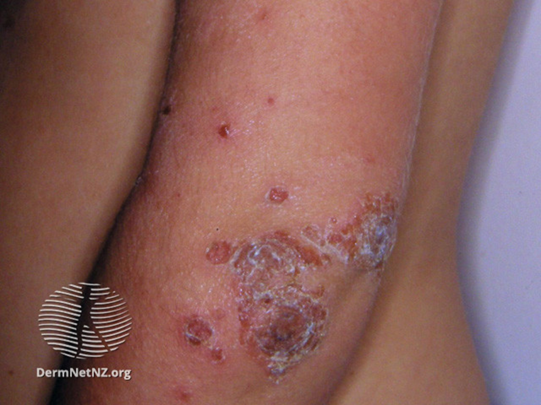
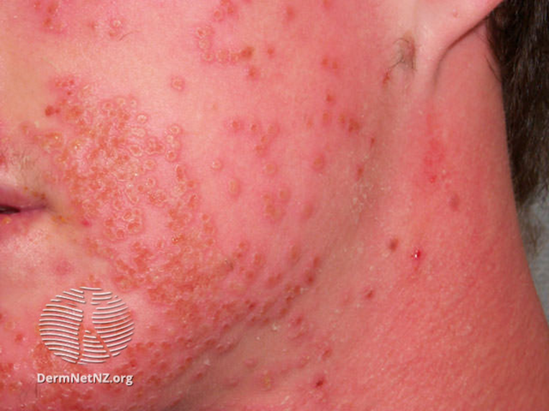
Complications
Impetigo
Infection – Impetigo, Eczema herpeticum
Dehydration
Lichenification
Erythroderma
Sleep deprivation
Family unit disruption
Psychological impact
Eczema herpeticum

Slide 11
Treatment
  Soap substitutes
    QV wash
    Dermol 500 (antiseptic)
  Emollients
    Lotions
    Creams
    Ointments
  Dressings
    Tubular bandages
  Other
    Remove trigger
    Treat infections
    Manage complications

Slide 12
1st Line Treatment | 2nd/3rd Line Treatment
Topical Corticosteroids* Trunk/Limbs: Very potent - Dermovate Potent - Betnovate, Elocon Face: Moderately potent - Eumovate Mild - 1% hydrocortisone Steroid sparing: Topical tacrolimus/Pimecrolimus | Phototherapy Systemic agents: Methotrexate Azathioprine Mycophenolate mofetil Ciclosporin Biologics: - Dupilimumab
*Depending on severity, start with a more potent topical steroid and taper down to a less potent one over 2-4 weeks

Slide 13

Eczema/ Dermatitis
Take Home Message
Many types of eczema – atopic eczema is commonest
Identify and remove any obvious trigger
Be aware of topical corticosteroid ladder
Topical treatment is flammable – advise smoking cessation
Monitor for complications – infection, dehydration, erythroderma, psychological impact

Slide 14
Blistering skin
Terminology:
Vesicle - <5mm diameter
Bulla- large blister
Erosion that can become crusted once blister roof detaches exuding serous fluid
Intra epidermal - Thin roof
Sub epidermal - Thick roof

Slide 15
Differential diagnosis
      Primary
      Bullous pemphigoid
      Pemphigus vulgaris
      Dermatitis herpetiformis
      Linear Ig A disease
      Bullous vasculitis
      Porphyria cutanea tarda
      Pemphigoid gestationis
      Inherited blistering disease
  Secondary
  Trauma, burn
  Viral - VZV, HSV
  Bacterial - Bullous impetigo
  Eczema, pompholyx, contact dermatitis
  Insect bite
  Drug reaction - photosensitivity, SJS etc

Slide 16
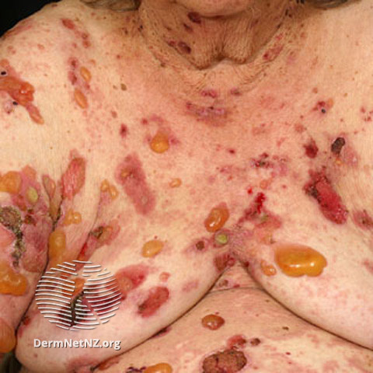
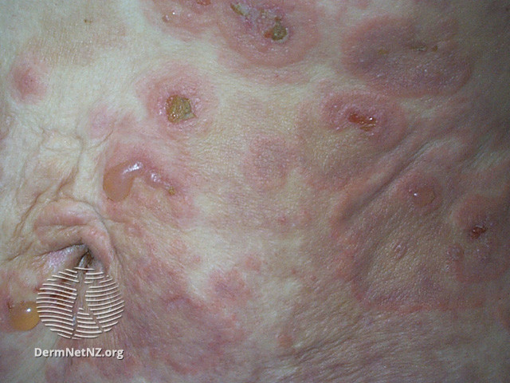
Commonest immunobullous disorder
Bullous pemphigoid

Slide 17
Bullous pemphigoid
Mostly affects people over 50 years old
Oral involvement in 1/3
Causes:
  Autoimmune
  Drugs - pembrolizumab, nivolumab, gliptins, penicillamine, frusemide, captopril, penicillin, sulfasalazine
  Paraneoplastic
Diagnosis by histology and immunofluorescence – x2 skin biopsies
Prognosis: Burns out in 3-7 years
Tail down treatment slowly to prevent withdrawal flare

Slide 18
Bullous pemphigoid
Standard treatment
Soap substitute
Emollient LP:SWP 50:50
Analgesia
Manage underlying cause
Active treatment
Prednisolone 0.5mg/kg/day with bone protection and PPI cover
AND Doxycycline 100mg BD
AND Very potent topical steroid - Dermovate ointment OD

Slide 19
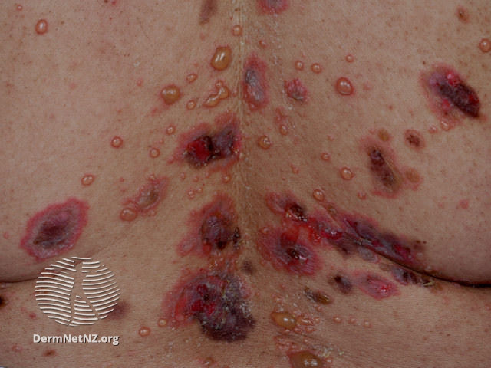
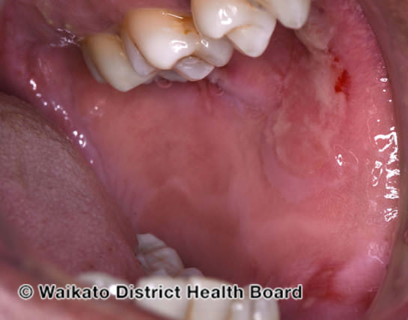
Pemphigus vulgaris

Slide 20
Pemphigus vulgaris
Treatment:
Soap substitute, emollient
Analgesia
MDT input – oral medicine, ophthalmology, ENT
High doses oral prednisone or
Pulsed IV methylprednisolone
Then add steroid sparing agent
Azathioprine
Mycophenolate mofetil
Cyclophosphamide
Rituximab - anti-CD20 monoclonal antibody
Rare autoimmune disease
Oral or genital ulceration
Flaccid blisters with erosions
Less common types:
Pemphigus foliaceus
Paraneoplastic pemphigus
Drug-induced pemphigus
Complications:
Painful, slow-to-heal ulcers
Superinfection
Spread to larynx causing hoarseness
Difficulty oral intake, nutritional deficiency

Slide 21
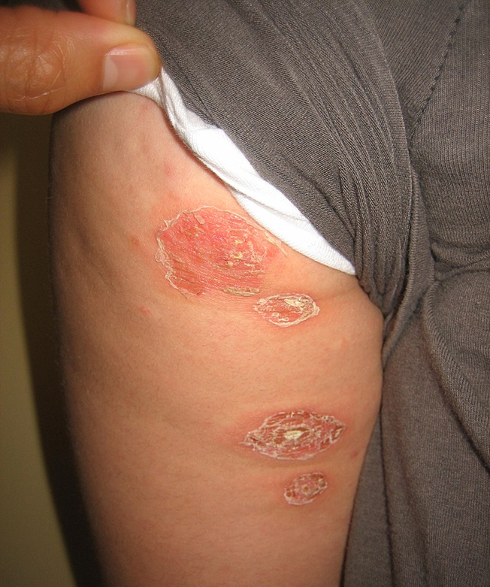
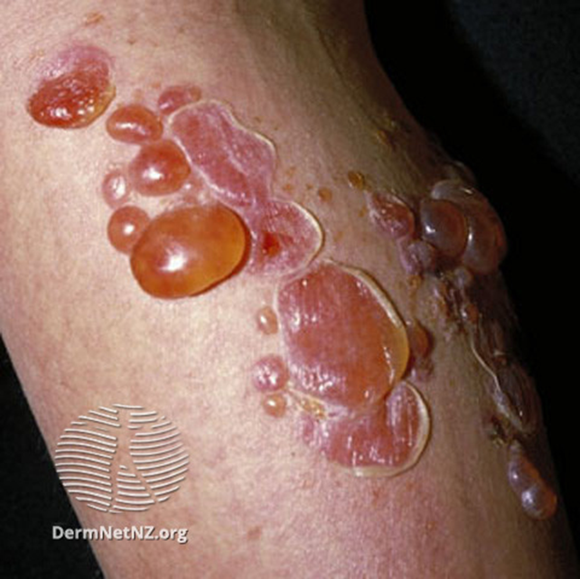
Bullous impetigo
Cause:
Staphylococcal exfoliative toxins
Presentation:
Small vesicles that evolve into flaccid bullae
Diagnosis:
Clinical but confirmed through bacterial swabs
Treatment:
Oral antibiotics
Prevent recurrence
  Treat carrier sites and others infected
  Dermol soap substitute – antibacterial
  Cut nails and hand hygiene

Slide 22
Blistering skin
Take Home Message
Full skin examination including examination of mucous membrane is essential
Many causes for bullous skin disease – Bullous pemphigoid is the most common autoimmune blistering disease
Regularly monitor for complications of systemic steroids – hypertension, infections, osteoporosis, hyperglycaemia
Management involves a MDT approach
Remember the importance of pain management

Slide 23
Cutaneous vasculitis
Large vessel – eg Giant cell arteritis
-> infrequent skin manifestations
Medium – eg Polyarteritis nodosa
-> nodules, livedo reticulitis
Small – most commonly seen
-> symmetrical palpable purpura on the lower limbs
Capillaritis
-> pigmented purpuric dermatosis

Slide 24
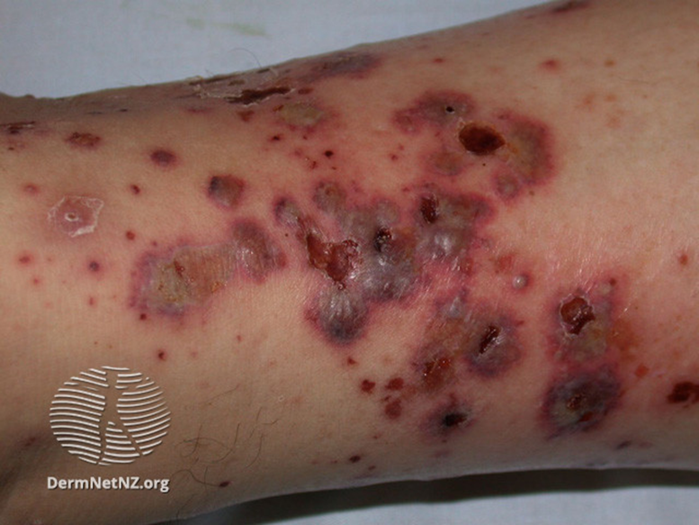
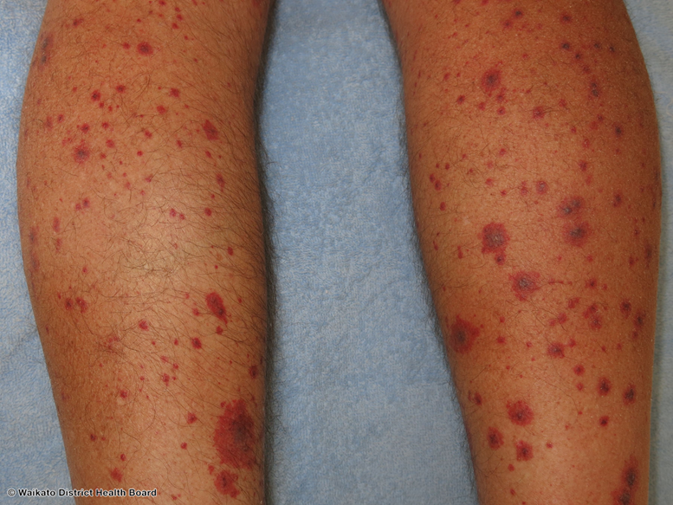
Small vessel vasculitis
Types:
Idiopathic (most commonly drug induced or infection driven)
Henoch Schonlein Purpura
Urticarial vasculitis
ANCA associated vasculitis
Cryoglobulinaemia
Cutaneous necrotising vasculitis
Hypersensitivity vasculitis

Slide 25
Investigations
Remember full skin, mucosal, lymph node examination
Bedside:
  Observations, weight
  Bacterial and viral skin swabs
  Urinalysis
Bloods:
  FBC, U&Es, LFTs, CRP
  Vasculitis screen - ANA, ENA, ANCA, complement, immunoglobulins, cryoglobulins, HIV, HBV, HCV
Biopsy:
x2 for Histology and Immunofluorescence
(not always required for idiopathic cutaneous vasculitis)

Slide 26
Standard treatment
Soap substitute, emollient
Rest, elevation, support stockings
Analgesia
Remove the trigger (infection/drug)
Manage complications – skin breakdown
Rheum/renal involvement if indicated
Topical steroid
Prednisolone 0.5mg/kg/day x 1-2weeks, tapered over 3-6 weeks
Colchicine 0.6mg BD
Dapsone 100mg OD
Active treatment

Slide 27
Cutaneous vasculitis
Take Home Message
Palpable symmetrical purpura – most commonly secondary to small vessel cutaneous vasculitis
Always rule out systemic involvement – check blood pressure, urinalysis and vasculitis screen
Exclude coagulopathy or medication causing purpuric rash
Remember HIV, HBC, HCV in vasculitis screen
Rest, elevation +/- compression of the leg is standard management
Usually resolves in 4-6 weeks

Slide 28
Urticaria
Acute
<6 weeks
Viral
Bacterial
Drugs
Insect bite
Food
Chronic
Inducible
Symptomatic dermographism
Cold
Heat
Solar
Aquagenic
Contact
Delayed pressure
Vibratory
Cholinergic (Sweat)
Spontaneous
Idiopathic
Autoimmune
Associated with chronic underlying infection
eg. H pylori

Slide 29
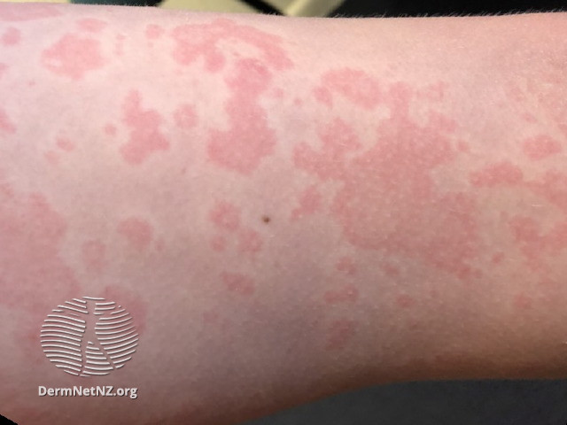
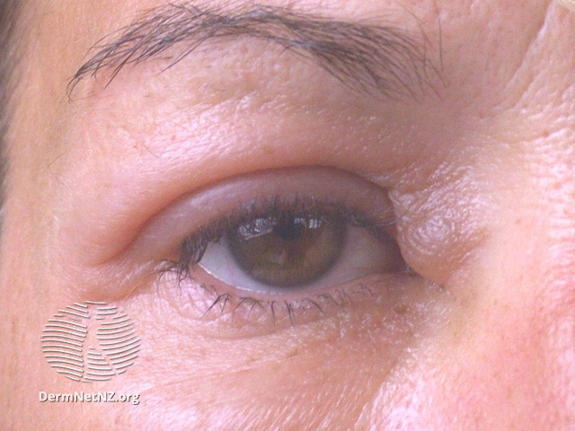
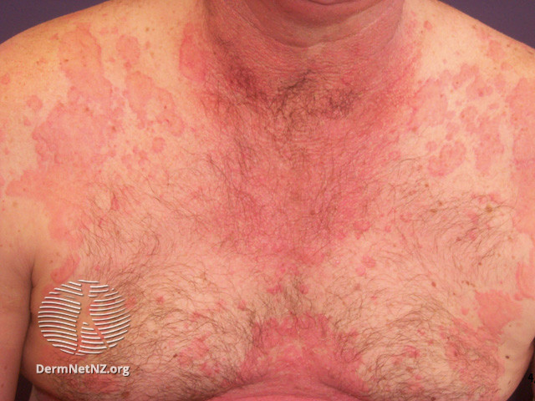
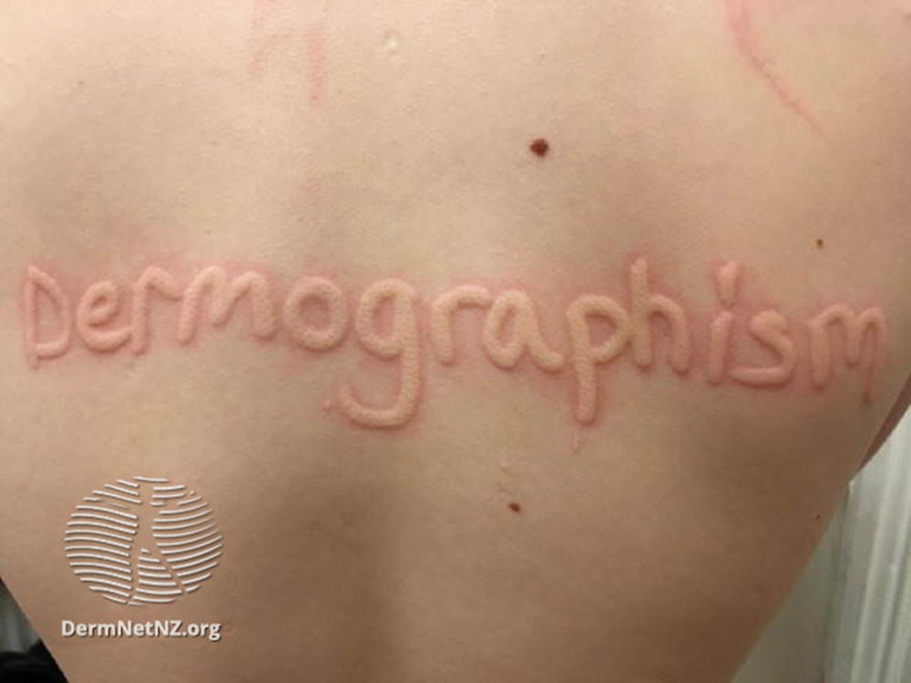
Urticarial wheals
Urticarial wheals
Urticarial wheals
Angioedema
Angioedema

Slide 30
Diagnosis
History
Duration of wheals – classically lasts less than 24 hours
Associated symptoms - very itchy, angioedema etc
Triggers
Inducible urticaria is often confirmed by inducing the reaction
eg. scratching the skin in dermographism or applying an ice cube in suspected cold urticaria, exercise, delayed pressure
Skin prick tests and radioallergosorbent tests (RAST)
if a drug or food allergy is suspected in acute urticaria
Biopsy
if urticarial vasculitis is suspected

Slide 31
Treatment
Remove trigger
Avoid aspirin, NSAIDs, opiates
Antihistamines - cetirizine, fexofenadine
Regular emollient - menthol 1%
Ranitidine – not currently in use due to global shortage
Montelukast
Omalizumab

Slide 32
Urticaria
Take Home Message
The cause of urticaria is often idiopathic and the process burns out with time
For Inducible urticaria – avoid the trigger
Recurrent angioedema can be due to the use of ACEi
Treatment is high dose antihistamine

Slide 33
Learning points
History is key
Common things are common - exclude infection
Use the 3Bs of investigation
Examine all the skin, use medical photography to assess progress
Standard management - soap substitute, emollient, remove trigger
Holistic management - Skin disease has great impact on psychosocial wellbeing

Slide 34
Get in touch!
Website
www.quackmeded.co.uk
Email
gg-uhb.quackmeded@nhs.net
Social Media
Twitter: @QUACK_ Med
Facebook: QUACK education

Slide 35
References
Dermnet NZ images
Simpson EL, Hanifin JM. Atopic eczema. Periodic synopsis. J Am Acad Dermatol. 2005 Jul;53(1):115-28. Medline
Kim JP, Chao LX, Simpson EL, Silverberg JI. Persistence of atopic dermatitis (AD): A systematic review and meta-analysis. J Am Acad Dermatol. 2016 Oct;75(4):681-687.e11. doi: 10.1016/j.jaad.2016.05.028. Epub 2016 Aug 17. Review. PubMed PMID: 27544489; PubMed Central PMCID: PMC5216177. PubMed.
Murrell DF, Daniel BS, Joly P, Borradori L, A et al. Definitions and outcome measures for bullous pemphigoid: recommendations by an international panel of experts. J Am Acad Dermatol. 2012 Mar;66(3):479-85. doi: 10.1016/j.jaad.2011.06.032. Epub 2011 Nov 5. PubMed. PubMed Central
British Association of Dermatologists’ guidelines for the management of bullous pemphigoid 2012 VA Venning, K Taghipour, MF Mohd Mustapa, AS Highet and G Kirtschig, BJD, Vol. 167, No. 6, December 2012 (p1200-1214)
Book: Textbook of Dermatology. Ed Rook A, Wilkinson DS, Ebling FJB, Champion RH, Burton JL. Fourth edition. Blackwell Scientific Publications.
Gota C. Overview of cutaneous small vessel vasculitis. In: UpToDate, Post TW (Ed), UpToDate, Waltham, MA. (Accessed on January 23, 2016.)
Guidelines for evaulation and management of urticaria in adults and children (CEH Grattan and FY Humphreys). BJD, Vol. 157, December 2007 (p1116-1123)
Greenberger PA. Chronic urticaria: new management options. World Allergy Organ J. 2014 Nov 5;7(1):31. doi: 10.1186/1939-4551-7-31. eCollection 2014. Review. PubMed PMID: 25383135; PubMed Central PMCID: PMC4223736.

