Slide 1
Acute Kidney Injury (AKI) in the first 24 hours
Kaitlin Mayne
ST3 Renal/GIM

Slide 2
Disclaimer*
Please note that QUACK is a regional teaching programme operating across GG&C, Lanarkshire and Ayrshire & Arran.
This presentation outlines general management, though local variances e.g. antibiotic prescription may vary slightly depending on your local trust
Remember to check your local guidelines

Slide 3
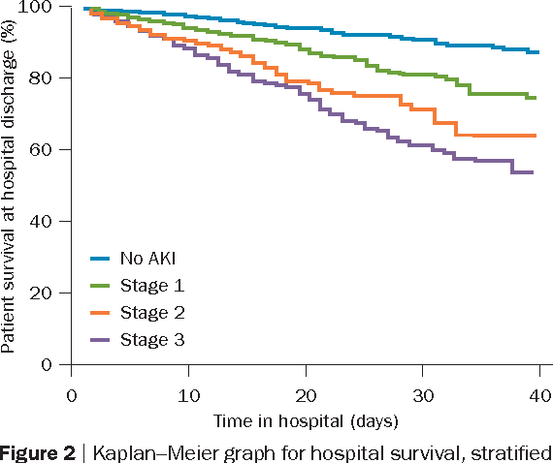
Why is AKI important (in acute medicine)?
Common: 1 in 5 hospitalised adults
65% of AKI starts in the community
Poor renal outcomes
↑ risk further AKI, CKD & ESRD
High overall mortality
Prolonged hospital stay - expensive
Rewa O, Bagshaw SM. Acute kidney injury—epidemiology, outcomes and economics. Nature. 2014;10:193-207.

Slide 4
AKI language
Stage | Serum creatinine (sCr) | Urine output
I | 1.5–1.9 times baseline OR ≥26.5 µmol/l increase * | <0.5 ml/kg/h for 6–12 hours
II | 2.0–2.9 times baseline * | <0.5 ml/kg/h for ≥12 hours
III | 3.0 times baseline OR Increase in sCr to ≥353.6 µmol/l * | <0.3 ml/kg/h for ≥24 hours OR anuria for ≥12 hours
* when creatinine change is known/presumed to have occurred within past 7 days
Don’t use eGFR in AKI
  eGFR formula assumes creatinine in steady state, not valid if changing
  Do not use eGFR in drug dosing in AKI – not safe
2012 Kidney Disease: Improving Global Outcomes (KDIGO) Clinical Practice Guideline for Acute Kidney Injury (AKI)

Slide 5
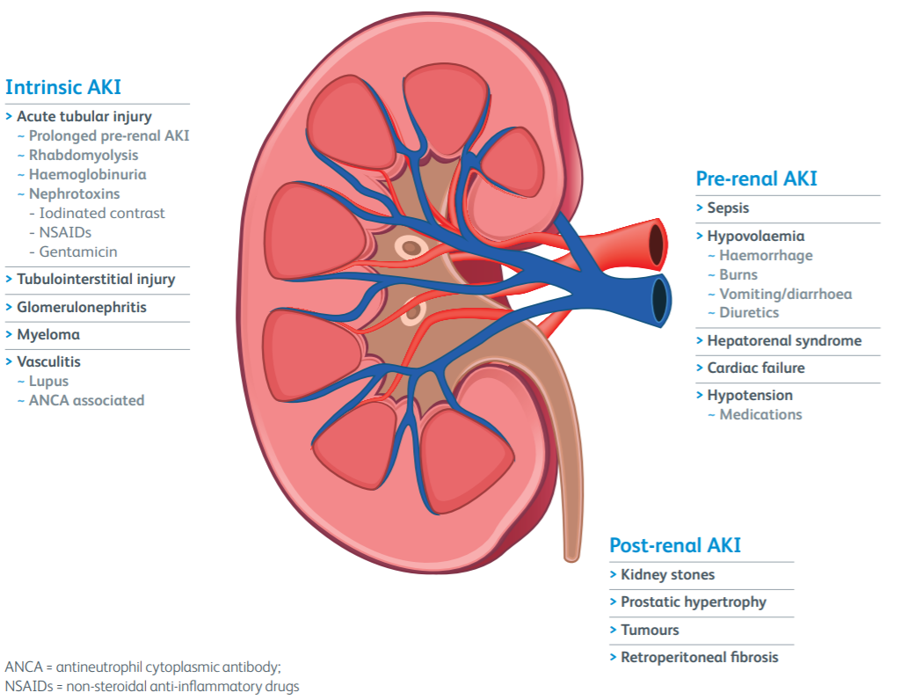

Causes of AKI
80% of all AKI
Often multifactorial
Urology
Renal USS ?hydronephrosis
Royal College of Physicians: Acute care toolkit 12 Acute kidney injury and intravenous fluid therapy

Slide 6
Cause of AKI - Clinical history
GI upset, infection symptoms, medications | Pre-renal
Frank haematuria, oedema | Glomerulonephritis likely
Fever, arthralgia, rash, haemoptysis | Vasculitis
‘Fall with long lie’/crush injury + raised creatine kinase | Rhabdomyolysis
Lower urinary tract symptoms | Obstruction
Rare associations not to miss:
Renal dysfunction + microangiopathic haemolytic anaemia, thrombocytopenia, neurological symptoms
Renal dysfunction + recent vascular intervention +/- livedo reticularis, low complement
Thrombotic microangiopathy (TTP, HUS)
Cholesterol embolism

Slide 7
Antibiotics to be aware of
Trimethoprim ↑creatinine ≠ AKI
  Inhibits tubular creatinine secretion – rapid, reversible rise in sCr independent of change to GFR
  Blocks distal potassium excretion – hyperkalaemia
Nitrofurantoin avoid if eGFR <45
  Not excreted in urine if creatinine clearance <30 therefore inadequate urine concentration to treat UTI and risk of toxicity
Gentamicin
  Directly nephrotoxic – tubular damage
  Risk factors: age, hypovolaemia, liver/renal dysfunction, prolonged therapy, hypokalaemia, hypomagnesaemia
  Avoid concurrent prescription of potentially nephrotoxic drugs

Slide 8
Contrast-associated AKI
(preferred to contrast nephropathy/contrast-induced AKI)
Usually multifactorial aetiology
Usually transient elevation in creatinine days 3-7
Risk factors:
Patient-related: strongest is CKD, age, inpatient, volume depletion, heart failure, chronic lung disease, myeloma, concurrent drugs
Procedure-related: osmolality of contrast agent, intra-arterial vs venous (angiography vs CT), high doses, multiple doses
If CKD 4/5 considering discussing with Renal team beforehand
Volume repletion generally advised, conflicting data/lacks RCT evidence
Bottom line: if the investigation with contrast is needed – do it

Slide 9
Acute tubular necrosis (ATN)
Commonest cause of intrinsic AKI
Ischaemic or toxic injury to tubular epithelial cells
Usually associated with hypotension, hypovolaemia, sepsis, nephrotoxic drugs (gentamicin, tacrolimus/ciclosporin)
3 phases: initiation, maintenance, recovery – polyuria in recovery
Can be caused by prolonged pre-renal AKI, mainstay is prevention
Difficult to differentiate from pre-renal AKI
  Urinary sodium low in pre-renal, >30 in ATN
  Earlier response to IV fluids in pre-renal vs ATN
No effective treatment once established, fluids helpful in early ATN

Slide 10
Clinical assessment of the patient with AKI
Volume status – hypovolaemic, euvolaemic or hypervolaemic?
Oedema
JVP
Mucous membranes
Skin turgor
Chest auscultation
Urine output
Weight
Blood pressure, O2 saturations
Other
Look for signs of infection
Examine for palpable bladder ?retention
Signs of systemic disease

Slide 11
Investigations
Urinalysis – blood/protein
Urine protein:creatinine ratio (uPCR)
  >300mg/mmol = nephrotic range
Bicarbonate (automatic in NHSL, need to request in GGC)
Glomerulonephritis screen
  ANCA (MPO/PR3), ANA, anti-GBM, RF, complement
  Myeloma screen: Igs & SPE, BJP, bone profile
Renal USS within 24 hours unless clear cause/improving

Slide 12
Management
Address the cause – AKI in itself is not a disease or diagnosis
Hypovolaemia – fluid resuscitation
Hypotension – if persists once euvolaemic ?vasopressors
Sepsis
Obstruction – relieve it - Urology
Fluid balance – catheter
Manage complications
  Hyperkalaemia, acidosis
Medication review
  Withold potential nephrotoxins – ACEI/ARB/NSAIDs/diuretics
  Avoid antihypertensives if low BP
  Adjust doses according to CrCl – antibiotics, opiates, antiepileptics, diabetes drugs, anticoagulants
  Monitor levels where appropriate eg. digoxin, lithium

Slide 13
When to refer to Renal
When not to phone Renal first:
Obstruction – urology
Multi-organ failure/haemodynamic instability - ICU
Stage III AKI
Stage II AKI not responding to treatment
Suspected intrinsic renal cause, even if mild AKI
  Proteinuria/haematuria
  No clear precipitant for AKI
  Signs of systemic disease – rash, joint pain, pulmonary haemorrhage
Indication for urgent dialysis
AKI in transplant patient

Slide 14
Indications for urgent dialysis
Refractory* hyperkalaemia >6.5mmol/l
Refractory* metabolic acidosis pH<7.15
Refractory* pulmonary oedema
Anuria
Uraemic pericarditis/encephalopathy
*despite maximal medical therapy

Slide 15
Key points
80% of AKI is pre-renal in aetiology, often multifactorial
Avoid referring to eGFR in AKI
AKI is not a diagnosis in itself – find and treat the cause
Urinalysis (+ uPCR if proteinuria) is essential
Fluid balance key to management

Slide 16
Get in touch!
Website
www.quackmeded.co.uk
Email
gg-uhb.quackmeded@nhs.net
Social Media
Twitter: @QUACK_ Med
Facebook: QUACK education

