Slide 1
Haematological Malignancies
Samantha Drummond
Clinical Teaching Fellow in Haematology

Slide 2
Disclaimer*
Please note that QUACK is a regional teaching programme operating across GG&C, Lanarkshire and Ayrshire & Arran.
This presentation outlines general management, though local variances e.g. antibiotic prescription may vary slightly depending on your local trust
Remember to check your local guidelines

Slide 3
Learning outcomes
By the end of this lecture you should be able to:
Describe the different types of haematological malignancies
Outline the pathophysiology and presenting features of AML
Suggest initial investigations and treatment for AML
Describe the pathophysiology of CML
Describe the presentation, investigation and management of CML
Explain the presenting features of MDS
Suggest initial investigations and management of MDS

Slide 4
Overview
Overview of haematological malignancies
Myeloid lineage malignancies
  AML
  CML
  MDS

Slide 5
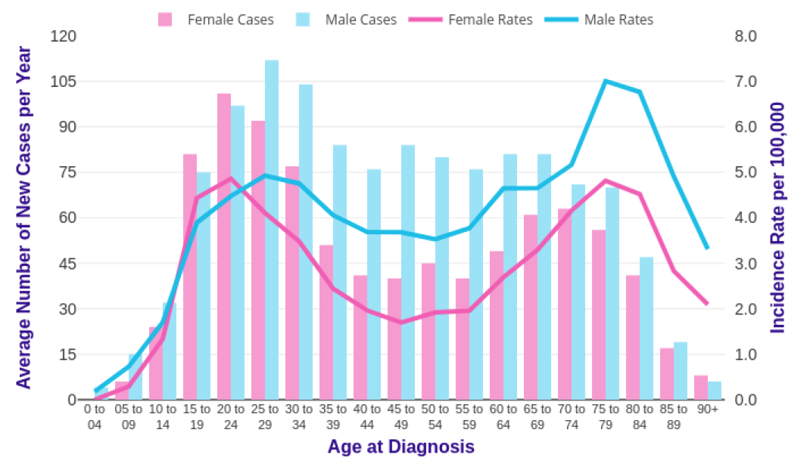
Haematological malignancies
Account for about 10% of all cancers
Occur in all age groups
Notes:
Haematological malignancies are relatively rare, accounts for about 8% of all malignancies
Occur in all age groups including children however most increase with age
Graph is of Hodgkin lymphoma

Slide 6
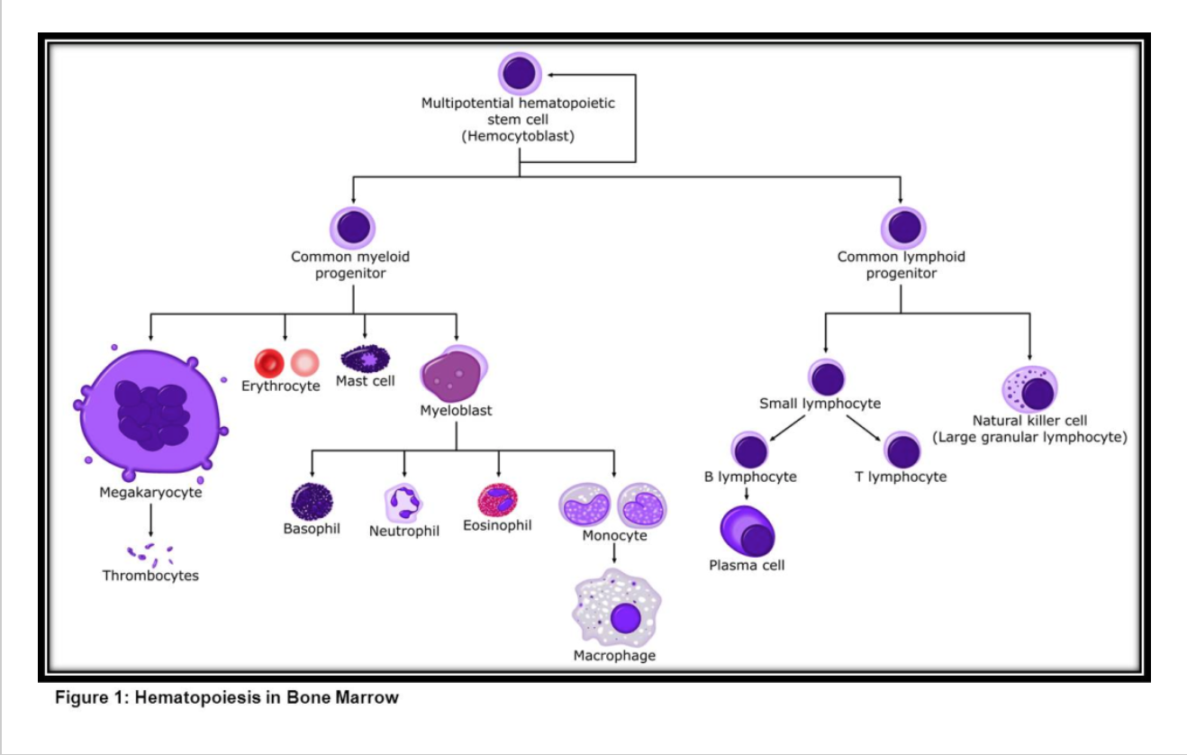

Slide 7
Red cells
Myeloid precursors
Neutrophils
Monocytes
Basophils
Eosinophils
Stem cell
Platelets
Lymphoid precursors
B lymphocytes
Plasma cells
T lymphocytes

Slide 8
Red cells
Myeloid malignancies
Myeloid precursors
Neutrophils
Monocytes
Basophils
Eosinophils
Stem cell
Platelets
Lymphoid precursors
B lymphocytes
Plasma cells
T lymphocytes
Notes:
This includes

Slide 9
Red cells
Myeloid precursors
Neutrophils
Monocytes
Basophils
Eosinophils
Stem cell
Platelets
Lymphoid malignancies
Lymphoid precursors
B lymphocytes
Plasma cells
T lymphocytes

Slide 10
Red cells
Myeloid precursors
Neutrophils
Monocytes
Basophils
Eosinophils
Platelets
Multiple myeloma
Stem cell
Lymphoid precursors
B lymphocytes
Plasma cells
T lymphocytes

Slide 11
Major Groups of Haematological Malignancies
Acute Leukaemias
  Acute myeloid leukaemia (AML)
  Acute lymphoblastic leukaemia (ALL)
Chronic Leukaemias
  Chronic myeloid leukaemia (CML)
  Chronic lymphocytic leukaemia (CLL)
Lymphoma
  Non-Hodgkin lymphoma (NHL)
  Hodgkin lymphoma (HL)
Multiple myeloma
Myelodysplastic syndromes (MDS)
Myeloproliferative neoplasms
Notes:
Polycythaemia rubra vera, essential thrombocytosis and myleofibrosis

Slide 12
Leukaemia vs Lymphoma
Leukaemia
Distribution of disease is the bone marrow and blood
Lymphoma
Distribution of disease is predominantly lymph nodes and solid organs
Notes:
Leukaemia is the 12th most common cancer in the UK, accounting for 3% of all new cancer cases (2017)
Non-Hodgkin lymphoma is the 6th most common cancer in the UK, accounting for 4% of all new cancer cases (2017).
Hodgkin lymphoma is not among the 20 most common cancers in the UK, accounting for less than 1% of all new cancer cases (2017).
Not mutually exclusive

Slide 13
Acute vs chronic leukaemia
Acute
Short duration
Rapid deterioration and fatal if untreated
Tends to affect very early cells
Bone marrow failure
Potentially curable
Chronic
Insidious onset
Can be asymptomatic
Affects more mature cells
Proliferation without bone marrow failure
Survival for a few years
May not necessarily require treatment
Currently not curable without BMT
Notes:
Concept of bone marrow failure
Leukaemic cells do not differentiate
Leukaemic cells retain ability to differentiate

Slide 14
Lymphoma
Majority present with nodal disease
  75% of adults present with nodal disease
Extra-nodal disease
  25% present with with extra-nodal disease
Systemic disease
  Fever, drenching sweats, weight loss, pruritis, fatigue
Notes:
Lymphoma is the most common haematological malignancy
Extra-nodal disease includes oropharyngeal, GI, skin involvement (skin is usually T cell lymphoma)

Slide 15

Multiple myeloma
Accounts for 10% of haematological malignancies
Notes:
Accounts for about 1% of all malignancies
Proliferation of plasma cells and usually associated with paraprotein secretion

Slide 16
Multiple myeloma
C Calcium
R Renal impairment
A Anaemia
B Bone problems
Notes:
Can get lytic bone lesions

Slide 17
Red cells
Myeloid malignancies
Myeloid precursors
Neutrophils
Monocytes
Basophils
Eosinophils
Stem cell
Platelets
Lymphoid precursors
B lymphocytes
Plasma cells
T lymphocytes

Slide 18
Myeloid malignancies
Acute myeloid leukaemia
Chronic myeloid leukaemia
Myelodysplastic syndromes
Myeloproliferative neoplasms

Slide 19

Case presentation 1
64 year old man
Attends GP with ‘tiredness’
What other questions would you ask?
What else would you consider in your differential diagnosis?
Notes:
What sort of things would you ask the man?
Has this changed ? Is it stopping you from doing anything? Any weight loss? Sweats? How long has this been going on for?
What else would you consider in your differential diagnosis?
-Anaemia. Depression, hypothyroidism, OSAS,

Slide 20
Case presentation 1
64 year old man
Attends GP with ‘tiredness’
What else would you consider in your differential diagnosis?
  Anaemia
  Depression
  Hypothyroidism
  Obstructive sleep apnoea syndrome
  …
Notes:
What sort of things would you ask the man?
Has this changed ? Is it stopping you from doing anything? Any weight loss? Sweats? How long has this been going on for?
What else would you consider in your differential diagnosis?
-Anaemia. Depression, hypothyroidism, OSAS,

Slide 21
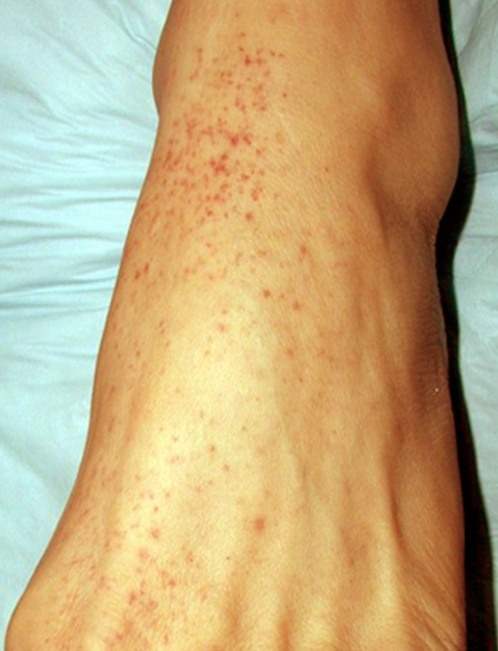
Case presentation 1 cont...
On further questioning
  Has felt short of breath on exertion over past 2 weeks
  Been feeling dizzy
  Noticed a ‘rash’
  Cough
What investigations would you like to do?
Notes:
What is this rash called?
What investigations would you like to do?
- FBC and blood film, coagulation screen, haematinics, U&E’s and LFTs, CRP, CXR and sputum culture

Slide 22
Case presentation 1 cont..
What investigations would you like to do?
  FBC and blood film
  Coagulation screen
  Haematinics
  U&Es and LFTs
  CRP
  CXR
  Sputum culture
Notes:
What is this rash called?
What investigations would you like to do?
- FBC and blood film, coagulation screen, haematinics, U&E’s and LFTs, CRP, CXR and sputum culture

Slide 23
Case presentation 1 cont…
Blood results
  Hb 65
  MCV 100
  WCC 0.9
  Neutrophils 0.3
  Platelets 12
How would you describe these results?
What would your differential diagnosis be now?
Notes:
How would you describe these blood results?
Pancytopenia
Anaemia is just macrocytic (upper limit of normal is 98)
What would your differential diagnosis be
- Bone marrow infiltration, sepsis, AML

Slide 24
Myeloid malignancies
Acute myeloid leukaemia
Chronic myeloid leukaemia
Myelodysplastic syndromes
Myeloproliferative neoplasms

Slide 25
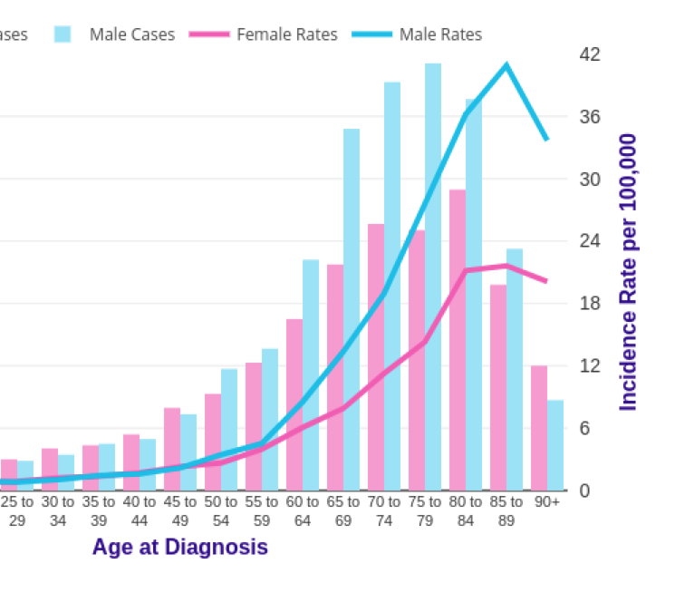
Acute Myeloid Leukaemia
Clonal expansion of myeloid blasts in the bone marrow, peripheral blood or extramedullary tissues
Epidemiology
  Most common acute leukaemia in adults
  3 per 100,000 annually
  Increasing frequency with age
Notes:
Pathophysiology- Increase in the proliferation but failure of the maturation of cells forming the myeloid lineage
Characteristically, abnormal blasts are present in the peripheral blood and normal haematopoiesis is reduced.
The accumulation of these blasts which are unable to differentiate into mature cells results in bone marrow failure

Slide 26
Acute Myeloid Leukaemia
Aetiology
  Unknown
  Association with:
    Previous chemotherapy
    Other haematologoical disorders (e.g. MPN, MDS, aplastic anaemia)
    Chromosomal abnormalities (e.g. Down syndrome)

Slide 27
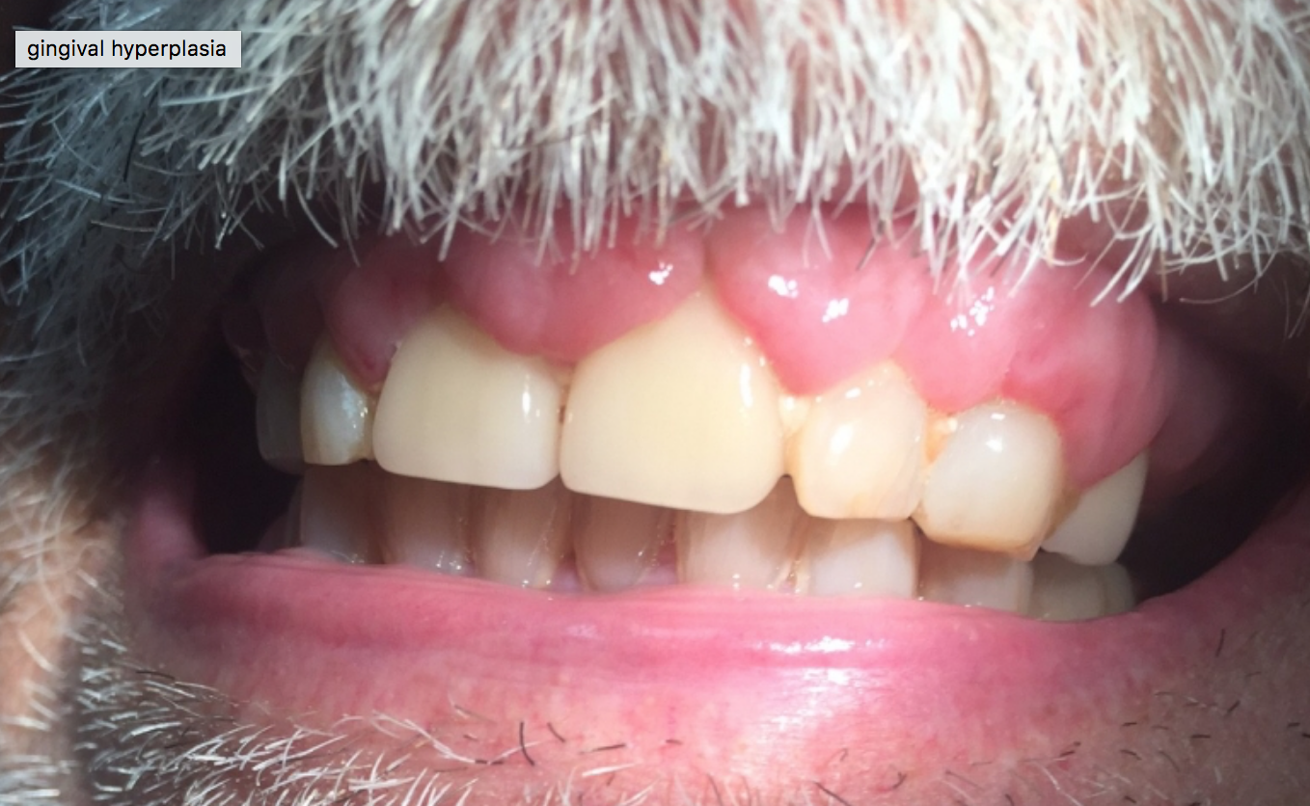
Acute Myeloid Leukaemia
Presentation
  Anaemia
  Infection
  Bleeding
  Gum hypertrophy and skin infiltration
  Hepatomegaly
  Splenomegaly
  Lymphadenopathy

Slide 28
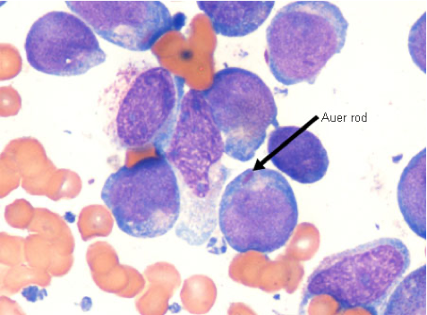
Acute Myeloid Leukaemia
Investigations
  FBC and blood film
  Coagulation screen
  Bone marrow aspirate (≥20%) and trephine
  Cytogenetics
  Immunophenotyping
  Consider LP if concern regarding CNS infiltration
Notes:
Blood film appearance is that of blast cells with Auer rods
Definitive diagnosis requires bone marrow biopsy.
WCC can be very high and this can cause leucostasis, usually presents with a high WCC but can be a low WCC as in our case
Presence of blast cells in ≥20% of the bone marrow cells confirms the diagnosis.
Auer rods are inclusion bodies is the cytoplasm which result from abnormal fusion of the primary granules. They confirm the presence of blasts

Slide 29
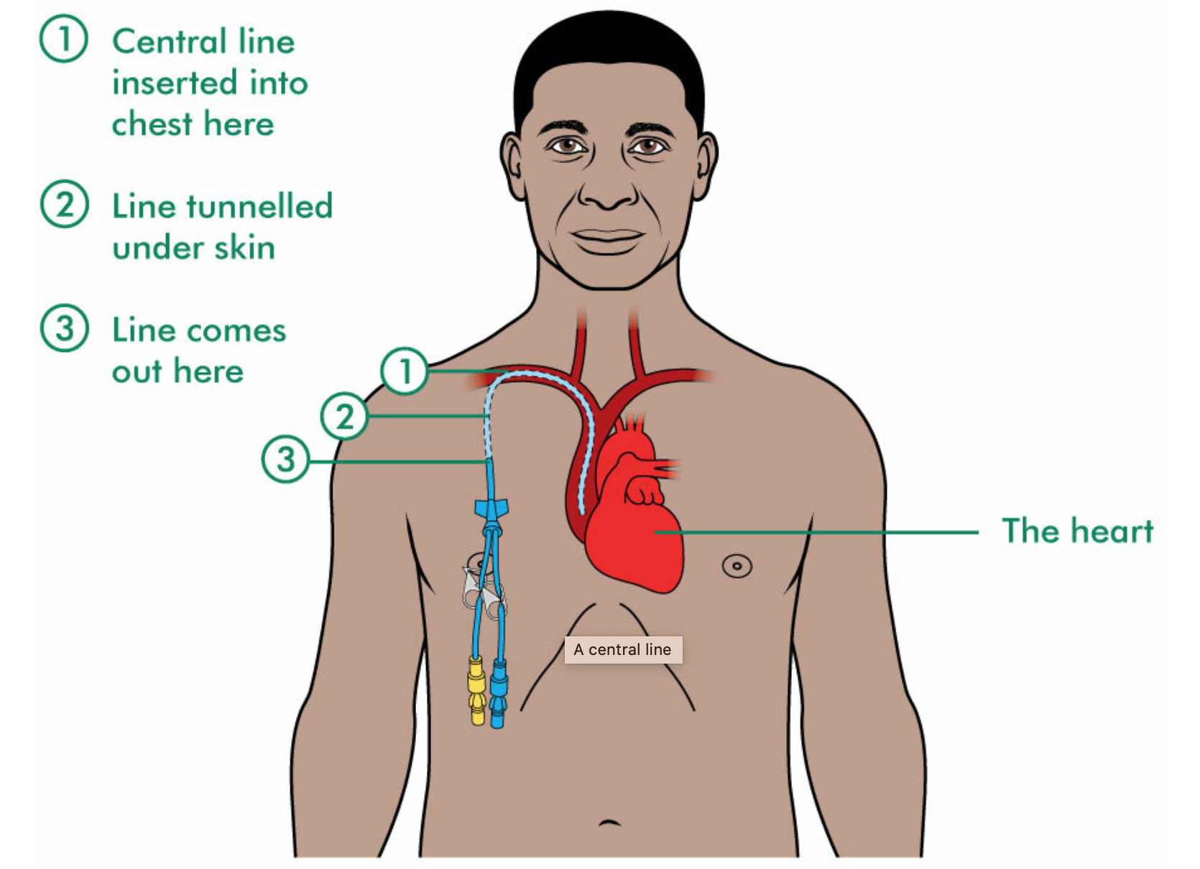
Acute Myeloid Leukaemia
Management
  Supportive e.g. blood products, antibiotic prophylaxis
  Chemotherapy
    Remission induction
    Consolidation
  Stem cell transplant
Notes:
Complete response considered <5% blast cells
Usually have a Hickman line inserted for chemotherapy- get image of Hickman line
If available patients can be entered into clinical trials
Chemo= DA (danarubicin plus cytarabine), consolidation is high dose cytarabine
In acute leaukaemia there are still some normal cells in the bone marrow, but there is a greater number of functionless blasts
During chemotherapy the normal cells are also destroyed
This worsens neutropenia and leave the patient vulnerable to infection
Treatment depends on how fit the patient is- may be for best supportive care only

Slide 30
Acute Myeloid Leukaemia
Prognosis
  70-80% of patients age <60 will achieve a complete remission
  50-60% of patients age ≥60 will achieve complete remission
Factors affecting prognosis
  Advancing age
  Failure to achieve complete remission with 1st cycle of induction therapy
  History of MDS or previous chemotherapy
  High blast count
Notes:
Older patients however have a higher rate of relapse
As well as certain mutations (FLT3)
Althoughmostpatientsachievecompleteremission,ahighincidenceofrelapseleadstopooroverall survival.

Slide 31
Acute promyelocytic leukaemia (APML)
Acute promyelocytic leukaemia (APML) is a subtype of AML
PML-RARA fusion gene (t15;17)
Associated with coagulopathy which can be life-threatening
Treatment
  Induction chemotherapy including all-trans-retinoic acid
  Consolidation
  Maintenance
Notes:
Form of AML with distinct cytological and clinical features
The classic appearance of APML is a normal WBC count, bi-lobed nuclei, hypergranulated blasts, and bundles of Auer rods
Re-arrangement of PML and retinotic receptor alpha gene (RARA)
Chromosome 15 retains RARA but is under the control of PML gene
Itisimportanttorapidlyidentifyacutepromyelocyticleukaemia,asassociatedcoagulopathymaybe life threatening.
DIC which may be life-threatening
Alls trans retinoic acid can induce maturation of leukaemic cells and is associate with lower incidence of DIC

Slide 32

Case presentation 2
54 year old lady who attended GP practice for routine bloods
Blood results
Hb 92
WCC 138
Platelet 730
Notes:
What questions would you want to ask?

Slide 33
Case presentation 2
Further history
  Feeling well in herself
On examination
  Splenomegaly
  No other significant findings
What investigations would you like to do now?
What is your differential diagnosis?
Notes:
Further investigations include
Those for anaemia
Repeat FBC and film
Bone marrow aspirate and trephine
LFTs
What do you think your differential diagnosis might be?
- CML, CLL, myeloproliferative disorder, low grade lymphoma,

Slide 34
Myeloid malignancies
Acute myeloid leukaemia
Chronic myeloid leukaemia
Myelodysplastic syndromes
Myeloproliferative neoplasms

Slide 35
Chronic Myeloid Leukaemia
Epidemiology
  1.25 per 100,000
  Accounts for 15% of adult leukaemias
  Median age at diagnosis 65 years
Presentation
  Fatigue
  Sweats
  Splenomegaly
  Weight loss
  Gout
  Bruising
Notes:
malignant clonal disorder of the haematopoietic stem cell that results in marked myeloid hyperplasia of the bone marrow
Dysregulation of haematopoiesis arises due to a BCR-ABL fusion gene that causes an abnormal expansion of myeloid cells in the bone marrow and peripheral blood
Rare in children
Slight male predominance
30% are asymptomatic at diagnosis
The only known risk factor is exposure to ionizing radiation
Splenomegaly is the most common examination finding

Slide 36
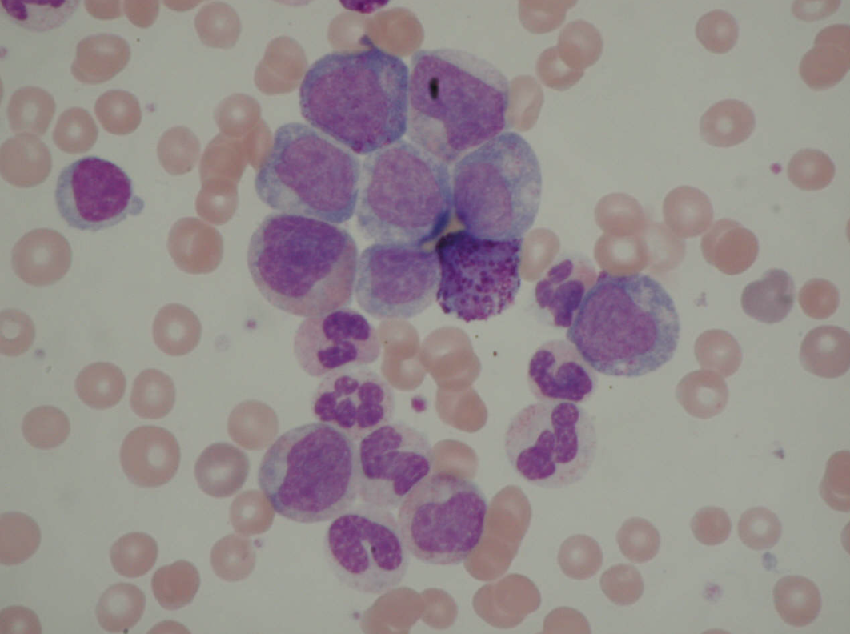
Chronic Myeloid Leukaemia
Investigation
  FBC (very high WCC) and blood film
  Bone marrow aspirate and trephine- hypercellular bone marrow
  Cytogenetics
Notes:
About 45% of patients have anaemia and 15-30% have thrombocytosis
Most commomly raised WCC is neutrophils and myelocytes
Blood film show all stages of white cell differentiation

Slide 37
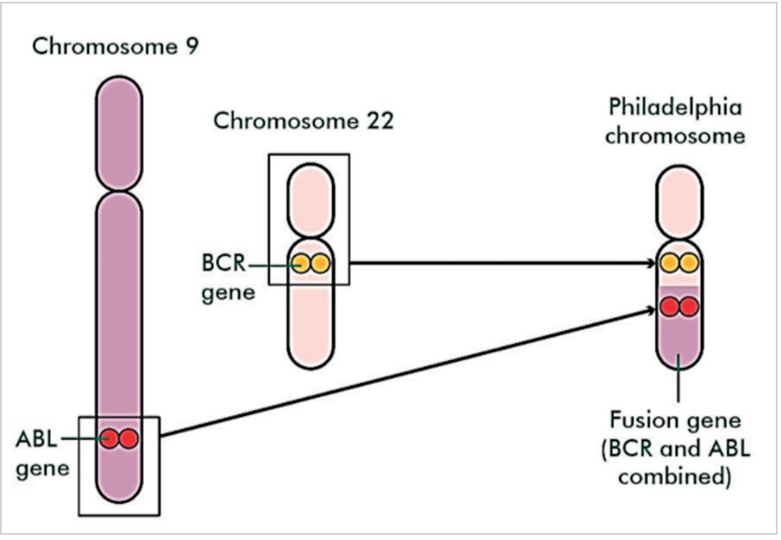
Philadelphia chromosome t(9;22)
Reciprocal translocation between chromosomes 9 and 22, t(9;22)(q34;q11)
Involves two genes that form a fusion gene- BCR-ABL
Produces an aberrant gene that is constitutively active and has greater tyrosine kinase activity than the normal ABL protein
Notes:
Present in more than 80% of patients
BCR-ABL is a constitutively active tyrosine kinase that phosphorylates and alters activity of downstream signal transduction proteins. This fusion protein transforms normal haematopoietic stem cells into malignant cells.

Slide 38
Chronic Myeloid Leukaemia
Treatment
  Tyrosine kinase inhibitor
  Allogenic stem cell transplant
Natural history
  Chronic phase
  Accelerated phase- blood counts and organomegaly increasingly refractory to treatment
  Blast crisis- resembles acute leukaemia
Notes:
Block ATP from binding to the BCR-ABL protein and therefore prevent phosphorylation and downstream signaling
TKI- imatinib
Imatinib is well tolerated and approximately 87% of patients achieve complete haematological response.
Allogeneic haematopoietic stem cell transplant (HSCT) plus high-dose induction chemotherapy is only
considered in patients who are fit enough for the procedure and who have failed TKI therapy.[15]

Slide 39
Case presentation 3
84 year old lady referred to CAU with ‘symptomatic anaemia’
What symptoms is this lady likely to be experiencing?
What further questions would you like to ask?
Notes:
SOB, dizziness, fatigue
Questions such as:
Blood loss, diet, FH, DH, duration

Slide 40
Case presentation 3
84 year old lady referred to CAU with ‘symptomatic anaemia’
What symptoms is this lady likely to be experiencing?
  SOB
  Fatigue
  Dizziness
What further questions would you like to ask?
Notes:
SOB, dizziness, fatigue
Questions such as:
Blood loss, diet, FH, DH, duration

Slide 41
Case presentation 3 cont…
Examination unremarkable
Blood results
  Hb 87
  MCV 112
  WCC 6.7
  Platelet count 120
What would be your next investigation?

Slide 42
Macrocytic anaemia
B12/folate assay
Bone marrow
Dyserythropoeisis
Megaloblastic
B12 deficiency
Folate deficiency
Non-megaloblastic

Slide 43
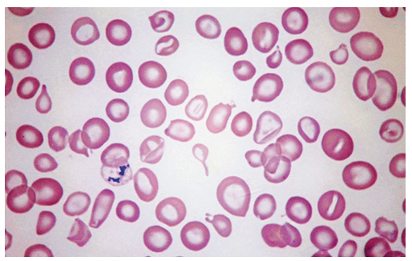
Case presentation 3 cont…
B12 and folate return normal
Notes:
Macrocytosis, dimorphic red cells, hypogranular neutrophils, dysmorphic monocytes/blasts
Abnormal shape and size of RBC including tear drop cells

Slide 44
Myeloid malignancies
Acute myeloid leukaemia
Chronic myeloid leukaemia
Myelodysplastic syndromes
Myeloproliferative neoplasms

Slide 45
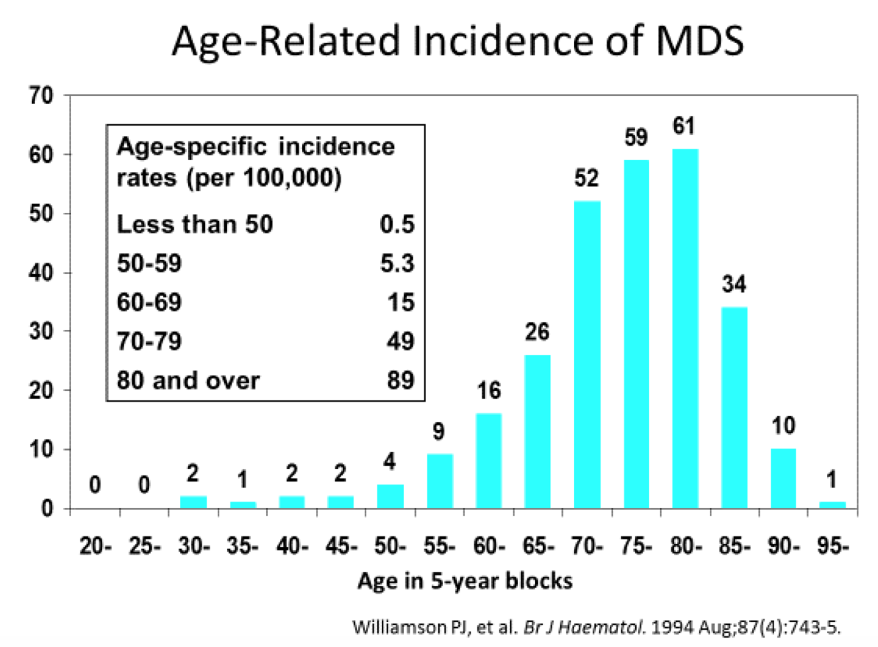
Myelodysplastic syndromes
Acquired clonal disorder
Characterised by ineffective haemopoeisis and peripheral cytopenias
Epidemiology
  Usually seen in older adults
  Median age 69
Notes:
Group of biologically and clinically heterogeneous clonal disorders characterized by ineffective haematopoeisis and subsequent peripheral cytopenia. Variable tendency to evolve to bone marrow failure or acute myeloblastic leukemia depending on subtype.
A heterogeneous group of clonal stem cell disorders. Uncontrolled proliferation and clonal expansion of neoplastic multipotential haematopoietic stem cells compromise the production of normal cells, producing a range of cytopenias

Slide 46
Myelodysplastic syndromes
Risk factors
  Age
  Prior cancer therapy
  Prior autologous stem cell transplant
  Environmental toxins e.g. benzene and other organic solvents
  Rarely familial syndromes
Notes:
Usually develops as a result of acquired chromosomal abnormalities
Cancer therapy- radiotherapy, alkylating agents (cyclophosphamide, melphalan, chlorambucil)
Syndromes include Fanconi anaemia, NF type 1

Slide 47
Myelodysplastic syndromes
Presentation
  Symptoms of underlying cytopenias
  Macrocytic or normocytic anaemia (60-80%)
  Neutropenia (50-60%)
  Thrombocytopenia (40-60%)
Investigation
  FBC and blood film
  Ferritin, B12 and folate
  BM aspirate and trephine
Notes:
No splenomegaly
Can also do immunohistochemistry and cytogenetic analysis
Pancytopenia with a macrocytic anaemia
Blood film appearance-

Slide 48
Myelodysplastic syndromes
Management
  Supportive
    Transfusion and consider iron overload
  Chemotherapy
    Can be low intensity eg hydroxycarbamide, cytarabine)
    Intensive chemotherapy in high risk younger patients
  Stem cell transplant (few patients eligible)
Prognosis
  Variable depending on subtype
  30% transform to acute leukaemia
Notes:
Pre-leukaemic
Fatal due to leukaemic progression or bone marrow failure

Slide 49
Myeloid malignancies
Acute myeloid leukaemia
Chronic myeloid leukaemia
Myelodysplastic syndromes
Myeloproliferative neoplasms

Slide 50
Questions ?
Email: s.drummond1@nhs.net

Slide 51
Thank you
Please fill out the feedback form for your certificate of learning

Slide 52
Get in touch!
Website
www.quackmeded.co.uk
Email
ggc.quackmeded@nhs.scot
Social Media
Twitter: @QUACK_ Med
Facebook: QUACK education

